Slide 1
Biological Adaptive Protection
Jeffrey A. Mahn
Nuclear Engineer (Retired)
Albuquerque, NM USA
jamahn47@gmail.com

Slide 2
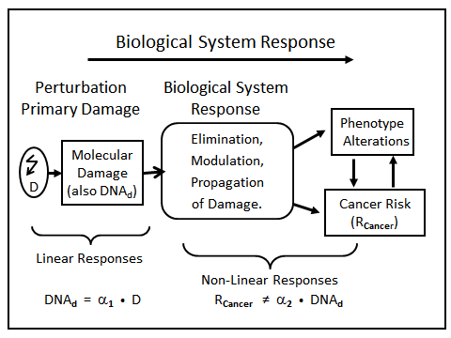
Adaptive Protection
Adaptive protection is physiological expression of cellular capabilities to maintain tissue structure integrity and function when exposed to low levels of potentially harmful agents
2
Notes:
Ref. L. E. Feinendegen personal communication and 2015 Health Physics Society Symposium, 13–14 July 2015, Health Risks From Low Doses and Low Dose-Rates of Ionizing Radiation
Adaptive protection measures are activated anytime the body is exposed to a biological stressor agent.
The flawed linear no-threshold (LNT) radiation dose-response model ignores the body’s highly effective adaptive protection mechanisms.

Slide 3
Adaptive Protection Responses
DNA damage prevention – stimulation of free radical detoxification system to neutralize free radicals and reactive oxygen species (ROS)
Appears to reach maximum about 4 hours after exposure to stressor
Active for hours to weeks depending on tissue/cell type
DNA damage repair – protection against chromosomal aberrations
Apoptosis removal – programmed cell death
Immune response stimulation

Slide 4
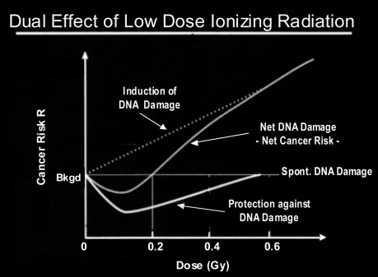
Ref. Evidence for Beneficial Low Level Radiation Effects and Radiation Hormesis, L.E. Feinendegen, MD, The British Journal of Radiology, 78 (2005), pp. 3–7
4
Notes:
This graphic shows that radiation-induced adaptive protection is stimulated by acute ionizing radiation doses up to 0.5 Gy.
0.1 Gray (10 rem) is the optimum dose for stimulating adaptive protection mechanisms.
0.2 Gray (20 rem) is effectively the threshold absorbed dose for observable radiation-induced adverse health effects.
From Feinendegen article:
Adaptive protection causes DNA damage prevention and repair and immune stimulation. It develops with a delay of hours, may last for days to months, decreases steadily at doses above about 100 mGy to 200 mGy and is not observed any more after acute exposures of more than about 500 mGy. Radiation-induced apoptosis and terminal cell differentiation also occur at higher doses and add to protection by reducing genomic instability and the number of mutated cells in tissues.

Slide 5
Adaptive Protection and Dose-Rate
Response level of adaptive protection depends on radiation dose-rate, rather than accumulated dose
Importance of dose-rate underscored by effectiveness of protracted radiotherapy treatment (i.e., fractionated doses)
Total radiation dose to cancerous tumor divided into
several smaller (fractionated) doses over period of several
days to allow body’s adaptive protection system time to
repair damage to surrounding normal cells between doses
Although high chronic dose-rate (likely >1 mGy/hr) of ionizing radiation can inhibit body’s adaptive protection system, low dose-rate natural background radiation (<0.0005 mGy/hr) does not
1 mGy/hr effectively high chronic dose-rate thresholdª
Notes:
Reference:
a. Is Chronic Radiation an Effective Prophylaxis Against Cancer?, Journal of
American Physicians and Surgeons 9, No. 1, Spring 2004, pp 6-10

Slide 6
Repair of DNA Damage
Organisms cannot survive without full-time, intensive activity of powerful adaptive protection systems to prevent, repair, and remove metabolism-induced DNA damage
Endogenous (i.e., spontaneous) rate of DNA damage from normal metabolism far exceeds rate of DNA damage caused by low-level ionizing radiation
Cells have very efficient repair mechanisms to fix broken DNA (e.g., DNA repair enzymes)
Damaged DNA migrates to special “repair centers” within cell, which put strands back together within hours

Slide 7
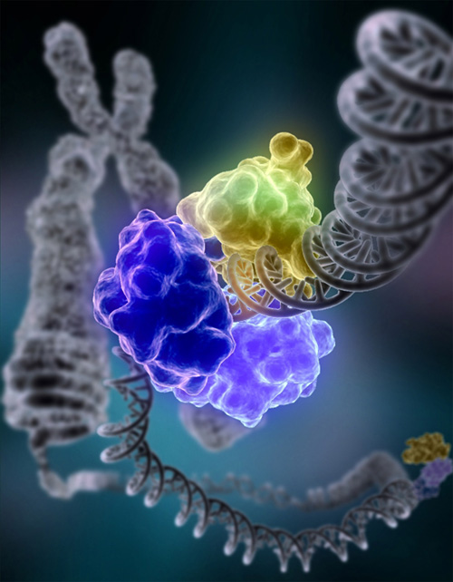
Repair of DNA Damage (cont.)
Special enzyme encircling double helix to repair broken strand of DNA
DNA repair begins in seconds to minutes after exposure
DNA repair times are ≈24 hours

Slide 8
Repair of DNA Damage (cont.)
Double-helical structure of DNA ideally suited for repair because it carries two separate copies of all genetic information—one in each of two strands
Each human cell contains multiple DNA repair systems, each with its own enzymes and preferences for type of damage recognized
Most systems use the undamaged strand of double helix as template to repair damaged strand

Slide 9
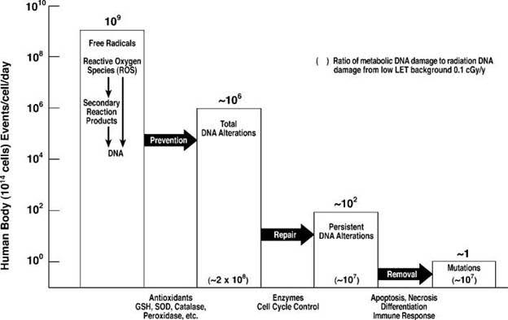
DNA Damage Reduction by Cellular Prevention, Repair, and Removal Mechanism
(Potential
Damage)
(Actual
Damage)
9
Notes:
This slide illustrates how adaptive protective systems work to repair DNA damage due to normal oxygen metabolism.
Adaptive protection sequentially reduces DNA damage from about one million DNA alterations/cell/day to about one “mutation”/cell/day.
GSH – Glutathione
SOD – Superoxide Dismutase
Graphic sources:
Pollycove, M., Radiobiological Basis of Low-Dose Irradiation in Prevention and Therapy of Cancer, Dose Response, 2007.
Pollycove M, Feinendegen LE. Radiation-induced versus endogenous DNA
damage: possible effect of inducible protective responses in mitigating endogenous damage. Human & Experimental Toxicology. 2003; 22:290-306
Evidence of Radiation Thresholds Between Beneficial and Detrimental Health Effects; Part B of Intervenor Report for CNSC Public Hearing by Dr. Jerry M. Cuttler, D.Sc., P.Eng., June 10, 2021

Slide 10
Radiation Effects in Perspective
DNA in human cells also damaged by normal biological functions (routine eating, breathing, stress of heat and exercise)
Gene mutations (unrepaired or mis-repaired DNA damage) from normal metabolism outnumber those caused by natural low-dose radiation by 7 orders of magnitude (10⁷)
Even high acute radiation doses add only few more gene mutations to millions occurring from normal metabolism
Ref. James Muckerheide, paper presented at the 8th International Conference on Nuclear
Engineering, held in Baltimore, April 2-6, 2000
Notes:
Low dose ionizing radiation is not a significant cause of biological harm in humans.

Slide 11
Adaptive Protection Summary
All organisms have powerful protection systems that react to stresses to heal injuries and destroy pathogens
All organisms adapt to changing environmental stresses via changing adaptive protection system activity levels
All organisms that breathe air (or consume oxygen for energy) suffer damage due to reactive oxygen species (ROS), and have protection systems that prevent damage, repair damage, and replace unrepaired cells/tissues
All humans incur cell damage from non-radiation-induced causes orders of magnitude higher than that from low-level natural background radiation
Notes:
If we didn’t have protective responses against the vast damage done by oxygen metabolism, we wouldn’t live past the embryonic stage, and our species would have long since become extinct, if it were ever able to have emerged in the first place.

Slide 12
Adaptive Protection Summary (cont.)
For all humans, low radiation doses stimulate activity of adaptive protection system
Low-dose radiation providing optimum adaptive protection benefit varies from individual to individual
Increases in low-dose exposure beyond that associated with optimum adaptive protection benefit reduce effectiveness of protection until NOAEL achieved
Exposures beyond NOAEL become increasingly harmful due to radiation-induced inhibition or damage to adaptive protection mechanisms
For all humans, radiation sensitivity affected by personal genetics, age, health, and other factors that cause optimum adaptive protection and NOAEL radiation doses to vary

Slide 13
Adaptive Protection In a Nutshell
No species that lacked the ability to repair damaged DNA could have emerged, much less reproduced, in a relatively high radioactive environment (compared to today) loaded with all sorts of other toxins as well.
13

