Slide 1
Effects of Ionizing
Radiation Exposure
Jeffrey A. Mahn
Nuclear Engineer (Retired)
Albuquerque, NM USA
jamahn47@gmail.com

Slide 2
Brief History of Ionizing Radiation

Slide 3
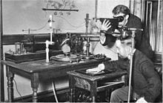
Historical Perspective of Radiation
1895 – first observance of
ionizing radiation
(x-rays) by Wilhelm
Roentgen
1896 – use of x-rays for
medical diagnostics
proposed by Roentgen
1898 – beneficial, or hormetic, effects of low doses of
x-rays observed
1902 – effectiveness of “radium rays” (gamma-rays) for
treating skin cancer recognized

Slide 4
Historical Perspective (cont.)
1904 – first death from excessive x-ray exposure recorded (about 100 deaths occurred from afflictions possibly related to ionizing radiation exposure by 1922)
1898 to 1970 – physicians used x-rays and radium to
heal wounds faster
stop infections (gas gangrene, boils, sinus, inner ear, whooping cough, pneumonia, etc.)
relieve arthritis and other inflammatory conditions
treat asthma, autoimmune diseases, type 1 diabetes
(No reported evidence of increased cancer in patients subjected to such radiation treatments^{a,b})
Notes:
Slide references:
Cuttler, J.M., Application of Low Doses of Ionizing Radiation in Medical Therapies, Dose-Response, Vol. 18(1), Jan.-Mar. 2020
Evidence of Radiation Thresholds Between Beneficial and Detrimental Health Effects; Part B of Intervenor Report for CNSC Public Hearing by Dr. Jerry M. Cuttler, D.Sc., P.Eng., June 10, 2021

Slide 5
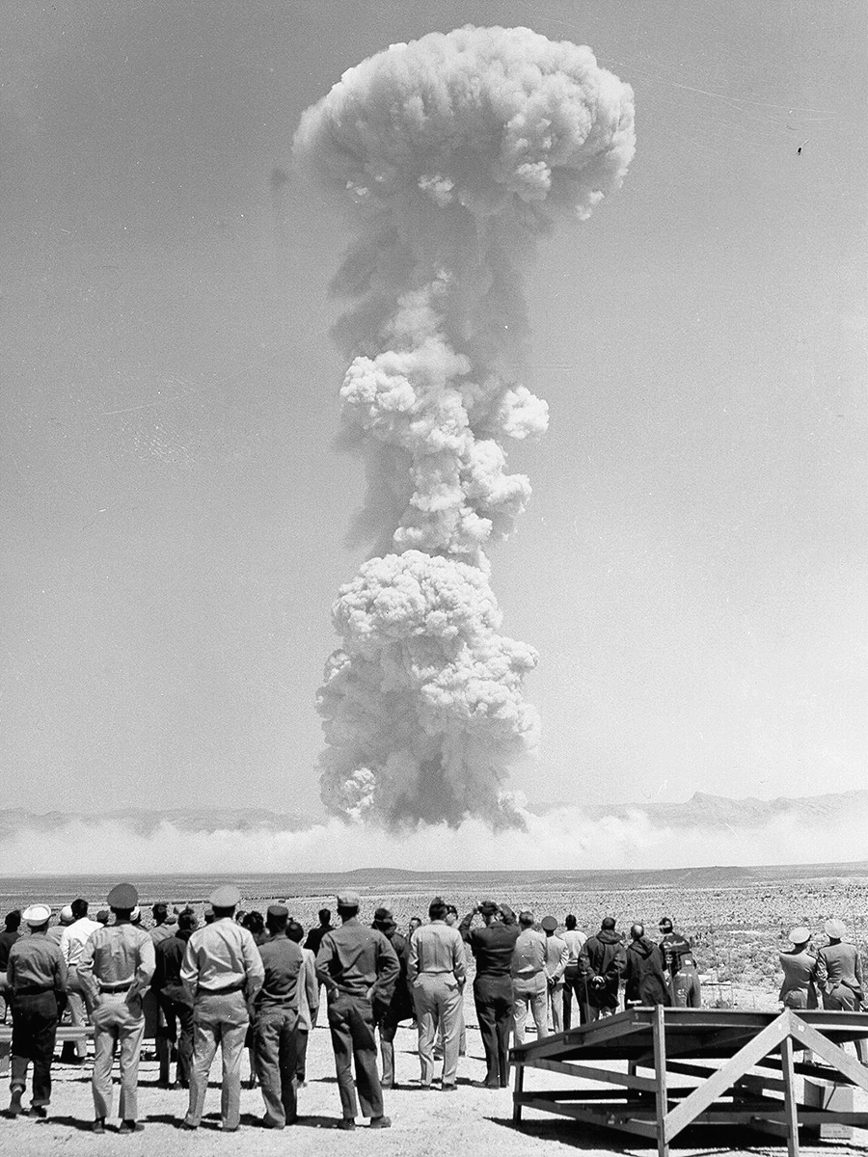
Historical Perspective (cont.)
Abrupt change in public mood regarding radiation after WW II due to political and social issues related to nuclear weapon testing
Claims of long-term adverse health
effects from low dose radioactive
fallout originally used in attempts to
halt nuclear weapon testing
Claims of adverse radiation-induced
health effects from fallout still being
alleged today despite termination of
above-ground testing by Limited Test
Ban Treaty of 1963 and no proven adverse health
effects

Slide 6
Living with Low-Dose
Ionizing Radiation

Slide 7
Important Note Regarding Chronic
Low-Dose Radiation Exposure
Chronic low-dose radiation exposure from natural background radiation generally expressed as annual dose
  Implies biological cell damage from chronic exposure to low-dose/dose-rate radiation is cumulative, ignoring body’s adaptive protection responses
  Such exposure more appropriately expressed as hourly or daily dose, since radiation-induced cell damage repaired in about 24 hours
  Chronic dose-rate from natural background radiation not high enough to result in adverse health effects
Notes:
There is a very important point to be made about chronic low-dose radiation exposures.
It should also be noted that the public’s exposure to chronic whole-body radiation is exclusively from natural background radiation, which results in no adverse health effects.

Slide 8
Natural Background Radiation
Natural background radiation sources shown below result in chronic exposures that vary around the world
External sources of high energy electromagnetic radiation include cosmic rays from beyond Earth and gamma-rays from radioactive decay of uranium and thorium in Earth’s crust
US Average -- 340 nSv/h
  Cosmic 34 nSv/h
    Terrestrial 34 nSv/h
    Internal (K-40) 45 nSv/h
    Inhaled (Radon) 227 nSv/h
8
Notes:
We are all exposed to low doses of ionizing radiation every day of our lives.
Note that this slide expresses natural background ionizing radiation exposures in absorbed dose per hour (nGy/h), rather than the more commonly found expression of equivalent dose per year (mrem/y). Absorbed dose per hour is a more appropriate unit for expressing chronic ionizing radiation exposure as explained previously. That is, since the body’s adaptive protection mechanisms repair radiation-induced cell damage in about 24 hours, chronic radiation exposure is not cumulative. In addition, absorbed dose is a measurable unit, whereas equivalent dose is not.

Slide 9
Internal Radionuclides
Potassium and carbon, essential elements that make up human body, contain radioactive K-40 and C-14 (both β emitters), respectively
Majority of internal radiation exposure from K-40
US Average -- 340 nSv/h
  Cosmic 34 nSv/h
    Terrestrial 34 nSv/h
    Internal (K-40) 45 nSv/h
    Inhaled (Radon) 227 nSv/h
9
Notes:
Not only are we constantly exposed to external low-doses of ionizing radiation, we are ourselves radioactive.
Potassium is ubiquitous in the world. It is in our cells as well as in most foods we eat. Anything containing potassium contains potassium-40, which has a 1.3-billion-year half-life.

Slide 10
Exposure from Inhaled Radon
Radon gas in air we breathe comes from radioactive decay of uranium and thorium in Earth’s crust (varies around the world)
Inhaled radon (α emitter) is largest contributor to natural background radiation exposure
US Average -- 340 nSv/h
  Cosmic 34 nSv/h
    Terrestrial 34 nSv/h
    Internal (K-40) 45 nSv/h
    Inhaled (Radon) 227 nSv/h
10
Notes:
Inhaled radon gas atoms decay within human lung tissue to deposit alpha particle energy as well as solid decay daughter radionuclides.
Some locations in the world exhibit much greater concentrations of radon gas than in the U.S. People in these locations are exposed to much higher radon radiation levels than Americans, with no observable adverse health effects.

Slide 11
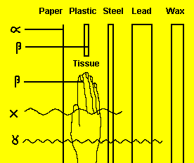
Penetrating Properties of Ionizing Radiation
Alpha and beta particles can’t penetrate dead layer of human skin; only health concern as internal source of radiation
Gamma-rays and x-rays penetrate human body; both external and internal radiation health concerns
11
Notes:
This graphic illustrates the relative penetrating power of alpha, beta, x-ray, and gamma-ray radiation.
Alpha particles have a range in air of only about 1.5 inches.

Slide 12
Types of Radiation Exposure
Acute Dose
  Dose delivered over short period of time (e.g., chest x-ray)
  Magnitude can be low or high, depending on dose-rate
  Not harmful at low dose-rate
Chronic Dose
  Dose delivered over extended period of time (e.g., natural background radiation)
  Low dose received at low dose-rate
  Not cumulative; doesn’t inhibit body’s adaptive protection mechanisms that repair radiation-induced cell damage
Dose Rate Effect
  High dose-rates may overwhelm biological adaptive protection mechanisms; low dose-rates do not
Notes:
Dose rate plays a significant role in causing biological damage.

Slide 13
External vs Internal Chronic Exposure
Chronic external exposure to natural background radiation not health hazard (chronic dose not cumulative)
Chronic internal exposures posing no health hazard
  natural radioisotope body burdens (e.g., carbon-14 and potassium-40)
  inhaled radon
  medical diagnostic radioisotopes with short half-lives (e.g., iodine-131)
Chronic internal exposures from unknowingly-ingested radioisotopes could be high enough to result in adverse health effects (e.g., radium dial painters)

Slide 14
Absorbed vs Equivalent Dose
For low LET* radiation (i.e., beta particles and gamma-rays) absorbed dose (mGy) and equivalent dose (mSv) are same
  Doses from low LET radiation applicable for both external and internal exposures
For high LET radiation (i.e., alpha particles) equivalent dose is about 20 times absorbed dose (i.e., does more biological harm for same absorbed dose than low LET radiation)
  Doses from high LET radiation applicable only for internal exposures as alpha particles have very limited range in air and cannot penetrate dead layer of human skin
* LET – linear energy transfer; expression of how quickly radiation energy
lost in radiation interactions

Slide 15
Internal Radionuclide Concerns

Slide 16
Ingestion of Radionuclides
Ingestion most important route for introduction of radionuclides into organisms, giving rise to internal exposures
Radioactive compounds generally considered insoluble if absorption through GI tract <5%
Soluble radioactive compounds show wide range of GI absorption percentages
Notes:
GI - gastrointestinal

Slide 17
GI Absorption of Radionuclides
Isotope | Radiation | Radiological Half-life | GI Absorption
Hydrogen-3 (Tritium) | β | 12 years | 100%
Strontium-89 | β | 51 days | 30%
Strontium-90/Yttrium-90 | β | 29 years | 30%
Zirconium-95/Niobium-95 | β,γ | 64 days | 0.01%
Ruthenium-103 | β,γ | 39 days | 0.03%
Ruthenium-106/Rhodium-106 | β,γ | 1 year | 0.03%
Iodine-131 | β,γ | 8 days | 100%
Cesium-137 | β,γ | 30 years | 100%
Barium-140/Lanthanum-140 | β,γ | 13 days | 5%
Cerium-141 | β,γ | 33 days | 0.01%
Cerium-144/Praseodymium-144 | β,γ | 285 days | 0.01%
Promethium-147 | β | 3 years | 0.01%
17
Notes:
This slide shows the solubility of some radionuclides in the GI tract.

Slide 18
Biological Excretion Pathways
Soluble
Insoluble
Stomach
Stomach
Small Intestine
30%
Blood
Small intestine
2%
28%
Large Intestine
Kidney
Large Intestine
100%
70%
Feces
Sweat +
Exhalation
Urine
Feces
18
Notes:
This slide shows the body’s normal pathways for removal of both soluble and insoluble radionuclides.

Slide 19
Radionuclide Effective Half-life
Radiological half-life – time it takes for one-half of radionuclide to decay to some other nuclide
Biological half-life - time it takes for body to excrete one-half of material absorbed, ingested or inhaled
Effective half-life – reduction of radioactive material in body by one-half through both radioactive decay and biological excretion
  Calculated as sum of inverse radiological and biological half-lives

Slide 20
Half-Lives of Common Radionuclides
in Human Body
Radiological Biological Effective
Half-Life Half-Life Half-Life
Radionuclides (Days) (Days) (Days)
Hydrogen-3 4.5x10³ 12 12
Carbon-14 2.1x10⁶ 40 40
Phosphorus-32 14.3 1155 14.1
Sulfur-35 87.1 90 44.3
Chromium-51 27.8 616 26.6
Manganese-54 300 25 23.1
Iron-59 45.1 600 41.9
Cobalt-58 72 9.5 8.4
Cobalt-60 1.9x10³ 9.5 9.5
Zinc-65 245 933 194
Rubidium-87 1.8x10¹³ 60 60
Strontium-90 1.0x10⁴ 1.8x10⁴ 6.4x10³
Technetium-99m 0.25 20 0.25
Iodine-131 8 138 7.6
Cesium-134 840 70 64.6
Cesium-137 1.1x10⁴ 70 70
Iridium-192 74.5 20 15.8
Gold-198 2.7 120 2.6
Mercury-203 45.8 14.5 11
Radon-222 3.83 None 3.83
Radium-226 5.9x10⁵ 1.64x10⁴ 1.6x10⁴
Uranium-235 2.6x10¹¹ 300 300
Plutonium-239 8.9x10⁶ 7.3x10⁴ 7.2x10⁴
1/t_{e} = 1/t_{r} + 1/t_{b}
20
Notes:
The combination of the radiological half-life and the biological half-life of a radioisotope results in an effective half-life.
The effective half-life is calculated as shown to the right of the table of half-lives.

Slide 21
Critical Organs for Selected Radionuclides
Radioisotope Critical Organ
Hydrogen-3 (Tritium) Whole Body
Phosphorous-32 Bone
Carbon-14 Fat
Sulfur-35 Testes, Whole body
Chromium-51 Lower Intestine
Cobalt-60 Lower Large Intestine
Zinc-65 Liver, Prostate
Rubidium-87 Pancreas
Strontium-89, 90 Bone
Yttrium-91 Bone
Technetium-99m Upper Large Intestine
Ruthenium-103, 106 Kidney
Iodine-125, 131 – 135 Thyroid
Tellurium-129m Kidney
Cesium-137 Whole body, Liver, Spleen
Cerium-144 Bone
Gold-198 Lower Large Intestine
Mercury-203 Kidney
Iridium-192 Lower Large Intestine
Radon-222 Lung
Radium-226 Bone
Uranium-235 Lower Large Intestine
Plutonium-239 Bone
Some body parts have affinity for certain soluble chemical elements
Sr-90, Ra-226, and Pu-239 are bone-seekers, resulting in long biological half-lives
Iodine isotopes accumulate in thyroid gland
Cs-137 tends to accumulate in liver and spleen

Slide 22
Biological Effects of
Ionizing Radiation

Slide 23
Ionizing Radiation/Cell Interactions
Discussions of adverse biological effects generally about exposures much greater than natural background radiation
Ionizing particles, gamma-rays, and x-rays collide with molecules in ≈1% of 100 trillion cells that make up average human
  Interactions generate clusters of free radicals known as reactive oxygen species (ROS) that produce random damage in cellular constituents, including DNA
  Some types of ionizing radiation more effective generating ROS in human cells than others (e.g., α-particles 20 times more damaging than γ-rays)

Slide 24
Possible Outcomes of
Radiation/Cell Interactions
Ionizing Radiation
Human Cells
Atoms in Cells Form Ions
No Change in Cell
Change in Cell
Cell Dies
Reproduces
Replaced
Malignant Growth
Benign Growth
Not Replaced
24
Notes:
This slide illustrates the primary health concern associated with ionizing radiation exposure --- the potential damage that can occur within human cells.
Potentially harmful changes may propagate when a damaged cell reproduces, or cells may die and not be replaced.

Slide 25
Biological Cell Susceptibility to Radiation
Different cells in body react differently to ionizing radiation exposure
Cells that undergo rapid division most susceptible to radiation effects
Hierarchy of cell susceptibility to radiation damage (highest to lowest)
  Lymph
  Blood
  Reproductive and Gastrointestinal
  Bone
  Nerve
  Brain
  Muscle
Notes:
Lymphatic system – part of the immune system that protects the body against infection and disease

Slide 26
Biological Effects Factors
Potential health effects of radiation exposure depend upon
  Dose (amount of energy deposited in body organs)
  Ability of radiation to harm human tissue (i.e., radiation type)
  Which organs are affected
Most important factor is dose - amount of energy
actually deposited
Equivalent dose (Sv) used to express biological effect accounting for these factors

Slide 27
Types of Biological Effects
Biological effects of radiation broken into two groups according to how responses (symptoms or effects) relate to dose (amount of radiation received)
  Stochastic (probabilistic) effects
  Deterministic (dose-dependent) effects
Notes:
Types of biological effects of ionizing radiation are characterized as either being probabilistic or dose dependent.

Slide 28

Stochastic Effects
Effects that have increased probability of occurrence with increasing dose; severity of effect not dose dependent
Example: skin cancer and
sunlight – probability of getting
skin cancer increases with
increasing exposure to sun
Effects generally delayed (latent)
  Cancer
  Genetic changes
Notes:
For probabilistic effects, the severity of the effect itself (e.g., cancer) is not dose dependent.
However, the probability of occurrence of the effect is dose dependent (i.e., the higher the dose, the higher the probability of cancer occurrence).

Slide 29

Deterministic Effects
Effects that increase in severity with increasing dose; caused by cell damage or cell death
Example: sunburn and sunlight –
severity of sunburn increases with
increasing exposure to sun
Deterministic effects have
threshold above which severity
increases with dose
  Radiation-induced skin burns
  Radiation sickness/acute radiation syndrome
  Cataracts
  Tumor necrosis (death)
Notes:
The severity of some biological effects is radiation dose dependent (e.g., radiation skin burns).

Slide 30
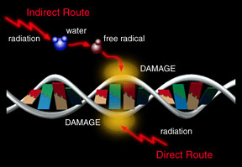
Biological Effects of Radiation
Biological cell/tissue damage dependent upon
  Dose and dose rate
  (acute or chronic)
  Direct effects - inter-
  actions with atoms of
  DNA and cellular
  components critical to
  survival of cell (often
  result of high LET
  radiation)
  Indirect effects - break less critical molecules into reactive parts (primary mechanism of low LET
  radiation)
Notes:
DNA – deoxyribonucleic acid

Slide 31
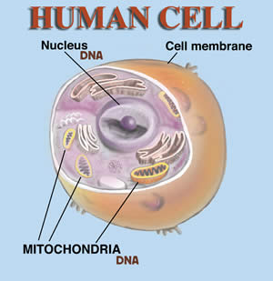
Biological Effects of Radiation (cont.)
Harmful effects caused by ionization (and excitation) in cells composing living tissue
Breaking of chromosomes
Swelling of cell and cell nucleus
Increase in cell fluid viscosity
Increase in cell membrane
permeability
Cell destruction
Ref. The Effects of Nuclear Weapons, US DoD and US DOE, Third Edition, 1977, p. 575

Slide 32
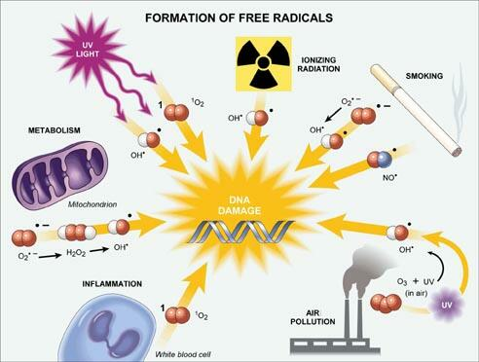
Biological Effects of Radiation (cont.)
  Harmful effects (cont.)
  Ionizing radiation one of
  various mechanisms that
  form free radicals and
  reactive oxygen species
  (ROS) in cell
  Free radicals may act as
  poisons
  ROS primary culprit in DNA radiation damage
  ROS production from normal metabolic processes dwarfs production from ionizing radiation
Notes:
As indicated in the figure, free radicals and ROS occur due to mechanisms other than ionizing radiation, including normal body metabolism.

Slide 33
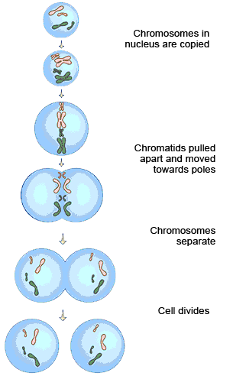
Biological Effects of Radiation (cont.)
Harmful effects (cont.)
  Process of cell division (mitosis)
  may be delayed by radiation
  exposure so normal cell
  replacement inhibited
Much cell damage of no long-
term consequence as most
molecules replaced regularly as
part of cell lifecycle
Ref. The Effects of Nuclear Weapons, US DoD and US DOE, Third Edition, 1977, p. 575
33
Notes:
Inhibited cell division may be another consequence of ionizing radiation exposure.
Biophysicist A.A. Kozlov presented a paper at the second International A.G. Gurwitsch Conference (organized by the International Institute of Biophysics) showing that background radiation is actually necessary for cell division, which means that inhibiting cell division requires radiation levels higher than natural background.

Slide 34
DNA Primary Focus of
Radiation-Induced Damage
Damage to DNA different than cell damage because it controls copying process
DNA is master record for cell, coordinates its function, and itself gets copied in cell lifecycle
Carries genetic instructions for development, functioning, growth and reproduction of all known organisms and many viruses
Only molecule in cell that occurs in only one copy (all other molecules occur in multiple copies so damage to one or more leaves many still functional copies)

Slide 35
DNA Primary Focus of
Radiation-Induced Damage (cont.)
High LET radiation (α particle) generally produces DNA damage through direct effects
Low LET radiation (β particle and gamma-ray) generally produces free radicals and reactive oxygen species (ROS)
Most DNA damage attributable to ionizing radiation occurs through production of ROS
Postulated that DNA damage propagated to subsequent cell copies and passed to subsequent generations, but insufficient evidence to support hypothesis
Notes:
LET – linear energy transfer

Slide 36
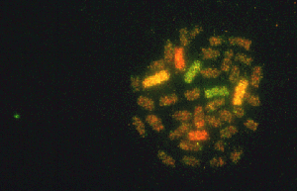
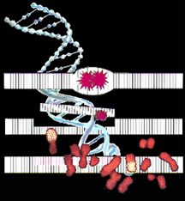

Effects of DNA Damage
Chromosome
Aberrations
Sometimes the damage affects the entire chromosome, causing it to break or recombine in an abnormal way. Sometimes parts of two different chromosomes may be combined.
Gene Mutation
Sometimes a specific gene is changed so that it is unable to make its corresponding protein properly.
Genomic Instability
Sometimes DNA damage produces later changes which may contribute to cancer.
Cell Destruction
Damaged DNA may trigger apoptosis, or programmed cell death. If only a few cells are affected, this prevents reproduction of damaged DNA and protects the tissue.
Gene Expression
A gene may respond to the radiation by changing its signal to produce protein. This may be protective or damaging.
36

Slide 37
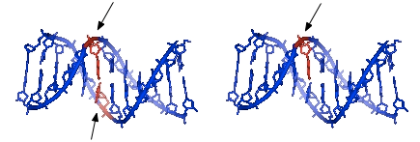
DNA Strand Breaks Occur Frequently
Double strand breaks (DSB) occur 10 times per day per cell.
0.27 mSv/d of radiation potentially adds 1 DSB per year.
Single strand breaks (SSB) occur 10,000 times per day per cell.
0.27 mSv/d of radiation potentially adds 12 SSBs per day.
Ionized oxygen molecules from metabolism principal cause of DNA breaks
Natural background radiation (U.S. average ≈0.008 mSv/d) not significant contributor to DNA strand breaks
37
Notes:
Refs.
http://en.wikipedia.org/wiki/DNA_repair
Feinendegen, Ludwig & Pollycove, Myron & Neumann, Ronald. (2012). Hormesis by Low Dose Radiation Effects: Low-Dose Cancer Risk Modeling Must Recognize Up-Regulation of Protection. Therapeutic Nuclear Medicine (pp.789-805)

Slide 38
High-Dose Radiation
Health Effects Studies

Slide 39
High-Dose Radiation
Health Effects Studies
High-dose exposures (>200 mGy) extremely uncommon
Evidence of harm from high radiation exposure almost entirely limited to
  Radium dial painters
  Atomic bomb survivors
  Chernobyl first responders
  People exposed in Goiania radiological accident
Provide evidence that doses <200 mGy do not increase cancer risk

Slide 40

Radium Dial Painters
Beginning about 1915, many women were employed in well-paying jobs to paint the hands and faces of clocks and watches with radium paint. At the time little was known about radiation or its effects.
40

Slide 41
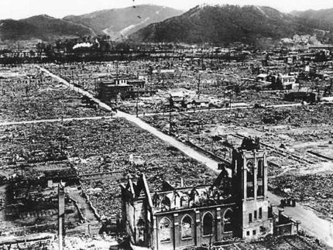
Atomic Bomb Survivors
Almost 200,000 Japanese were killed when the atom bombs were dropped on Hiroshima and Nagasaki in 1945, the vast majority killed by the thermal blast (fireball) and the subsequent pressure blast (shockwave) that destroyed buildings in which people were located. Survivors who were subjected to high, acute radiation doses have been extensively studied.
41

Slide 42
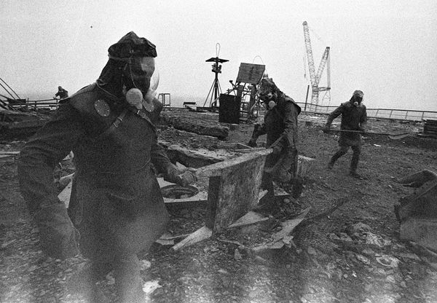
Chernobyl First Responders
Chernobyl first responders, tasked with smothering fire and radioactive debris following reactor disruption accident, received very high whole-body exposures from gamma-rays.
Notes:
Photo source: http://news.nationalgeographic.com/news/energy/2011/04/110426/chernobyl-25-years-liquidators-pictures/#/chernobyl-25th-anniversary-liquidators-firefighters-roof_35076_600x450.jpg

Slide 43
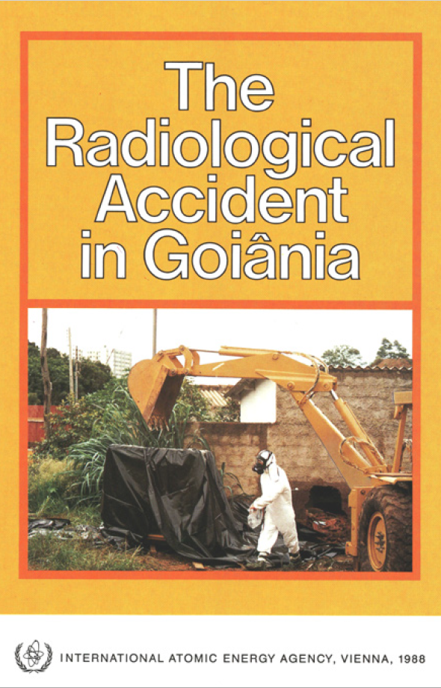
This radiological contamination accident occurred in Goiania, Brazil after an unsecured radiotherapy source was stolen from an abandoned hospital site and subsequently handled by many people.
It was a unique radiological incident in that casualties incurred initial acute whole-body external gamma-ray irradiation from Cs-137 followed by chronic whole-body internal exposures from ingested Cs-137.

Slide 44
Radiation Exposure Effects
In Three Graphics

Slide 45
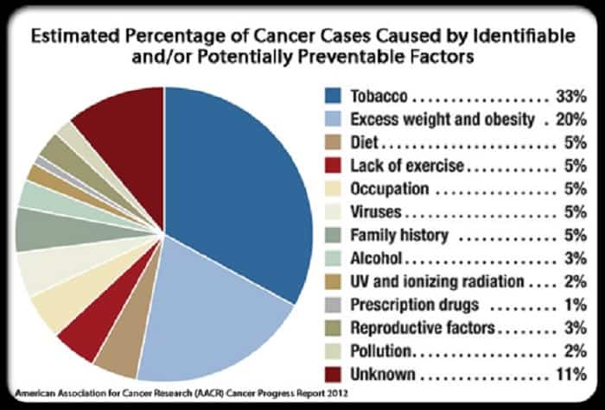
Cancer Cause Probabilities
Ionizing Radiation Not a Big Cause of Cancer
Notes:
This graphic from the American Association for Cancer Research (2012) illustrates the various causes of cancer.
Occupational carcinogens include asbestos, formaldehyde, silica, wood dust, and numerous organic and inorganic chemical compounds.

Slide 46
Visualizing Acute Radiation Dose Effects
Increased Cancer Risk
Observable Biological Harm
No adverse health effects
47
Notes:
This graphic provides another way to visualize the effects of different acute radiation doses.

Slide 47
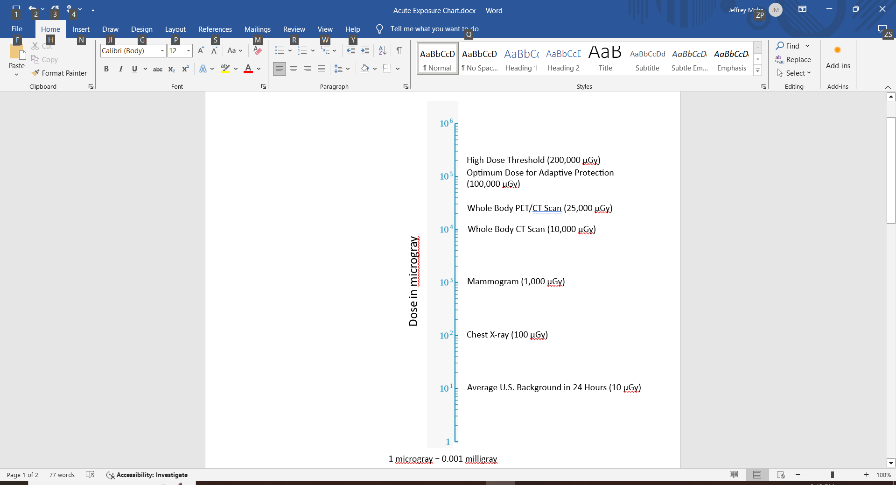
Acute Exposures in Perspective
Public acute exposures to low LET ionizing radiation orders of magnitude below threshold for biological harm
Low LET radiation contributes only about 4.5 μGy to natural background radiation exposure
48
Notes:
Note the logarithmic scale and doses in microgray so that order-of-magnitude differences between normal low-dose exposures and the high-dose threshold are obvious.

Slide 48
Radiation Exposure Takeaways
Radiation exposure does not create unique cancer risk situation; nor is such risk distinguishable from cancer risk due to other cancer-causing agents
Public health data do not absolutely establish occurrence of cancer following acute exposure to low-dose radiation (<200 mGy)
Studies of radiological technicians chronically exposed to low levels of radiation above normal background show no adverse biological effects
49
Notes:
An important item to note here is that although various types of cancer may be associated with specific causal agents (e.g., lung cancer and smoking), the cancer risk from exposure to ionizing radiation is no different than the cancer risk from exposure to other cancer-causing agents.

Slide 49
Radiation Exposure Effects Summary
Ingestion is most important route for
introduction of radionuclides into organisms
Certain body parts more specifically affected
by exposure to different types of radiation
sources
Potential health effects of radiation exposure
depend upon radiation type, dose, and
affected organ(s)

Slide 50
Radiation Exposure Effects Summary (cont.)
Effects depend upon how biological responses
relate to dose
  Stochastic effects – increasing probability of
  occurrence with increasing dose
  Deterministic effects – increasing severity of
  response with increasing dose
Harmful effects caused by ionization (and
excitation) in cells composing living tissue

Slide 51
Radiation Exposure Effects Summary (cont.)
Possible consequences of chronic exposure at
rates several hundred times natural
background:
  Leukopenia (low white blood cell count)
  Anemia (low red blood cell count)
  Detrimental changes in tissue structure
  Leukemia
  Malignant tumors
  Cataracts
  Increased rate of genetic mutation

Slide 52
Radiation Exposure Effects Summary (cont.)
DNA is most important molecule that can be
changed by radiation
Studies have shown most radiation-induced
DNA damage normally repaired by the body
Gene mutations (unrepaired or mis-repaired
DNA damage) from normal metabolism
outnumber those caused by natural radiation
by 10⁷

Slide 53
Radiation Exposure Effects Summary (cont.)
High radiation doses are real and serious
danger
Radiation is very good cell killer, but poor
cancer producing agent
Scientific advances say low doses of
radiation produce very different biological
responses than high doses
Medical uses of radiation beneficial
Environmental radiation levels not major
cause of cancer

Slide 54
Additional References
M. Bishop, 1989. “Cancer,” in Molecular Biology of the Cell,
eds. Bruce Alberts, et al., Chap. 21, pp. 1187-1218
D. Billen, 1990. “Spontaneous DNA Damage and Its Significance
for the ‘Negligible Dose’ Controversy in Radiation Protection,”
Radiation Research, Vol. 124, pp. 242-245
H. Varmus, and R.A. Weinberg, 1993. “Genes and the Biology of
Cancer,” Scientific American Library, Vol. 153
Dose-Response information – Health Physics Society
Miller, D.W., Jr., MD, Afraid of Radiation? Low Doses are Good for You, April 2, 2004

