Slide 1
Ionizing Radiation Risk
Jeffrey A. Mahn
Nuclear Engineer (Retired)
Albuquerque, NM USA
jamahn47@gmail.com

Slide 2
Terminology
Latent cancer – a cancer condition that is present but not active or causing symptoms
LNT – Linear No-threshold (radiation dose-response model)
BEIR V – Biological Effects of Ionizing Radiation Committee V
ICRP – International Commission on Radiological Protection
UNSCEAR – United Nations Scientific Committee on the Effects of Atomic Radiation

Slide 3
Risk Issues are Emotional
Solutions are Technical
Decisions are Political
4
Notes:
Here are some truisms that generally apply to matters of risk.
Risk issues are emotional because more often than not risks (or hazards) have more to do with perception than reality; and undeniably, human behavior is primarily driven by emotion and not by facts.
Where hazards are not avoidable, risk mitigation measures are generally technical in nature.
Risk solutions are rarely without opposition, which means alternative solutions must often be negotiated before a final decision can be rendered.

Slide 4
Risk Definition
_{Risk =} No. of injuries or deaths
No. of people exposed to hazard
Theoretical risk calculation based on
inference, extrapolation from clinical
studies, or epidemiology studies
Real measured risk based on observation
5
Notes:
So, just what is risk?
Generally no distinction is made between theoretical risk (e.g., radiation escaping from a used nuclear fuel storage facility) and real risk (e.g., driving a motor vehicle) when communicating risk matters to the general public.
The potential consequences of theoretical risks are generally modeled and are heavily dependent on assumptions underlying the risk model.
The actual consequences of real risks can be measured.

Slide 5
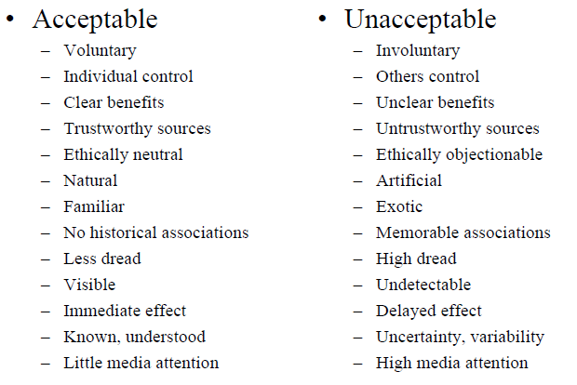
Emotional Aspects of Risk Perception
6
Notes:
One of the major obstacles to effective risk communication is risk perception – the notion that some risks are “acceptable” and others not.
The acceptability or unacceptability of risks is more often than not driven by emotions.
This slide lists some of the factors that determine the emotion-based acceptability or unacceptability of risks.

Slide 6
Comparing Risks
7

Slide 7
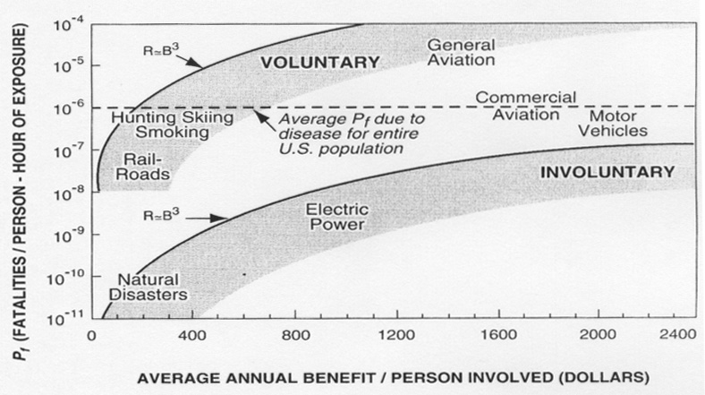
Representative Acceptance Domains for Voluntary and Involuntary Risks
8
Notes:
This slide is a pictorial of commonly accepted voluntary and involuntary risk domains, from Starr, C. (1969), “Social Benefit Versus Technological Risk.” Science, Vol. 165, September, 1969: pp. 1232-1238.
The risks were measured by computing the fatalities per person per hour of exposure and the average annual benefit per person involved.
As indicated in the figure,
Both voluntary and involuntary risk acceptance is roughly proportional to the 3rd power of associated benefit.
The “acceptable” probability of occurrence for voluntary risks is approximately 1000 times higher than the “acceptable” probability of occurrence for involuntary risks presenting the same benefit.
This graphic illustrates the significant influence that the voluntary/involuntary nature of risks has on risk acceptability.

Slide 8
Risk of 1 in a Million Chance of Dying
Smoking 1.4 cigarettes (lung cancer)
Eating 40 tablespoons of peanut butter (aflatoxin)
Spending 2 days in New York City (air pollution)
Driving 40 miles in a car (accident)
Flying 2,500 miles in a jet (accident)
Canoeing for 6 minutes (drowning)
Receiving 10 mrem (0.1 mSv) of radiation (cancer)
Adapted from DOE Radiation Worker Training, based on work by B.L Cohen, Sc.D.
9
Notes:
This slide compares different risks by showing a statistic associated with each risk that would result in 1 in a million chance of dying.
Note that a dose of 10 millirem is what the average American receives in about two weeks from natural background radiation.
Aside: Talking about statistical deaths can be quite misleading. Actual deaths of real people are fatalities that are clearly attributable to the cause in question and tend to be immediate. Statistical deaths are fatalities that can only be seen in an increase in mortality rate for a population.
Saying that a certain health hazard kills some number of people a year, really means that exposure to the hazard shortens the lives of some number of people (reflected in an increase in the overall mortality rate for a population). This begs the question, by how much?

Slide 9
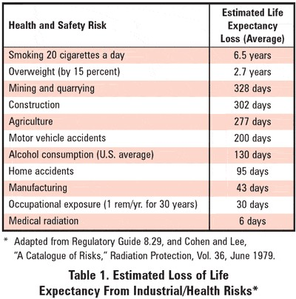
Estimated Loss of Life Expectancy from Industrial/Health Hazards*
10
Notes:
Estimated loss of life expectancy (LLE) is another way of comparing risks.
The issue here is, what amount of resources should be devoted to trying to further reduce a loss of life expectancy. Common sense says you don’t spend a lot of resources to reduce a LLE of a few weeks, much less 6 days. On the other hand, spending significant resources to reduce a LLE on the order of years may be prudent.
Medical radiation exposure in this table includes dental x-rays and nuclear medicine diagnostic procedures.
Ref. NRC Regulatory Guide 8.29, Instruction Concerning Risks from Occupational Radiation Exposure, July 1981

Slide 10
General Risk/Attitude Correlation for Involuntary Risk of Death*
Involuntary Risk (deaths per person per year) | General Attitude
10⁻² | Natural death reference
10⁻³ | Unacceptable; activities having this involuntary risk difficult to find
10⁻⁴ | Acceptable; effort and money spent to reduce risk to this level
10⁻⁵ | Only mild inconvenience acceptable to avoid this level of risk
10⁻⁶ | Considered an “act of God”
Starr, C., “Social Benefit vs. Technological Risk,” Science, Vol. 165, September 1969, pp. 1232-1238
Notes:
In 1977 the International Commission on Radiological Protection (ICRP) adopted a risk-based approach to setting radiation protection standards.
The ICRP decided that a valid method for judging the acceptability of the level of risk in radiation work is by comparing this risk with that for other occupations recognized as having high standards of safety, which are generally considered to be those in which the average annual mortality due to occupational hazards does not exceed 10⁻⁴.
This approach required that the average incremental risk of death from radiation exposure to workers in radiation industries be no larger than the average incremental risk of death from traumatic injuries to workers in industries having high standards of safety.
Ref. Recommendations of the International Commission on Radiological Protection, ICRP Publication 26, adopted January 17, 1977
Also, Inkret, W.C., Meinhold, C.B., and Taschner, J.C., A Brief History of Radiation Protection Standards, Los Alamos Science Number 23, 1995

Slide 11
Ionizing Radiation Hazard

Slide 12
Radiation Hazard
Radioactive material is potentially hazardous
Extent of hazard depends on
  Quantity (Ci, mCi, μCi, nCi or pCi)
  Type of radiation (alpha, beta, gamma, neutrons)
  Energy of radiation (MeV, KeV, eV)
  Form (sealed source, electroplated, unconfined)
  Phase (solid, liquid, particulate or gas)
  Shielding between receptor and source
  Distance to receptor from source
  Exposure time
  Type of exposure (external, inhaled, or ingested)
Dose a function of all of the above
Dose units: for gamma-rays and x-rays 1 Gy = 1 Sv = 100 Rem
13
Notes:
Risk controls for the ionizing radiation hazard must take into account the myriad of variables that influence radiation exposures as shown in this slide.
While the primary focus of risk controls is to minimize radiation exposures, those controls may take many forms.

Slide 13
Relative Radiation Hazards
The sun
  natural ionizing radiation hazard – doesn’t evoke great
  fear
  causes 1.3 million skin cancer cases in U.S. each year¹
  causes 7,800 melanoma deaths in U.S. each year¹
Nuclear radiation
  weaker carcinogen than most people think
  caused only about 500 cancer cases among 90,000
  survivors of atomic weapons in Hiroshima and
  Nagasaki¹
14
Notes:
This slide illustrates the difference in how “familiar” and “unfamiliar” risks are perceived.
Ionizing radiation from the sun is the same as “man-made” ionizing radiation even though they are generally viewed very differently.
Radiation from the sun (a “familiar” risk) kills many people each year, but is feared less than “man-made” radiation (an “unfamiliar” risk) having a very low mortality rate.

Slide 14
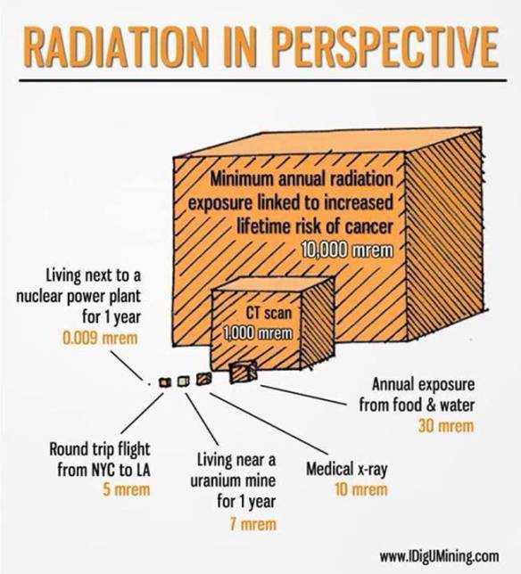
15
Notes:
This slide shows one way of visualizing relative differences in radiation exposure risks. However, it needs to be pointed out, once again, that acute and annual chronic exposures are incorrectly being compared (because the body’s adaptive protection mechanisms for chronic low-dose exposures are neglected).
Nevertheless, there is one fault in this pictorial that needs to be corrected – the 10,000 mrem “minimum annual radiation exposure linked to increased lifetime risk of cancer” is less than the 26,000 mrem annual exposure in Ramsar, Iran, where there has been no observed increased lifetime risk of cancer.
The 10,000 mrem annual dose actually corresponds (roughly) to the optimum annual dose of the idealized dose-response curve introduced in the radiation hormesis presentation.
The threshold for increased lifetime risk of cancer in this pictorial should be around 900,000 mrem per year, which would be represented by a very much bigger cube.
It should also be pointed out that the (cumulative) chronic radiation dose from living next to a nuclear power plant for one year (represented by the dot in the figure) is equivalent to the radiation dose one would receive from eating 10 bananas or 2 Brazil nuts --- undoubtedly, a much clearer visualization of the risk posed by nuclear power plant radiation emissions.

Slide 15
Radiophobia and the Linear No-Threshold Radiation Dose Response Model

Slide 16
Radiophobia Historical Background
1950
  Albert Einstein estimated that ‘radioactive poisoning of the
  atmosphere (by H-bombs) and hence annihilation of any
  life on earth, has been brought within the range of
  technical possibilities’
  Hans Bethe warned on television that H-bomb clouds ‘could
  annihilate life on earth’
Similar statements repeated in publications, books, and movies of 1950s (On the Beach, Failsafe, Dr. Strangelove)
17
Notes:
In the 1950s some well known scientists speculated about the consequences that would come from a conflict involving nuclear weapons.
This speculation inspired further speculation, as well as outright science fiction, in both printed media and movies.

Slide 17
Radiophobia Historical Background (cont.)
1958
  Linus Pauling estimated genetic effects from atmospheric
  nuclear weapon testing: ‘I state that nuclear tests ....
  would seriously damage over 20 million unborn children,
  including those caused to have gross physical or mental
  defect, and also the still births and embryonic, neonatal
  and childhood death.’
Detrimental health effects associated with high-dose x-ray, gamma-ray, and beta-ray irradiations, were used to extrapolate to zero dose and became basis for assumption that radiation-induced cancer and mutation risk increases linearly with dose without any threshold
Notes:
Linus Pauling, among others, went so far as to make dire predictions about adverse genetic effects that would result from continued nuclear weapon testing.
Based on known effects from very high doses of ionizing radiation, it was assumed that there is some level of cancer risk associated with any radiation dose, no matter how small.

Slide 18
Radiophobia Historical Background (cont.)
When nuclear arms race between US and Russia began after WWII, well-meaning scientists created radiation scare to stop atomic bomb testing (radioactive fallout)
Linear no-threshold (LNT) dose response model created in 1956 to link low-dose ionizing radiation to risk of cancer death

Slide 19
Linear No-Threshold (LNT)
Dose-Response Model
Genetic Defect Risk
Cancer Risk
Radiation Exposure
Radiation Exposure
Extrapolation is from effects of very high (acute) doses received by atomic bomb survivors.
20
Notes:
The LNT dose-response model has been incorrectly applied for both cancer and genetic mutation risks.
The model was generated by extrapolating very high dose-response data from atomic bomb survivors to zero dose, absent any low dose data to support such an extrapolation.
As has been pointed out previously, high-dose radiation exposures can overwhelm the body’s adaptive protection systems, but low-dose exposures do not.
So, although a linear relationship may be observed between high-dose radiation exposures and cancer or genetic defect risk, such a relationship has not been observed for low-dose exposures.

Slide 20
LNT Cancer Risk Assumptions
Non-cancer specific
Non-organ dose specific
Exposure is cumulative exposure to whole body
Collective dose risk, ICRP 60 (1991)¹³
  0.0004 risk of fatal cancer per rem (0.04 per Sv) = 1 in 2,500 chance of fatal cancer per rem of exposure (1 in 25 per Sv) for occupational workers*
  0.0005 risk per rem (0.05 per Sv) = 1 in 2,000 chance of fatal cancer per rem of exposure (1 in 20 per Sv) for general population*
* These values take into account uncertainties in probability estimates of fatal cancer used in
radiation protection and assume several factors derived from scientific and epidemiological
studies for lifespan of the population, quality of the radiation, total body exposure, and
linear response at low doses.
21
Notes:
This slide shows the unrealistic basis for ICRP radiological protection regulations.
In particular,
risk is non-cancer specific means all cancer forms are assumed to have the same radiological risk,
risk is non-organ dose specific means all body organs are assumed to have the same dose susceptibility to damage,
radiation exposure (and therefore biological damage) is assumed to be cumulative means the body’s adaptive protection mechanisms are ignored, and
collective dose risk means spreading small doses among a large population increases the probability of a fatality.
An interesting observation regarding the ICRP collective dose risk shown In this slide (from ICRP 60, Table S-3): occupational workers, who would receive a higher “collective” dose than the general public, are assumed to have a lower fatal cancer risk than the general public (i.e., 1 in 2500 vs 1 in 2000 per rem). Despite using the LNT model for both demographics, the observed results of scientific and epidemiological lifespan studies would seem to indicate a beneficial effect associated with the higher dose demographic.

Slide 21
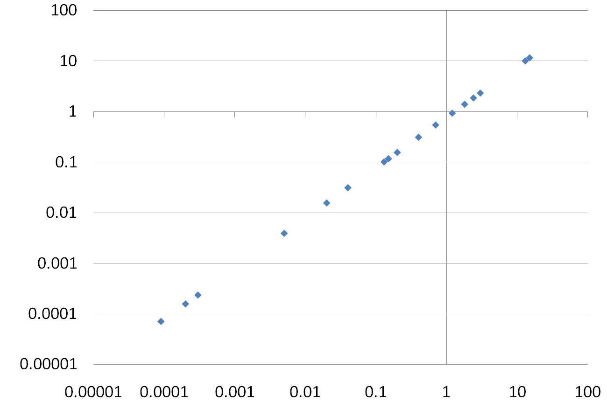
LNT Predicts Cancer Risk Based on
Cumulative Low-Dose Exposures
42% normal lifetime cancer risk
Smoking 1 ½ packs a day →
Lifetime cancer risk %
Coal mining →
← Grand Central worker
Annual mammogram →
← Human internal K-40, C-14
3.5 mSv/y
natural background
radiation
Atmospheric nuclear testing →
← Living near a coal power plant
← Nuclear fuel cycle
Radiation dose rate mSv/y
22
Notes:
Graphic source: http://home.comcast.net/~robert.hargraves/public_html/2.Fear.ppt
This figure shows LNT dose-response model lifetime cancer risk predictions for various low-dose-rate exposures.
The 42% normal lifetime cancer risk is from the American Cancer Society. All of the exposures shown in the figure, except for smoking, are below the average annual natural background radiation dose of 3.5 mSv per year for the American public.
LNT ignores the body’s adaptive protection mechanisms that neutralize radiation-induced damage for acute doses up to 0.2 Gy. For low LET radiation (where 1 mSv = 1 Gy), even the maximum chronic dose rate of 100 mSv per year in the figure (less than 0.3 mGy per day) is more than a factor of 600 less than the maximum acute dose for which adaptive protection is effective.
Note that 1) all exposures highlighted in the figure, except for the annual mammogram, are chronic exposures, and 2) except for smoking, all of the radiation exposures in the figure are from external sources of low LET radiation. Tobacco contains radioactive polonium-210, an alpha particle emitter, which results in internal exposure of the lungs to high LET radiation when tobacco smoke is inhaled.
Therefore, in reality there is no meaningful lifetime cancer risk associated with any of the non-smoking radiation exposures shown in the figure.

Slide 22
Low-level Radiation Effects
Invisible or Not There?
  Studies of populations chronically exposed to elevated natural background radiation (low-level radiation) show no consistent or conclusive evidence of associated increases in cancer risk²
  Atomic bomb survivors who received acute doses less than 0.5 Sv (50 rem) showed no statistically significant increase in genetically related diseases²

Slide 23
Fallacy of Cumulative
Dose Assumption
Rotating x-ray beam focused on cancer tissue delivers up to 80,000 mSv of radiation
To minimize small risk of causing cancer in nearby tissue, total radiation dose divided into fractions
Delivery of fractional doses over non-consecutive days gives healthy tissue time to recover between doses (adaptive protection)
If LNT were true, fractionated radiation therapy (3 million therapies per year) would not work

Slide 24
Collective Dose Concept
LNT dose-response model, accepted in 1959
by International Commission on Radiological Protection (ICRP) as philosophical basis for radiological protection, birthed concept of “collective dose”
  Collective dose – expression for aggregate radiation dose incurred by a population, deﬁned as product of number of individuals exposed to radiation source and average radiation dose

Slide 25
Illustration of Collective Dose Fallacy
Illustration: applying collective dose concept to non-radiation hazard
  Assume 100 mg of arsenic, taken all at once, is lethal dose for adults (actual lethal dose is 120-200 mg, and biological half-life is ≈4 days)
  Lethal dose then characterized as 100 person-mg (on average, adult human body contains about 3 mg, or 3,000 μg, of arsenic)
  Assume 1 μg given to each of 100,000 adults (population dose is then 100 person-mg)
  If lethal dose is 100 person-mg, can anyone die from single microgram dose of arsenic?
Notes:
Let’s look closer at the collective dose concept to see how absurd it is using a non-radiation hazard.
The biological half-life of approximately 4 days means that the human body excretes one-half of its accumulated arsenic every 4 days. This assures that ingested naturally-occurring low levels of arsenic in the human environment do not accumulate to become lethal.
Remember Paracelsus, who reminds us that it’s the dose that makes the poison.
We know this to be true because we consume arsenic in green leafy vegetables and we don’t even get sick, much less die from eating leafy vegetables. In fact, eating such food is necessary for good health.

Slide 26
Collective Dose Fallacy (cont.)
Illustration (cont.)
  LNT dose-response model asserts if probability of death is 100% for ingestion of 100,000 μg of arsenic, then probability of death is 90% for ingestion of 90,000 μg, 50% for 50,000 μg, and 0.001% for 1 μg
  Although risk is extremely small, LNT risk-based theory predicts that if 100,000 people each ingest 1 μg of arsenic, one will find a way to die (by adding 1 μg to the 3,000 μg already in his/her body)
27
Notes:
100,000 people x 1 μg x 0.00001 probability of death per μg = 1 death
As absurd as this seems, it must be noted that current government regulations imposed on naturally-occurring (but safe) low levels of arsenic in drinking water mandate unwarranted reductions based on the collective dose concept.
Paracelsus must be rolling over in his grave.

Slide 27
Collective Dose Fallacy (cont.)
Calculating radiation risk from home smoke detectors using collective dose and LNT model²
  Am-241 source results in average household personnel exposure of 0.008 mrem (8x10⁻⁵ mSv) per year from 59.5 keV gamma-ray accompanying alpha decay (Ref. U.S. Nuclear Regulatory Commission) Note that this is a chronic, not acute, dose.
  Assume 0.008 mrem annual exposure of 200 million people (80% of U.S. population)
  Collective dose concept asserts annual latent fatal cancer risk is 1,600 person-rem
Notes:
Now let’s look at the collective dose implications for a radiation hazard.
It is worth noting that radiation exposure does not create a unique cancer risk situation, nor is the risk directly measurable or distinguishable from the cancer risk caused by other sources (environmental, chemical, biological, etc.).
It is also worth noting that home smoke detectors are not a radiation hazard, as long as the americium-241 source is not ingested.

Slide 28
Collective Dose Fallacy (cont.)
Calculating radiation risk from home smoke detectors (cont.)
  Assume cancer mortality “risk factor” of 5 in 10,000 per rem³ (0.05% per rem is conservatively high for chronic exposure)
  Risk is additional 0.8 fatal cancers among exposed population of 200 million people
  No proof that average annual exposure of 0.008 mrem to an individual from home smoke detector produces any harmful effects (average annual dose to individuals in U.S. is 360 mrem from all sources), but also no way of proving it doesn’t if cumulative dose assumed to be valid
Notes:
Paracelsus would be dismayed.

Slide 29
Collective Dose Fallacy (cont.)
  Collective dose can achieve large mortality risk factor by multiplying small individual radiation doses by large numbers of potentially exposed individuals
  0.0005 risk per rem = 1 fatality per 2,000 person-rem as shown below
30
Notes:
This is the collective dose visual that makes one want to say, whaaaaaaaat?
According to the collective dose concept, each combination of dose and exposed population in the table have the same cancer fatality risk.
It must be pointed out here that although most nuclear medicine diagnostics are less than 1,000 mrem and patients don’t die from that acute dose, the collective dose concept forces us to accept that one patient out of every 2,000 will die from a dose of 1,000 mrem.
The reality is that the application of the collective dose concept leads to significant risk control implementation costs for no discernible (actual) risk reduction benefit.

Slide 30
Refutation of Collective
Dose Concept
In 2007 the ICRP modified its position on collective dose, stating that “collective effective dose is an instrument for optimization, for comparing radiological technologies and protection procedures. Collective effective dose is not intended as a tool for epidemiological studies, and it is inappropriate to use it in risk projections. Specifically, the computation of cancer deaths based on collective effective doses involving trivial exposures to large populations is not reasonable and should be avoided.”
Ref. ICRP Publication 103, Recommendations of the International Commission on Radiological Protection, 2007
31
Notes:
The key phrase in this modified position is “the computation of cancer risks based on collective effective doses …. should be avoided.”
The ICRP avoided directly stating that collective doses should not be used for predicting cancer risks.
Furthermore, ICRP Publication 103 includes the statement, “To avoid aggregation of low individual doses over extended time periods and wide geographical regions the range in effective dose and the time period should be limited and specified.”
This statement would appear to merely limit the magnitude of an exposed demographic and the duration of exposure time for application of the collective dose concept.
So, despite the 2007 wording modifications, collective dose continues to be used to predict the cancer risk of postulated accidental releases of ionizing radiation to an exposed population.

Slide 31
Refutation of Collective
Dose Concept (cont.)
  Position statement of Health Physics Society*
  A large dose to a small number of people is not equivalent to a small dose to many people, even if the collective doses are identical.
  For populations estimated to receive a lifetime dose less than 100 mSv [10 rem] above background, collective dose is highly speculative and an uncertain measure of risk and should not be used for estimating population health risks.
* Radiation Risk in Perspective, Position Statement of the Health Physics Society;
adopted January 1996, Revised July 2010
Notes:
The Health Physics Society has rejected the collective dose concept.

Slide 32
Refutation of Collective
Dose Concept (cont.)
We should change our approach to radiation exposure and eliminate the LNT and collective dose, which have perpetuated the use of a fraudulent indicator that bears no relation to the onset or likelihood of health effects or cancer.
A. David Rossin, past President of the American Nuclear Society
33
Notes:
A. David Rossin, a past President of the American Nuclear Society, has stated the obvious deception underlying the use of LNT and collective dose in support of radiation safety regulations.

Slide 33
LNT Model Perpetuates
Radiation Phobia
Despite failure of adverse health consequences to materialize from low dose radiation, linear no-threshold (LNT) risk model persists to this day, helping to perpetuate low-dose radiation phobia
Notes:
Cancer mortalities predicted by using the LNT dose-response model are just nameless and faceless statistics that never materialize.
That is, none of these predicted deaths have ever been verified to happen to real people.
LNT radiation-induced cancer mortality predictions have merely been a means to frighten people.

Slide 34
If LNT were correct, we would have been extinct a long time ago.
Chary Rangacharyulu
35
Notes:
Chary Rangacharyulu, a professor of Physics and Engineering Physics at the University of Saskatchewan in Canada, puts the LNT dose-response model in the proper perspective.

Slide 35
Deception of Linear No-Threshold Dose-Response Model
Notes:
Let’s consider the risks associated with some actual high radiation exposures.

Slide 36
The Deception of LNT
Calabrese, E.J., An abuse of risk assessment: how regulatory agencies improperly adopted LNT for
cancer risk assessment, Arch. Toxicol. DOI
10.1007/s00204-015-1454-4, 18 January 2015
Calabrese, E.J., Cancer risk assessment foundation unraveling: New historical evidence reveals that the
US National Academy of Sciences (US NAS),
Biological Effects of Atomic Radiation (BEAR)
Committee Genetics Panel falsified the research
record to promote acceptance of the LNT, Arch.
Toxicol. DOI 10.1007/s00204-015-1455-3, 20 January
2015
37
Notes:
Here are two of numerous articles that have been published about the LNT deception.
Edward Calabrese is an American toxicologist and professor in the Department of Environmental Health Sciences at the University of Massachusetts Amherst. He is also the Editor-in-Chief of the scientific journal Dose-Response.

Slide 37
The Deception of LNT (cont.)
Precautionary Principle* most often used as basis for why LNT dose-response model should remain standard for radiation risk assessment
* Precautionary Principle – the introduction of any product
or process whose ultimate effects are uncertain or
disputed should be resisted
38
Notes:
Unable to produce evidence that low dose/dose-rate ionizing radiation is detrimental to human health and unwilling to recognize the validity of data showing a beneficial health effect, LNT supporters invoke the precautionary principle as the “conservative” approach to minimizing radiation risk.
Use of the LNT model is conservative only under the assumption that the biological effects of low dose radiation exposure are always detrimental.

Slide 38
LNT Deception Consequences
Many complex nuclear energy facility regulations to prevent very unlikely events that could release small amounts of radioactive material have hugely increased costs of facility construction and operation
The As Low As Reasonably Achievable (ALARA) protocol also unnecessarily increased operating costs of nuclear energy facilities
39
Notes:
It was radiation phobia and the LNT hypothesis that birthed the ALARA protocol, which was eventually adopted as the gold standard of nuclear safety.

Slide 39
ALARA Consequences
Potential low-dose therapies for inflammatory diseases (e.g., pneumonia), autoimmune, neurodegenerative, and other diseases shunned by some in medical industry
  Option of convenient, affordable low-dose radiation treatments not always available to patients
Reluctance of some doctors to use nuclear medicine diagnostic imaging procedures

Slide 40
ALARA Consequences (cont.)
Potential for inadequate diagnostic images necessitating multiple diagnostic procedures
Large expenditures of money to reduce already low radiation exposures with no discernable health benefit
Public remains fearful of harmless radiation exposures

Slide 41
Unwarranted Expenditures
Due to LNT Deception
Annual public radiation doses from abandoned U.S. uranium mill tailings sites (UMTRA* Project) assessed using collective dose concept
Number of cancer deaths at each site over next 100 years predicted from LNT model using collective dose assessment data
Overall cost-effectiveness $1.1 million per (predicted) cancer death averted
Many site cleanup costs both unwarranted and excessive
* Uranium Mill Tailings Remedial Action

Slide 42
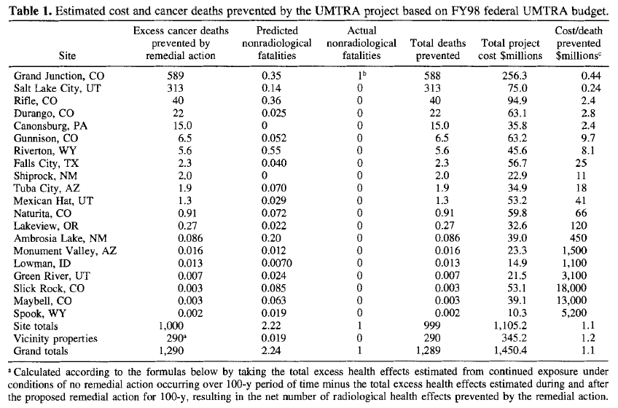
43
Notes:
The last column in this slide shows the cost per death prevented in millions of dollars for each of the UMTRA Project sites.
It’s noteworthy that the value of a statistical life (VSL) in Western countries typically ranges from $1 million to $10 million.
At 12 of the 20 UMTRA Project sites the cost per death prevented was more than $10 million, and for six of the sites the cost per death prevented was more than a billion dollars.

Slide 43
Lack of Low-Dose Radiation
Evidence to Support LNT
“No reproducible evidence exists of harmful effects from increases in background radiation three to ten times the usual levels. There is no increase in leukemia or other cancers among American participants in nuclear testing, no increase in leukemia or thyroid cancer among medical patients receiving Iodine-131 for diagnosis or treatment of hyperthyroidism, and no increase in lung cancer among non-smokers exposed to increased radon in the home.”
Rosalyn Yalow, “Concerns with Low Level Ionizing Radiation,” Mayo Clinic Proceedings, 69: 436-440
44
Notes:
Rosalyn Yalow was an American medical physicist and a co-winner of the 1977 Nobel Prize in Physiology or Medicine for development of the radioimmunoassay technique, a radioisotope tracing technique that allows the measurement of tiny quantities of various biological substances in human blood as well as a multitude of other aqueous fluids.

Slide 44
Radiation Phobia
LNT model, collective dose concept, and ALARA protocol continue to perpetuate low-dose radiation phobia
Reason that low-dose ionizing radiation studies cannot be [absolutely] conclusive is that risk, if any exists at low radiation levels, too small to be seen in presence of other risks of life*
* Report NT-14-3, Occupational Radiation Exposure from Naval Reactors’
Department of Energy Facilities, May 2014

Slide 45
A Realistic Radiation
Dose-Response Model

Slide 46
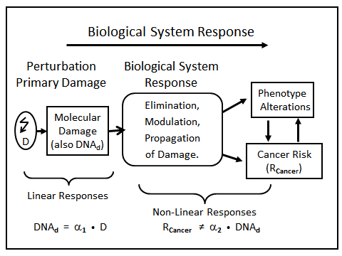
47
Notes:
While DNA damage is a linear function of radiation dose rate, DNA repair is a highly nonlinear process.
At relatively low radiation dose rates adaptive protection mechanisms are stimulated and the cell “repair centers” can correctly repair DNA breaks.
When the repair process begins to be challenged at relatively high radiation dose rates, the error rate of the repair process goes up.
Hence, the overall dose-response behavior is not a linear function of dose for low dose exposures.
When the body’s adaptive protection mechanisms are overwhelmed by a very high acute dose of radiation, then the dose-response behavior is a linear function of dose.
Ref. L. E. Feinendegen personal communication and 2015 Health Physics Society Symposium, 13–14 July 2015, Health Risks From Low Doses and Low Dose-Rates of Ionizing Radiation

Slide 47
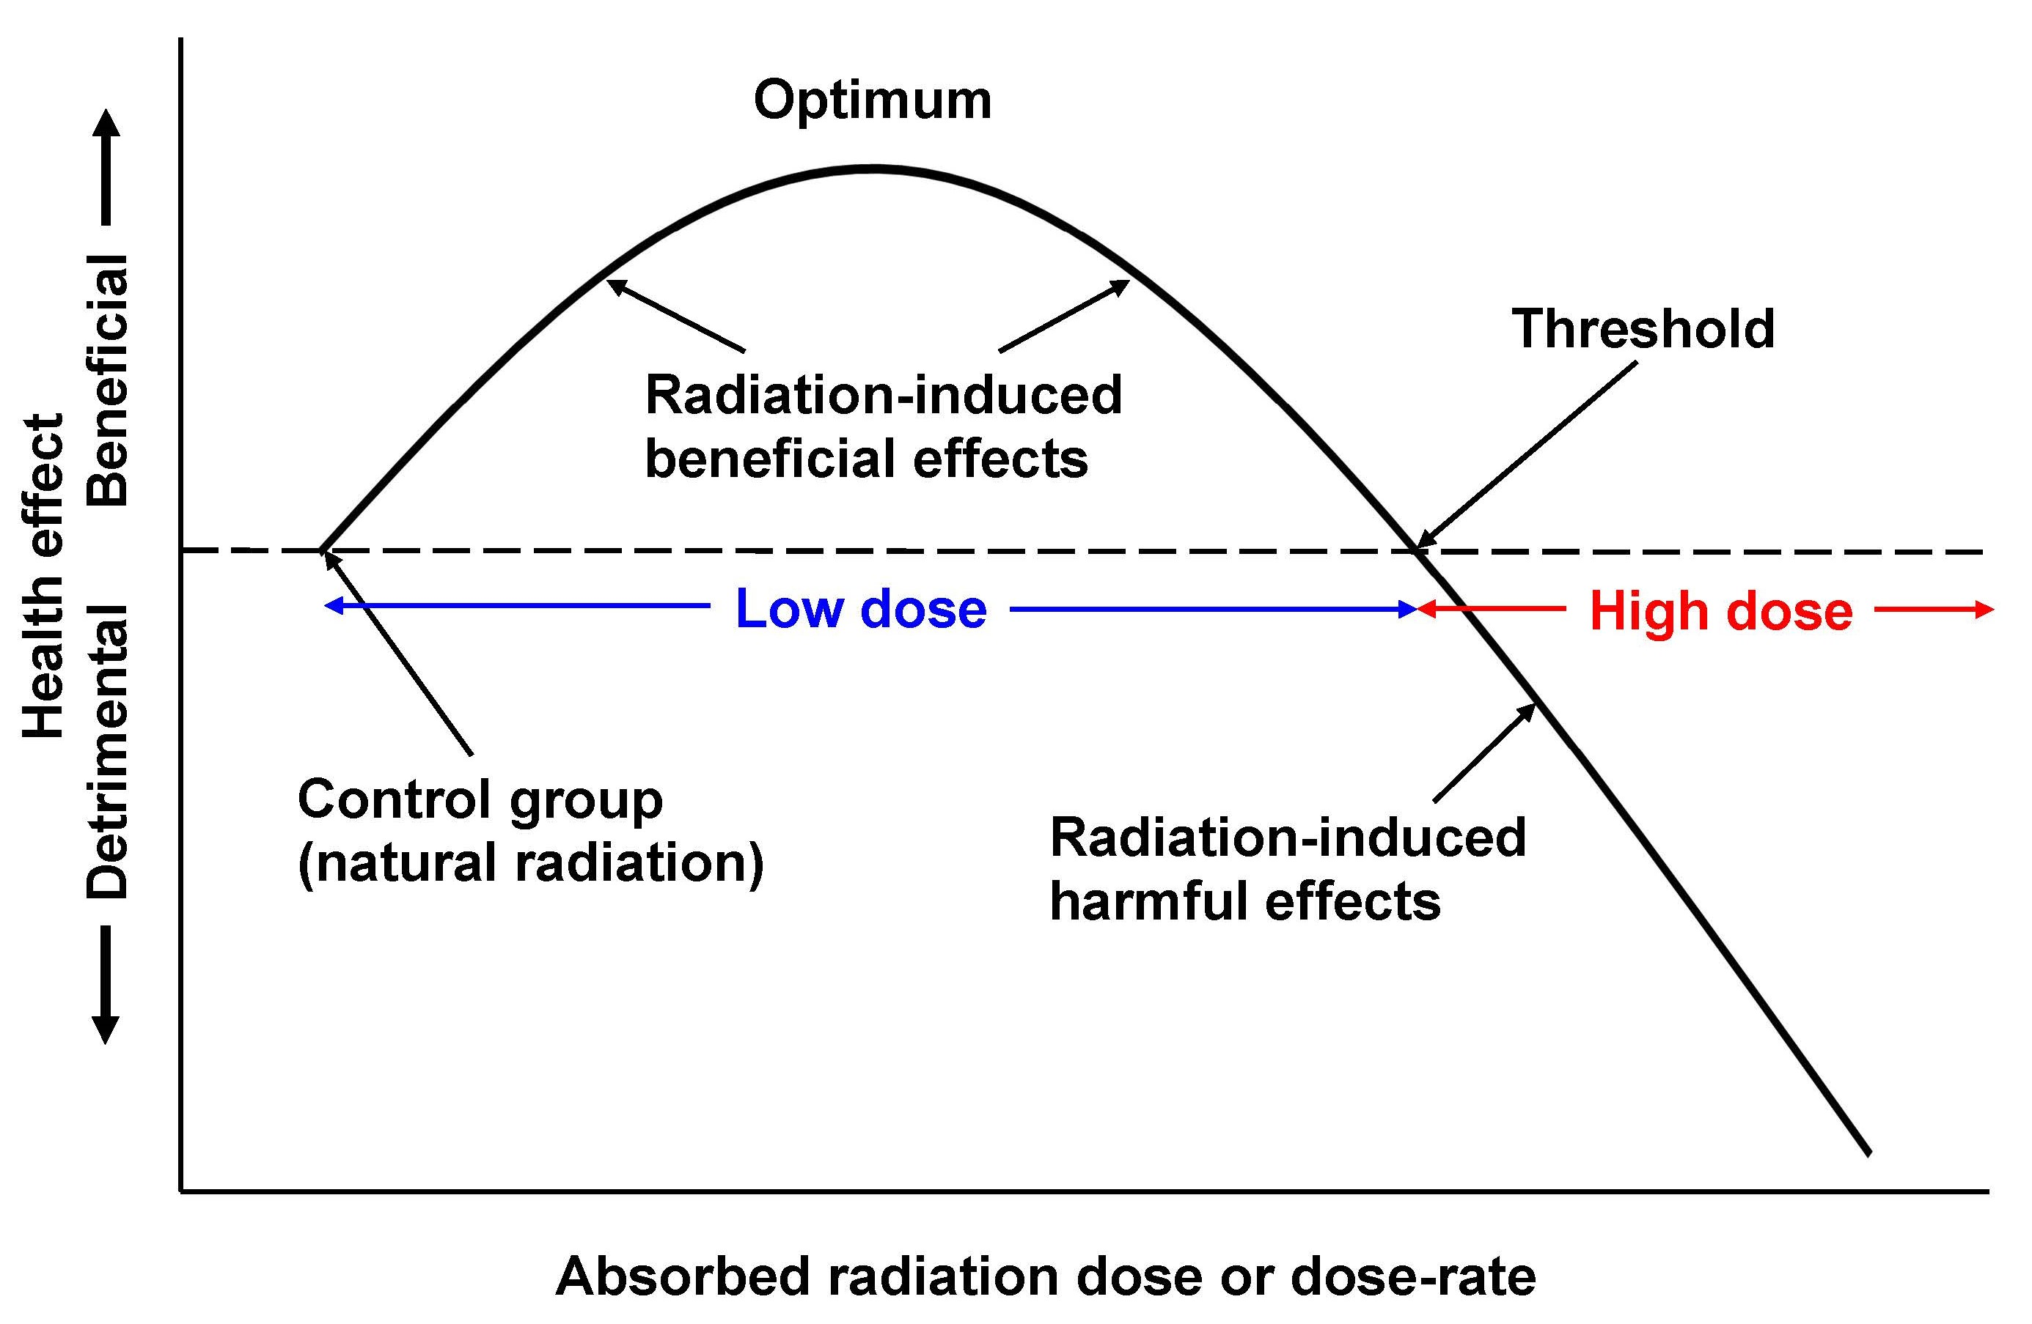
A Realistic Dose-Response Model
48
Notes:
This dose-response curve was presented in the radiation hormesis presentation.
It accurately reflects the non-linearity of the biological response to low level radiation-induced cell damage that must be accounted for in any model used to regulate radiation risk.
Unfortunately, government regulatory agencies continue to use the flawed LNT model to regulate radiation exposures.

Slide 48
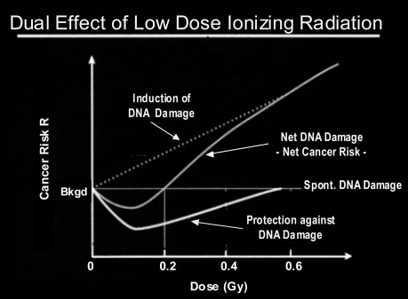
Ref. Evidence for Beneficial Low Level Radiation Effects and Radiation Hormesis,
L.E. Feinendegen, MD, The British Journal of Radiology, 78 (2005), pp. 3–7
49
Notes:
This dose-response curve was also presented in the radiation hormesis presentation.
It is the same as the curve in the previous slide with the vertical axis response data reversed.
It shows that radiation-induced adaptive protection neutralizes radiation-induced DNA damage for acute doses up to 0.2 Gy (20 cGy).
The hormesis dose-response model accurately portrays low-dose ionizing radiation risk.

Slide 49
Data Refuting Low-Dose Radiation Risk
Notes:
Let’s consider the risks associated with some actual high radiation exposures.

Slide 50
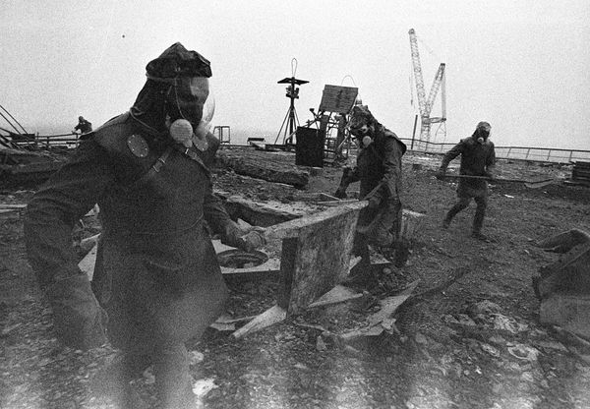
Chernobyl Radiation Exposure Observations
Notes:
Photo source: http://news.nationalgeographic.com/news/energy/2011/04/110426/chernobyl-25-years-liquidators-pictures/#/chernobyl-25th-anniversary-liquidators-firefighters-roof_35076_600x450.jpg

Slide 51
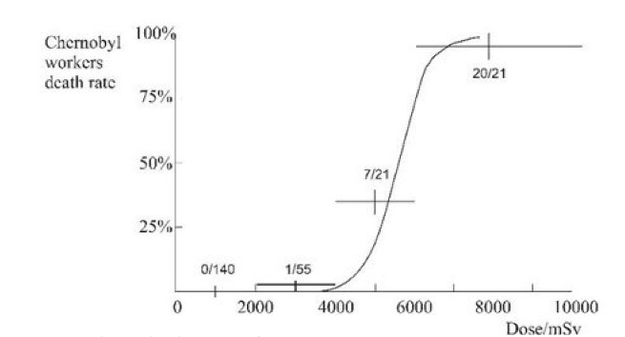
Chernobyl Emergency Worker Death from Acute Radiation Syndrome
Above 4,000 mSv (400 rem) 27 of 42 exposed workers died.
Below 2,000 mSv (200 rem) none of 140 exposed workers died.
Source: Wade Allison, Radiation and Reason
52
Notes:
This graphic shows the number of Chernobyl first responders who died relative to the total number of first responders exposed in each dose range (curve is for percent rate mortality vs. dose).
Note that 2,000 mSv (200 rem) is the threshold dose for acute radiation syndrome (ARS).
Of the 97 first responders who experienced ARS, 28 died from their exposure.
22 first responders who recovered from ARS died from various causes in the following 19 years.
This is one of the most vivid examples of why the linear extrapolation of high dose data to zero dose is fallacious.
Graphic source: http://www.radiationandreason.com/uploads//enc_EdinburghJune13A.pdf

Slide 52
Chernobyl Radiation Risk
Low radiation doses from Chernobyl dust estimated and compared with natural doses by UNSCEAR⁵
  In first year following accident, average individual dose received by Northern Hemisphere inhabitants estimated to be 0.045 mSv --- less than 2% of average global annual natural dose
  Average annual dose from accident received by approximately 5 million people living in contaminated regions only about 1/3 of average natural radiation dose for those regions⁶ (i.e., total dose ≈ 133% of natural radiation dose)
  These doses dwarf in comparison with natural radiation doses in some parts of the world^{7,8}
53
Notes:
Unfortunately, hysteria tends to rule when radiation information is absent.
Following the Chernobyl accident, even though radiation doses to other parts of Western and Eastern Europe were never a significant threat, pregnant women were advised to have abortions and cow milk was dumped.

Slide 53
Chernobyl Radiation Risk (cont.)
Conflict between LNT risk calculations and observed cancer mortalities⁹
  UN Chernobyl Forum, using LNT model, predicted 1760 excess cancer deaths for surrounding population of 405,000 (even exceeded excess cancer deaths predicted by ICRP 60 LNT model)
  Regardless, no radiation-induced increase in cancer mortality occurred
  4000 cases of thyroid cancer identified in enhanced screening begun immediately after accident; only nine cases resulted in death
54
Notes:
One would think humankind would learn from reality that the LNT dose-response model is fiction.
Yet it continues to be used to falsely predict dire consequences from low dose radiation exposures.

Slide 54
Chernobyl Radiation Risk (cont.)
Conflict between LNT risk calculations and observed cancer mortalities (cont.)
  Collective dose concept used to predict that 53,000 people in Northern Hemisphere would die of Chernobyl-induced cancer over 50 years¹⁰ – fictitious number that can never be validated
  Except for thyroid cancers in population of highly contaminated areas of Belarus, Russia, and Ukraine, no increase in incidence of solid tumors and leukemia, and no increase in genetic diseases observed^{7,11,12,15}
55
Notes:
It needs to be emphasized once again, the 53,000 deaths in the Northern Hemisphere by the year 2036 is a fictitious number that will never be manifested in reality.
Despite the differences between LNT mortality predictions and reality, the LNT model continues to be used to assess the consequences of hypothetical radiation releases as well as to justify unnecessary radiological protection regulations for low dose radiation.
Perhaps its continued use is to intentionally frighten people?

Slide 55
Worldwide (and Local) Average Annual Radiation Doses from Natural and Man-made Sources
Exposures (in mSv) of global population from
radiation sources, and of inhabitants of regions contaminated by radioactive fallout after Chernobyl
accident (after UNSCEAR, 1988; UNSCEAR, 2000)
56
Notes:
This graphic shows global population whole-body exposures from the end of World War II to the year 2000 due to the following radiation sources:
natural background radiation (1 – 260 mSv)
nuclear medicine procedures (<1 mSv)
above-ground nuclear weapon testing (max, ≈0.11 mSv)
the Chernobyl accident (<0.05 mSv)
nuclear power operations and activities (negligible)
It also shows that radiation exposures of populations in eastern European regions that were contaminated by Chernobyl radioactive fallout did not exceed exposures from natural background radiation.
Note the significant rise in medical radiation exposures that occurred in the decades preceding the Chernobyl accident.

Slide 56
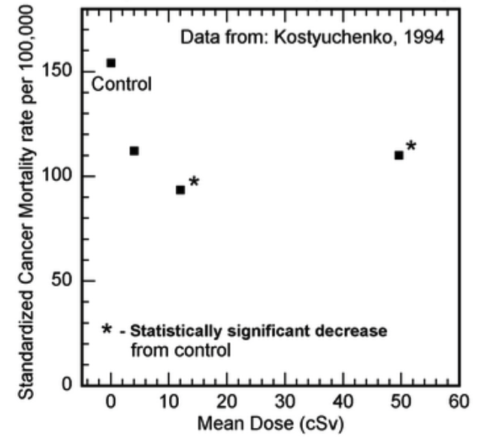
1957 Mayak Weapons Plant Contamination Exposed 7854 People with up to 50 cSv
Significantly reduced cancer mortality rates in the 12 cSv and 50 cSv cohorts in villages near the Mayak nuclear weapons facility compared to control cohort
57
Notes:
Here is another example of the conflict of LNT mortality predictions and reality.
The Mayak accident (or Kyshtym accident) that occurred in 1957 at a Russian plutonium production and nuclear fuel reprocessing plant was a radioactive contamination accident resulting from a chemical explosion in a nuclear waste tank.
About 10,000 people were potentially exposed to various radiation levels, with the highest exposure being about 50 cSv (50 rem).
The exposed cohorts (groups) had lower cancer mortalities than the control (unexposed) group.
References:
Compelling Reasons for a Paradigm Shift in Radiation Safety and Revised Health Physics Goals https://drive.google.com/file/d/0B6XPKnvfFRDJX1JVXzZlYW1FWVE/view
Long-term irradiation effects in the population evacuated from the East-Urals radioactive trace area, V.A. Kostyuchenko, L.Yu. Krestinina, 1994
http://www.sciencedirect.com/science/article/pii/0048969794900809

Slide 57
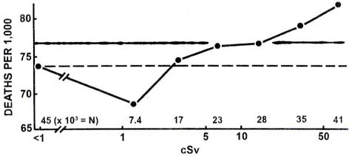
Atom Bomb Survivor
Cancer Mortality Rate⁴
(Numbers above abscissa indicate thousands of people included in each point; i.e. the number receiving a dose ≤ x. Dashed and solid horizontal lines represent mortality rates for “in-the-city” and “out-of-city” control populations, respectively.)
58
Notes:
This graphic, seen previously in the radiation hormesis presentation, shows a decreased mortality rate compared to the “out-of-city” control group for those exposed to bomb radiation doses of less than 20 cSv (20 rem).

Slide 58
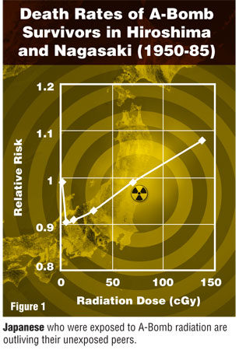
Source: M. Mine et al., Apparently Beneficial Effect of Low to Intermediate Doses of A-Bomb Radiation on Human Lifespan, International Journal of Radiological Biology, 58:1035, 1990
59
Notes:
This graphic shows a decrease in the death rate from non-cancerous diseases for Nagasaki male atomic bomb survivors who received radiation doses between 0 and 75 cGy (0 – 75 rem) compared to age-matched unexposed males.

Slide 59
Atom Bomb Survivor Average Lifespan
Japan’s Mainichi news web site reported on June 30, 2015 that average life span of atom bomb survivors (as of end of March 2015) not significantly different than average lifespan of unexposed populations
  Average age (population): Hiroshima City, 79.6 (58,933); Hiroshima Prefecture, 82.1 (24,434); Nagasaki City, 79.12 (34,198); and Nagasaki Prefecture, 80.68 (13,669)

Slide 60
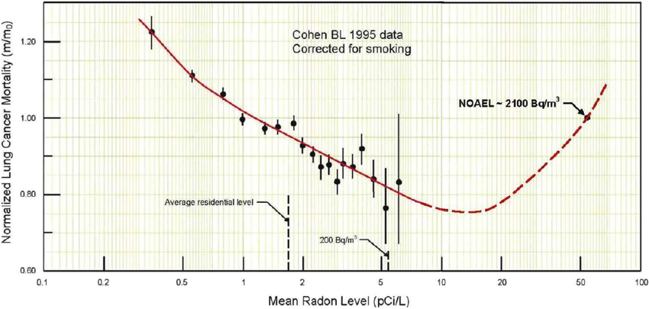
The Truth About Home Radon
NOEAL – no observed adverse effect level
61
Notes:
This slide shows the fallacy of the home radon risk narrative.
Professor Bernie Cohen’s initial five-year investigation of radon-induced lung cancer covered 1,601 counties, comprising about 90 percent of the U.S. population. It considered radon data from the EPA and state agencies, and 272,000 measurements by University of Pittsburgh researchers. The research found that instead of increased cancer with the increased presence of radon, the cancer rate decreased significantly.
The home radon remediation level of 4 pCi/L is an arbitrary EPA limit that has nothing to do with biological health. As indicated, this radon level is well within the hormetic region and remediation measures will actually reduce the beneficial effects of home radon.
NOAEL – no observed adverse effect level; actually, radon levels of up to 3700 Bq/m³ have been observed in some dwellings in Ramsar, Iran with no evident ill-effect on the inhabitants.
A 2021 Polish study confirmed that that the relative number of lung cancers decreases with increasing radon concentrations up to about 200 Bq/m³ (Pylak M, Fornalski KW, Reszczyńska J, Kukulski P, Waligórski MPR, Dobrzyński L., Analysis of Indoor Radon Data Using Bayesian, Random Binning, and Maximum Entropy Methods, Dose Response 2021 May 17;19(2):15593258211009337)

Slide 61
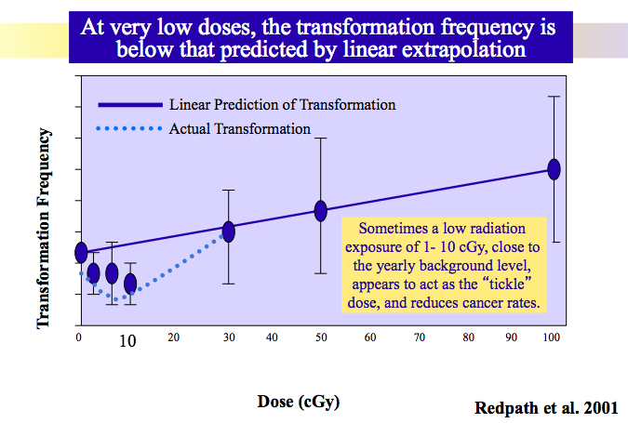
US Low-dose Radiation Studies
Disproving LNT Defunded
100 mSv
62
Notes:
This figure, generated with data from the U.S. government low-dose radiation program, shows beneficial effects of ionizing radiation doses up to 100 mSv (10 rem).
The figure was removed from the government website when the program was cancelled.
http://atomicinsights.com/low-dose-radiation-research-program-defunded-2011/
Graphic source: https://slideplayer.com/slide/14715501/90/images/10/Cells+transforming+to+cancerous+cells.jpg

Slide 62
Radiation Risk Summary
Natural ionizing radiation risk from solar radiation doesn’t evoke great fear, yet results in thousands of deaths each year in U.S.
Nuclear radiation is weaker carcinogen than perceived by most people
Studies of populations chronically exposed to elevated natural background radiation (low-level radiation) have not shown consistent or conclusive evidence of associated increases in cancer risk
Notes:
Radiation has affected biology through 4 billion years of evolutionary history.
Although high radiation doses are hazardous, organisms have evolved not only to tolerate lower dose radiation but also to benefit by it.

Slide 63
Radiation Risk Summary (cont.)
LNT dose-response model birthed concept of “collective dose” – fraudulent indicator that bears no relation to onset or likelihood of health effects or cancer
LNT model low-dose fatality risk calculations in conflict with observed cancer mortality data for Chernobyl accident and for Japanese atomic bomb survivors
Notes:
A-bomb survivors have longer lifespans and lower cancer risk, on average.

Slide 64
Radiation Risk Summary (cont.)
Risk of genetic anomaly from 1 rem (0.01 Sv) of radiation exposure to reproductive organs approximately 50 to 1,000 times less than risk of various spontaneous genetic anomalies¹⁴
Risk estimate for radiation-induced cancers small compared to normal incidence of about 1 in 4 chances of developing any type of cancer¹⁴
  Radiotherapy cause of second malignancy in only 1% of patients treated for primary malignancy
LNT model overestimates cancer risk from low-dose radiation exposure

Slide 65
References
RISK: A Practical Guide for Deciding What’s Really Safe and What’s Really Dangerous in the World Around You, David Ropeik, et al, Harvard Center for Risk Analysis
Outlook on BRC, Nucleonics Week, September 26, 1991 [BRC = below regulatory concern]
Health Effects of Exposure to Low Levels of Ionizing Radiation: BEIR V, Committee on the Biological Effects of Ionizing Radiation (BEIR V), National Research Council; ISBN: 0-309-58970-3 (1990)*
T.D. Luckey, Biological Effects of Ionizing Radiation: A Perspective for Japan, Jour. of Amer. Phys. and Surg., Vol. 16 No. 2, Summer 2011
Sources and Effects of Ionizing Radiation, United Nations Scientific Committee on the Effects of Atomic Radiation UNSCEAR 2000; Report to the General Assembly
Observations on the Chernobyl Disaster and LNT, Zbigniew Jaworowski, 2010
Sources and Effects of Ionizing Radiation, United Nations Scientific Committee on the Effects of Atomic Radiation UNSCEAR 2000; Report to the General Assembly, Annex J: Exposures and Effects of the Chernobyl Accident, pp. 451-566
* According to BEIR V (p. 6 and p. 162), the risk of cancer death is 0.08% per rem for doses received rapidly
(acute) and might be 2-4 times less than that (0.04% per rem) for doses received over a long period of time
(chronic). These risk estimates are an average for all ages, males and females, and all forms of cancer. There is a
great deal of uncertainty associated with the estimates.

Slide 66
References (cont.)
Cancer Incidence in Areas with Elevated Levels of Natural Radiation, SMJ Mortazawi, et al, International Journal of Low Radiation, 2006; 2:20-27
Health Effects of the Chernobyl Accident and Special Health Care Programmes, Report of the UN Chernobyl Forum, Expert Group "Health", World Health Organization, 2006; ISBN: 9789241594172
Health and Environmental Consequences of the Chernobyl Nuclear Power Plant Accident, M Goldman, et al, U.S. Department of Energy, 1987; pp. 1-289
Medical Radiological Consequences of the Chernobyl Catastrophe in Russia, VK Ivanov, et al, NAUKA, 2004
Chernobyl’s Legacy: Health, Environmental, and Socio-economic Impacts and Recommendations to the Governments of Belarus, the Russian Federation and Ukraine, 1-57; The Chernobyl Forum
1990 Recommendations of the International Commission on Radiological Protection, ICRP Publication 60, Ann. ICRP 21 (1-3), 1991
USNRC Reactor Concepts Manual, Biological Effects of Radiation
Sources and Effects of Ionizing Radiation, United Nations Scientific Committee on the Effects of Atomic Radiation UNSCEAR 2008; Report to the General Assembly, Vol. II Effects

