Slide 1
Matter, Atoms, and Quarks
Jeffrey A. Mahn
Nuclear Engineer (Retired)
Albuquerque, NM USA
jamahn47@gmail.com

Slide 2
Makeup of Our World
Matter – the world we can see, touch, hear, smell, and taste
Atom – the building block of matter
Quark – elementary particle and fundamental constituent of matter

Slide 3
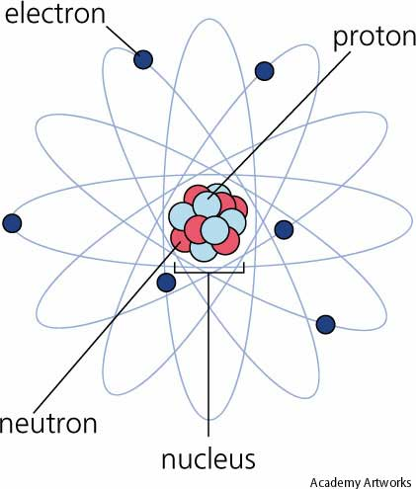
The Atom
3
Notes:
This is the planetary model of the atom.
The nucleus consists of protons and neutrons held together by the strong nuclear force.
Electrons orbit the nucleus and have discrete energy levels. To get a perspective, if the hydrogen nucleus was 1 foot in diameter, the electron occupying the lowest energy level would be found an average of 10 miles away.
So, all matter is made up of atoms and the atom is mostly empty space.

Slide 4
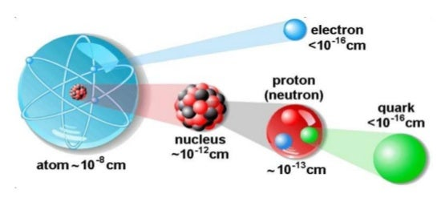
Atomic Structure
4
Notes:
This graphic illustrates the relative sizes of the constituents of an atom.
Note that the atom is mostly empty space.

Slide 5
Quarks
Six kinds of quarks called up, down, charm, strange, top, and bottom
Combine to form composite particles called hadrons, most stable of which are protons and neutrons
Only up and down quarks occur commonly in nature
Notes:
Accelerator experiments conducted between 1967 and 1973 led to the discovery of quarks.
All commonly observable matter is composed of up quarks, down quarks and electrons.

Slide 6
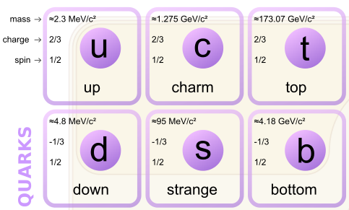
Quark Properties
6
Notes:
Quarks have intrinsic properties including mass, electric charge, and spin.
The takeaway from this slide is the charge of the Up and Down quarks (red circles), which will be noted in the next slide.

Slide 7
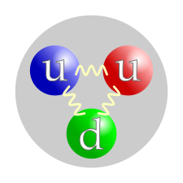
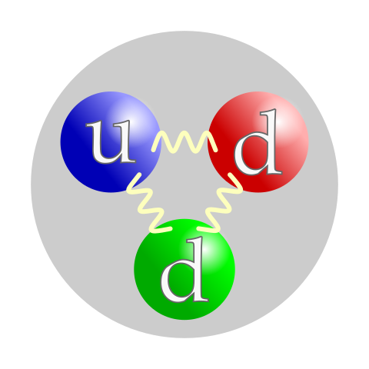
Proton and Neutron Structure
Proton composed of two up quarks and one down quark that result in +1 electric charge
Neutron composed of one up quark and two down quarks that result in no net electric charge
7
Notes:
The combination of two up quarks and one down quark in the proton creates a positive electric charge for the proton.
The electric charge of one up quark is cancelled by the charge of the two down quarks in the neutron, resulting in no net electric charge.

Slide 8
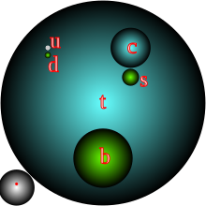
Relative Quark Masses
Relative masses for all six quarks, illustrated as balls of proportional volumes.
Proton (gray) and electron (red) are shown in bottom left corner for scale.
8
Notes:
This graphic illustrates the relative quark masses, with the largest ball representing the mass of the top quark.

Slide 9
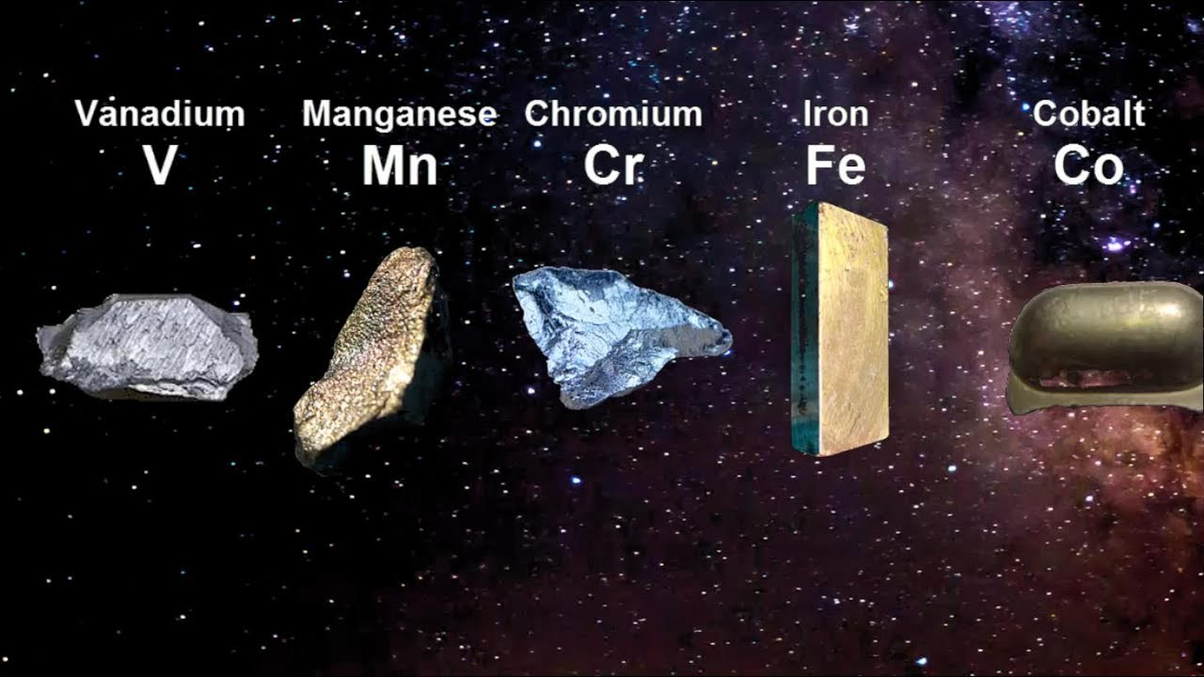
Chemical Elements

Slide 10
Chemical Elements
Characterized by number of protons (atomic number) in atomic nucleus
Periodic Table of the Elements - known elements arranged in order of ascending atomic number (number of protons) in atomic nucleus
118 known elements
All elements above uranium (atomic number 92) manmade

Slide 11
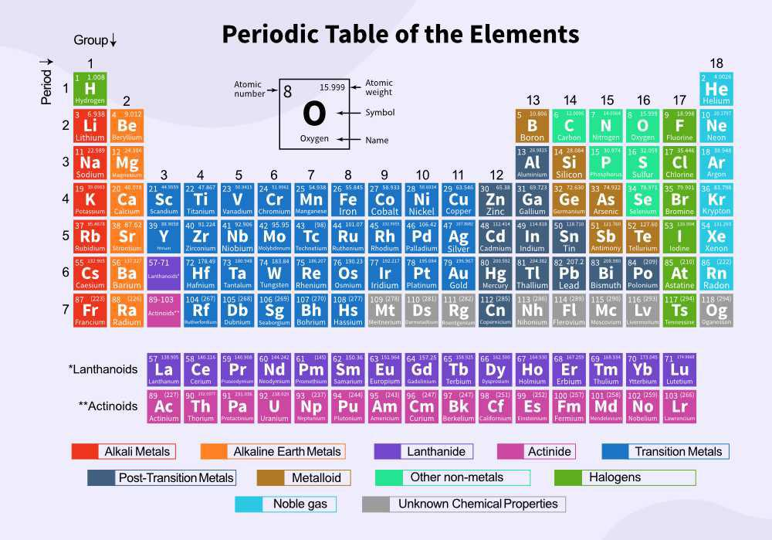
11
Notes:
All the known chemical elements can be arranged in order of the number of protons in the atomic nucleus to produce the Periodic Table.
The atomic number is the number of protons in the atomic nucleus.
The atomic mass is the sum of the protons and neutrons in the atomic nucleus.
Point out how the Lanthanide series and Actinide series elements fit into the table.
Elements of the same color (Group) in the graphic have similar chemical properties. For example, the Alkali Metals on the left and the Noble Gases on the right.

Slide 12
Isotope
Isotopes of chemical element contain same number of protons, but different number of neutrons in atomic nucleus
Isotope nucleus may be stable or unstable (radioactive)
All chemical elements consist of multiple isotopes
Element atomic mass is weighted average (% abundance) of stable isotope masses
Atomic mass for elements with no stable isotopes is mass of longest-lived radioactive isotope (generally in parentheses)
Over 3,000 chemical isotopes identified
Notes:
For elements having stable isotopes, the atomic mass shown in the Periodic Table is the weighted average (percent abundance) of the stable isotope masses.

Slide 13
Isotopes of Hydrogen
13
Notes:
This graphic illustrates the common isotopes of hydrogen.
The natural abundance in hydrogen of the protium isotope is 99.985%.
The nucleus of a protium atom is a single proton.
“Normal” water, consisting of protium and oxygen, is written as H₂O
The natural abundance in hydrogen of the deuterium isotope is 0.015%.
Deuterium is sometimes called heavy hydrogen because its nucleus contains a proton and a neutron – two subatomic particles of approximately the same mass.
The nucleus of a deuterium atom is called a deuteron
“Heavy” water, consisting of deuterium and oxygen, is written as D₂O
Tritium is a radioactive isotope of hydrogen with a relatively short half-life (12.3 years).
Note that the element plutonium was discovered in 1940 by scientists at UC-Berkeley who were bombarding natural uranium with deuterons.

Slide 14
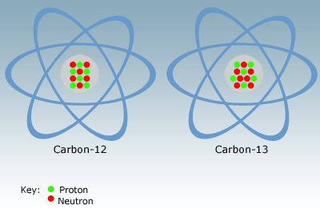
Stable Isotopes of Carbon
14
Notes:
Naturally occurring carbon consists of two isotopes of carbon – 98.9% is carbon 12, which contains 6 protons and 6 neutrons in the atomic nucleus, and 1.1% is carbon-13, which contains 6 protons and 7 neutrons in its nucleus.

Slide 15
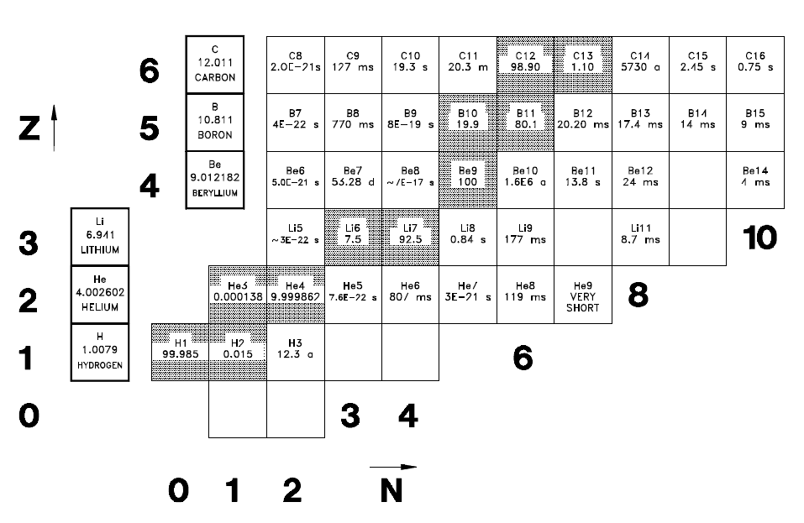
Chart of the Nuclides
Isotope Illustration
15
Notes:
All known chemical isotopes are displayed in the Chart of the Nuclides.
This graphic shows the first six rows (first six elements of the Periodic Table) of the Chart of the Nuclides.
Z is the number of protons (atomic number) and N is the number of neutrons in the atomic nucleus.
The shaded isotopes are stable, the unshaded isotopes are unstable or radioactive.

Slide 16
ANS Interactive Isotopes App
https://isotopes.ans.org/
Wi-Fi Password: delnorte5800
Notes:
This App can be used to find information about chemical element isotopes, including their uses.
Radioactive decay chains can be mapped using this App.

Slide 17
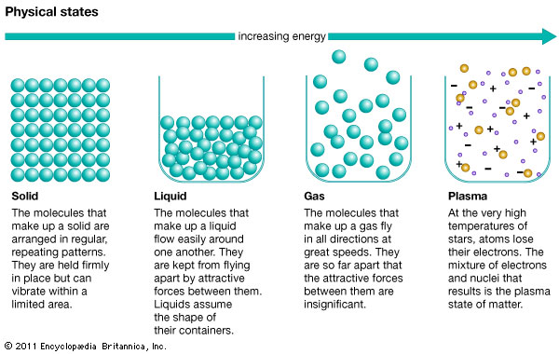
States of Matter
17
Notes:
The state of matter is determined by the internal energy (or temperature) of its atoms.

Slide 18
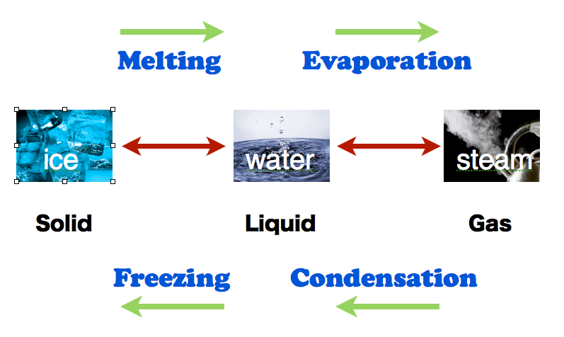
Physical Changes in Matter
Changes of state – involve changes in internal energy of atoms
18
Notes:
Water is a very good illustration of how matter changes physically with changes in the internal energy of its atoms.
Water is also a rather unique substance in that its solid form (ice) is less dense than its liquid form.

Slide 19
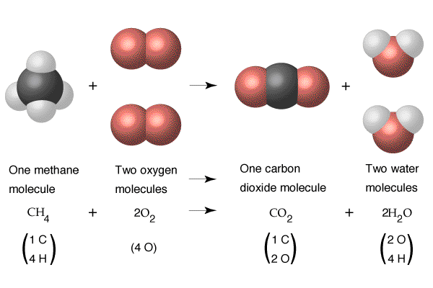
Chemical Changes in Matter
Chemical reactions – involve interactions of electrons in atoms
Combustion of CH₄ produces about 0.0035 eV per gram CH₄
19
Notes:
Molecules are formed by electron bonds between atoms.
Energy is often liberated by the breaking and making of electron bonds between atoms.
The burning (oxidation) of methane gas in this graphic releases energy in the form of heat.

Slide 20
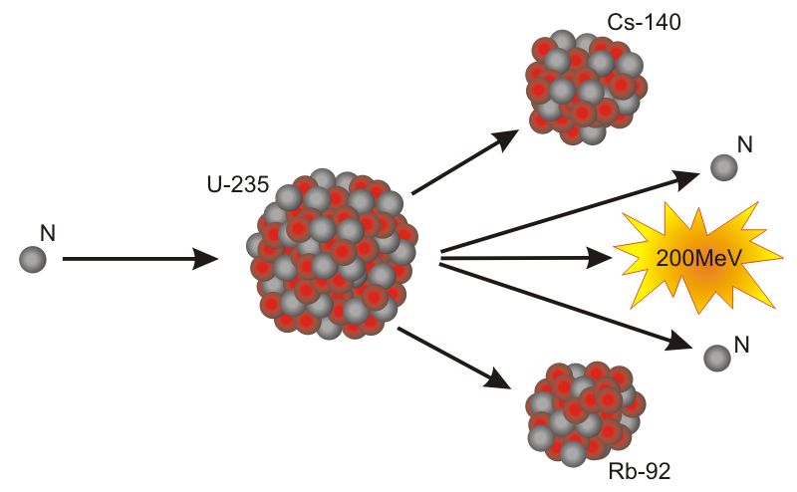
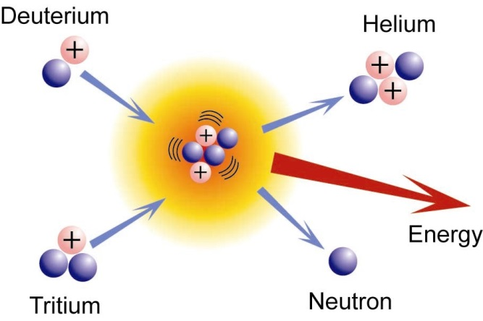
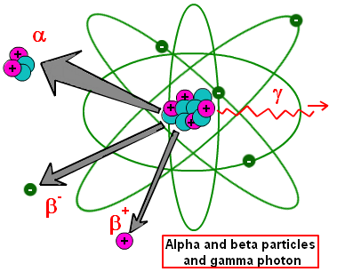
Nuclear Changes in Matter
Nuclear changes – involve changes in nuclei of atoms (fission, fusion, radioactive decay)
20
Notes:
Fission – splitting of a heavy atomic nucleus into two lighter atomic nuclei with liberation of 2-3 neutrons and a lot of energy
Fusion – combining of two very light nuclei into a heavier nucleus, liberating a lot of energy
Radioactive decay – process by which an unstable atomic nucleus becomes more stable by emitting energy in the form of particles or ionizing electromagnetic waves

Slide 21
Fission
Splitting the Atom

Slide 22
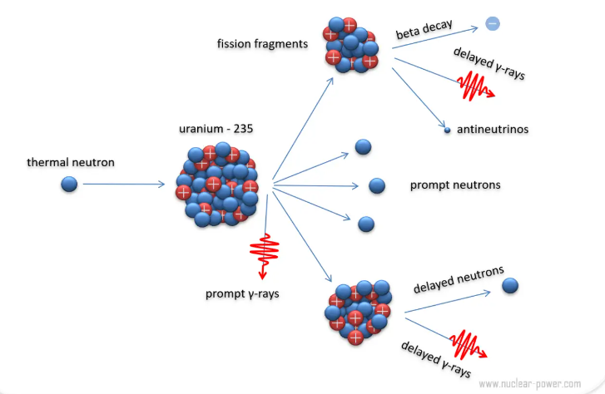
Fission Illustrated
22
Notes:
This slide illustrates the primary contributors to the 200 MeV of fission energy.
Fission fragments
Liberated neutrons
Beta particles
Gamma-rays
The distribution of fission energy within these items is shown on the next slide.
Graphic source: https://www.nuclear-power.com/nuclear-power/fission/

Slide 23
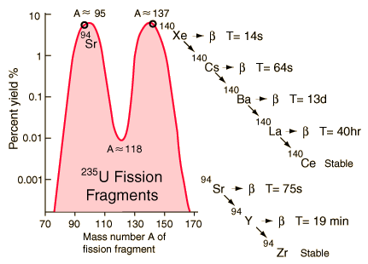
U-235 Fission Fragment Distribution
23
Notes:
The fission of uranium-235 atoms produces a bimodal distribution of fission fragments, with the most probable fragments having atomic mass numbers of 95 and 137.
The radioactive decay chains for radioactive fission fragments strontium-94 and xenon-140 are illustrated in the graphic. Strontium-94 and xenon-140 are isotopes of the elements strontium and xenon, respectively.
For each isotope in the radioactive decay chain the primary decay mode and associated decay half-life are identified.
Graphic source: https://www.bing.com/images/search?q=Products+of+Uranium+Fission&FORM=IRBPRS&=1407&=1#view=detail&id=BCE733E35B714A7AEFE3245637F7B1A035DB4188&selectedIndex=3

Slide 24
Fission Energy Disposition
Mev %
Fission Fragment Kinetic Energy 168 84
Fission Neutron Kinetic Energy 5 2.5
Prompt Gamma-ray Energy 7 3.5
Fission Fragment Delayed Radiation
Beta Particle Energy 8 4
Gamma-ray Energy 7 3.5
Radiative Capture Gamma-ray Energy 5 2.5
Total 200 100
Kinetic energy and radiation energy is converted to thermal energy in reactor materials.
24

Slide 25
Fusion
Harnessing the Sun

Slide 26
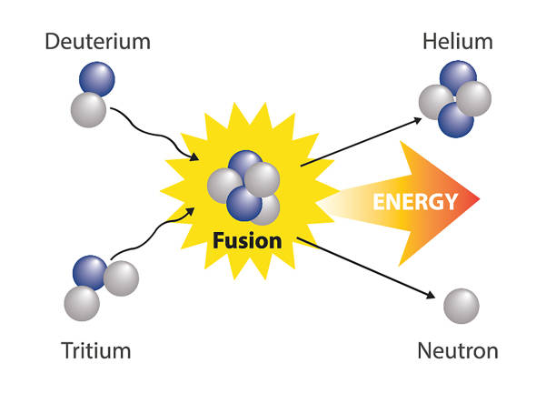
Fusion Illustrated
26
Notes:
The D-T fusion process releases roughly four times as much energy per gram of fuel as uranium-235 fission.
Fission reaction energy – 200 MeV
Fusion reaction energy – 17.6 MeV
On an energy per gram of reactant material basis,
U-235 Fission: 200 MeV/235 g/mol ≈ 0.85 MeV/g
D-T Fusion: 17.6 MeV/5 g/mol ≈ 3.5 MeV/g
D-T fusion energy/U-235 fission energy = 3.5/0.85 ≈ 4
Graphic source: Wikipedia – Nuclear Fusion

Slide 27
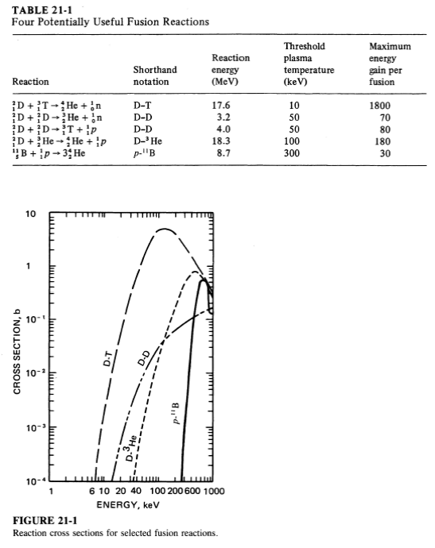
Potentially Useful Fusion Reactions
27
Notes:
While nearly all stable isotopes lighter than iron and nickel will fuse with some other isotope and release energy, deuterium and tritium are by far the most attractive for energy generation as they require the lowest activation energy (thus lowest temperature), while producing the most energy per unit weight.
This table shows that deuterium-tritium fusion has the lowest threshold plasma temperature and the highest maximum energy gain per fusion event (circled in red).
This is why the fuel focus for most fusion machine research is deuterium and tritium.
Note the shorthand notation for the different fusion reactions. D-³He is the fusion of deuterium and helium-3 and p-¹¹B is the fusion of hydrogen (proton) and boron.
From hereon, the notation D-T will be used for the deuterium-tritium reaction.

Slide 28
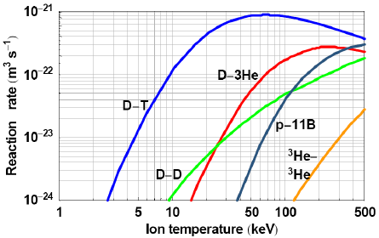
Fusion Reaction Rate vs Plasma Temperature
28
Notes:
Here one can easily see that D-T fusion has the highest reaction rate at the lowest threshold ion (plasma) temperature of about 50 keV.
Source: Petkow, D, Herdrich, G, Laufer, R, and Röser, HP, Key technologies for fusion-based space propulsion: A case study; International Astronautical Federation - 58th International Astronautical Congress 2007. 8. 5586-5590
Also: Prof. G.L.Kulcinski, NEEP602 Course Notes (Fall 1996), Resources from Space; Fusion: The Power Source of the 21st Century, March 27, 1996

Slide 29
D-T Fusion Energy Disposition
MeV %
He-4 Kinetic Energy 3.5 20
Neutron Kinetic Energy 14.1 80
Total 17.6 100
D-T fusion produces about 20 MeV per gram of D-T.
Ideally, the He-4 nuclei (alpha particles) would expend
their energy heating the D-T plasma.
Neutron kinetic energy would be converted to thermal energy in reactor materials.
29
Notes:
If fusion becomes a practical energy source for generating electricity, it could generate four times more energy per kilogram of fuel than fission, and nearly four million times more energy than burning coal or oil (International Atomic Energy Agency).

Slide 30
Radioactive Decay
Transmutation of Atoms

Slide 31
Radioactive Decay
The process by which an unstable atomic nucleus becomes more stable by emitting energy in the form of particles (alpha and beta), oftentimes with accompanying ionizing electromagnetic waves (gamma-rays)

Slide 32
Types of Radioactive Decay
Alpha (α) Decay
Helium nucleus (2 protons & 2 neutrons)
Beta Minus (β⁻) Decay
Electron emitted from atomic nucleus when a neutron converts to a proton and an electron
Beta Plus (β⁺) Decay
Positron (antimatter counterpart of electron) emitted from atomic nucleus when a proton converts to a neutron and a positron
Electron Capture (ε)
Proton in nucleus combines with captured inner shell electron of atom to produce a neutron
32
Notes:
Notes:
A neutron converts to a proton when one of its down quarks changes into an up quark; a proton converts to a neutron when one of its up quarks changes to a down quark.
The weak force allows a neutron down quark to change to an up quark, leading to creation of an emitted electron/antineutrino pair.
Similarly, the weak force allows a proton up quark to change to a down quark, leading to creation of an emitted positron/neutrino pair.
Electron capture is considered a type of beta decay because the basic nuclear process, mediated by the weak force, is the same. That is, a proton up quark changes to a down quark, leading to creation of an emitted neutrino.

Slide 33
Radioactive Decay Terminology
Original nucleus called parent nucleus
Nucleus resulting from radioactive decay called daughter nucleus
Radioactive decay transmutes (changes) original atomic element (parent) into different atomic element (daughter)
Daughter nucleus has different number of protons than parent nucleus and is therefore different element

Slide 34
Fission and Fusion Radioactive Byproducts
Fission fragments and many decay daughter isotopes are radioactive
Absorption of very energetic fusion neutrons in fusion component/system materials creates radioactive isotopes
Primary decay modes for fission and fusion radioactive byproducts are beta minus, beta plus, and electron capture

Slide 35
Supplemental Slides

Slide 36
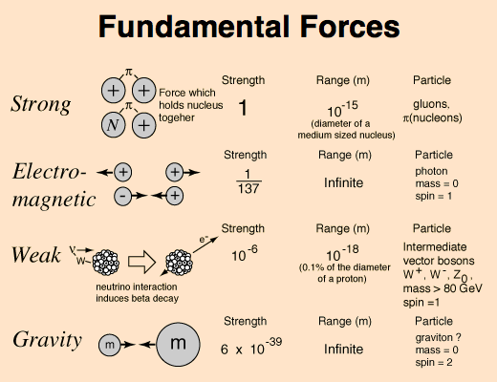
Notes:
Quantum mechanics provides the foundation for understanding the strong, electromagnetic, and weak forces of nature.
Strong nuclear force – force that holds quarks together and binds protons and neutrons together in atomic nucleus
Electromagnetism – force that governs interaction of particles having an electric charge
Weak nuclear force – force capable of transforming neutrons into protons and vice versa; cause of radiation phenomena such as beta, positron, and electron capture decay
Gravity – attractive force between bodies having mass; described by theory of general relativity, but not yet incorporated into the Standard Model of particle physics that describes the other three forces as quantum field theories.

Slide 37
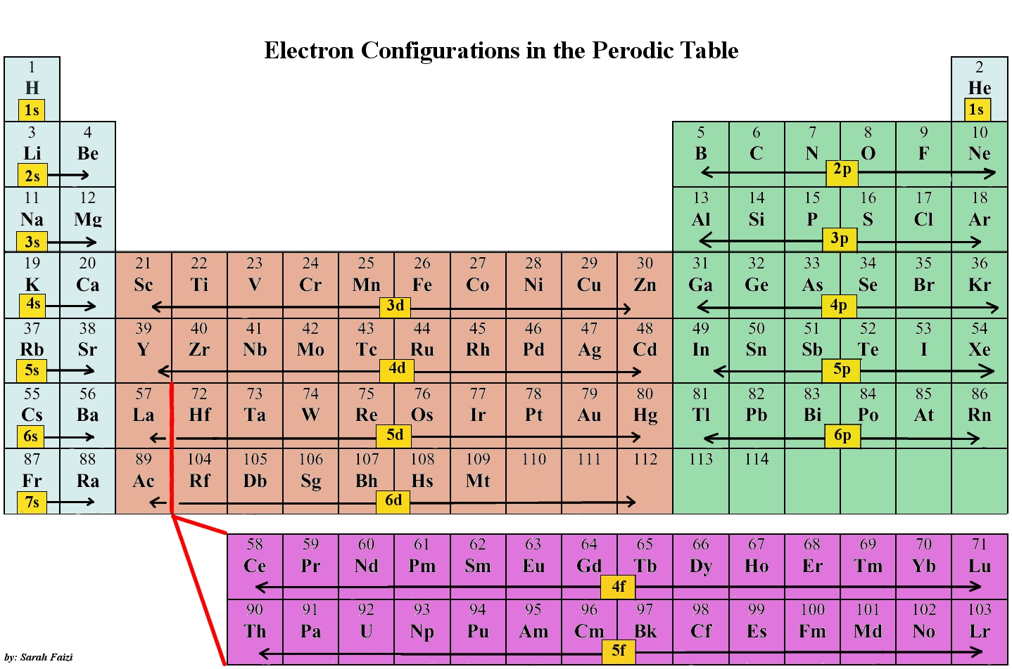
115
116
117
118
Notes:
This graphic shows how the electron shells of the atoms are filled for the elements in the Periodic Table.
Atomic orbitals are the basic building blocks of the atomic orbital model, a very simple model for visualizing the electron structure of matter.
Each s subshell consists of a single orbital, accommodating up to two electrons, each with a discrete spin (spin up or spin down).
Each p subshell consists of 3 orbitals, accommodating up to 6 electrons.
Each d subshell consists of 5 orbitals, accommodating up to 10 electrons.
Each f subshell consists of 7 orbitals, accommodating up to 14 electrons.
Electrons in elements 113 through 118 in the graphic fill the 7p orbitals.

Slide 38
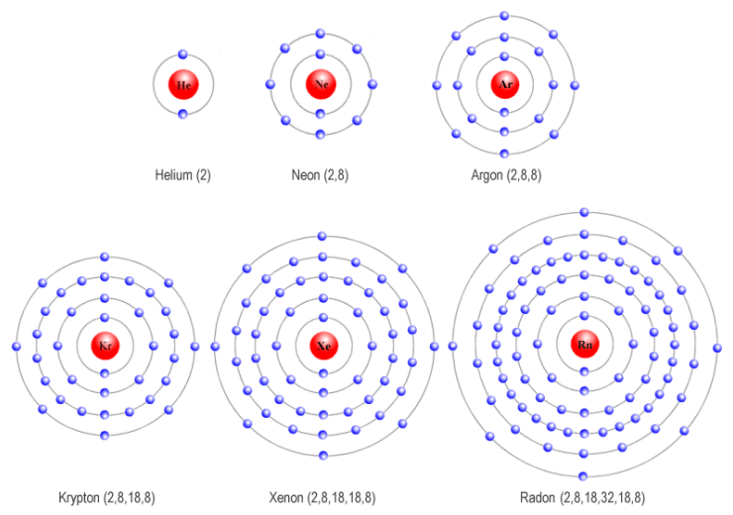
Noble Gas Electron Shell Illustrations
Notes:
Helium – 1s subshell filled
Neon – 1s, 2s, and 2p subshells filled
Argon – 1s, 2s, 2p, 3s, and 3p subshells filled.
Krypton – 1s, 2s, 2p, 3s, 3p, 3d, 4s, and 4p subshells filled.
Xenon – 1s, 2s, 2p, 3s, 3p, 3d, 4s, 4p, 4d, 5s, and 5p subshells filled.
Radon – 1s, 2s, 2p, 3s, 3p, 3d, 4s, 4p, 4d, 4f, 5s, 5p, 5d, 6s and 6p subshells filled.

Slide 39
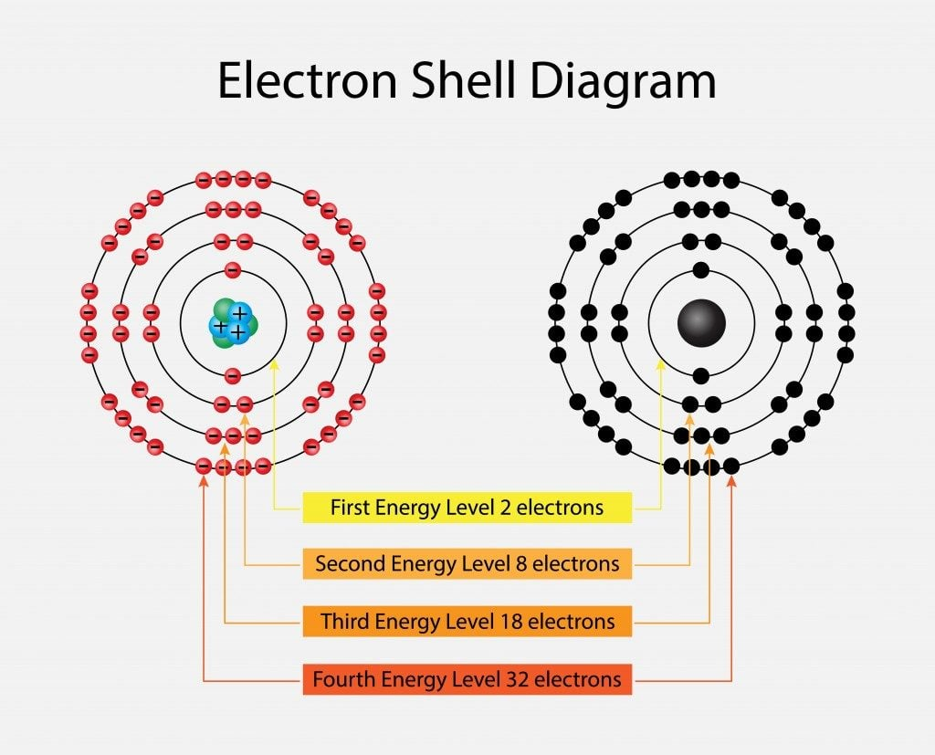
Notes:
This graphic illustrates the electron shells in the atomic orbital model.
The first energy level consists of a single s subshell, accommodating a total of 2 electrons.
The second energy level consists of an s subshell and a p subshell, accommodating a total of 8 electrons.
The third energy level consists of an s subshell, a p subshell, and a d subshell, accommodating a total of 18 electrons.
The fourth energy level consists of an s subshell, a p subshell, a d subshell, and an f subshell, accommodating a total of 32 electrons.

Slide 40
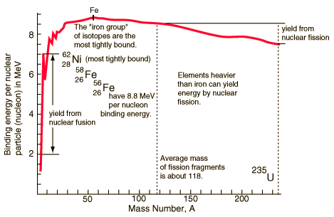
Binding Energy per Nucleon
²³⁵U binding energy is ~ 7.4 MeV per nucleon
Notes:
This graphic illustrates the energy that is liberated in fission and fusion reactions, called binding energy because it is the energy that binds the protons and neutrons together in the atomic nucleus.
The figure shows that the maximum binding energy per nucleon (i.e., per particle in the nucleus) is about 8.8 million electron volts (≈ 1.6 x 10⁻¹³ Joules), which is typical of the “iron group” of isotopes.
The protons and neutrons in heavy isotopes like uranium-235 and in the isotopes of hydrogen (deuterium and tritium) are less tightly bound in the nucleus.
Uranium fission, which produces lighter isotopes having larger binding energies per nucleon, therefore liberates ≈ 1 MeV per nucleon.
Fusion of the deuterium and tritium nuclei liberates much more energy (≈ 5 MeV per nucleon) in producing a helium nucleus.

Slide 41
