Slide 1
Our Radioactive World
Jeffrey Mahn
Nuclear Engineer (Retired)
jamahn47@gmail.com

Slide 2
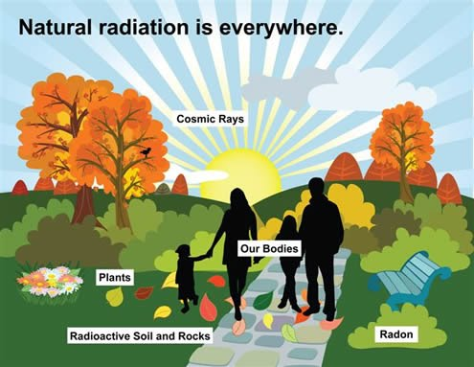
Notes:
We live in a radioactive world.
So, let’s look at the sources of ionizing radiation we are exposed to every day of our lives.

Slide 3
Average Annual Radiation Exposure
Natural background (cosmic & terrestrial, including radon) varies around the world
U.S. Average -- 350 mrem/y
  Cosmic 30 mrem/y
  Terrestrial 30 mrem/y
  Internal (K-40) 40 mrem/y
  Inhaled (Radon) 200 mrem/y
  Medical 50 mrem/y
3
Notes:
This slide shows the primary sources of ionizing radiation that compose what we call natural background radiation.
Note that the annual doses shown in the slide vary somewhat in the literature.
The total U.S. average annual background dose will vary depending on the number of contributors included in calculating the average dose.
The individual contributors to the average likewise vary in the literature, as we will see shortly.
The medical contribution may vary by a factor of two or more, depending on one’s health.
The specific numbers are not that important since none of these sources of background radiation exposure result in any adverse health effects.
The most significant takeaway in this slide is to note that radon is the source of more than half of our background radiation exposure --- because it’s in the air we breathe.
Since radon is an alpha particle emitter and alpha particles have a very short range, radon decay deposits its energy only in lung tissue (alpha particles cannot penetrate the dead layer of human skin).

Slide 4
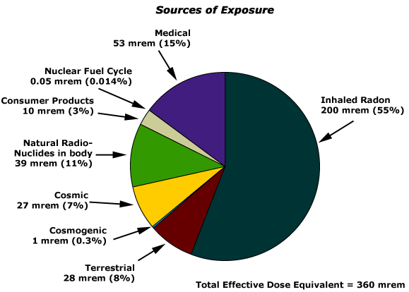
Sources of Background Radiation
4
Notes:
This graphic shows the various contributors to our dose from natural background radiation in a pie chart.
Comparing the numbers in this slide to the numbers in the previous slide, one can see how the individual contributors to our average background radiation dose may vary in the literature.
However, the largest single contributor to our natural background radiation dose is radon, which comes from the radioactive decay of uranium and thorium – both very plentiful in the Earth’s crust.
Cosmic radiation is high energy, heavy, charged particles entering Earth’s atmosphere from sources in space.
Cosmogenic radiation is the secondary radiation resulting from cosmic radiation interactions with atoms in Earth’s atmosphere. Except for carbon-14, and sodium-22, which have metabolic roles in the human body, the cosmogenic radionuclides contribute little to radiation doses.

Slide 5
Cosmic and Cosmogenic Radiation

Slide 6
Cosmic Radiation
Composition
  89% protons
  9% alpha particles
  1% electrons
  1% heavy element nuclei
Interactions with atoms in upper atmosphere produce muons, electrons, positrons, neutrinos, and neutrons
  Muons traveling at essentially speed of light constitute ≈80%
  of natural background dose from cosmic radiation*
  Electrons produced by muons, or present in electromagnetic
  cascade, primary contributor to remainder of charged-
  particle cosmic radiation background dose*
* UNSCEAR 2000 Report, Sources and Effects of Ionizing Radiation, Annex B, Exposures from
Natural Radiation Sources

Slide 7
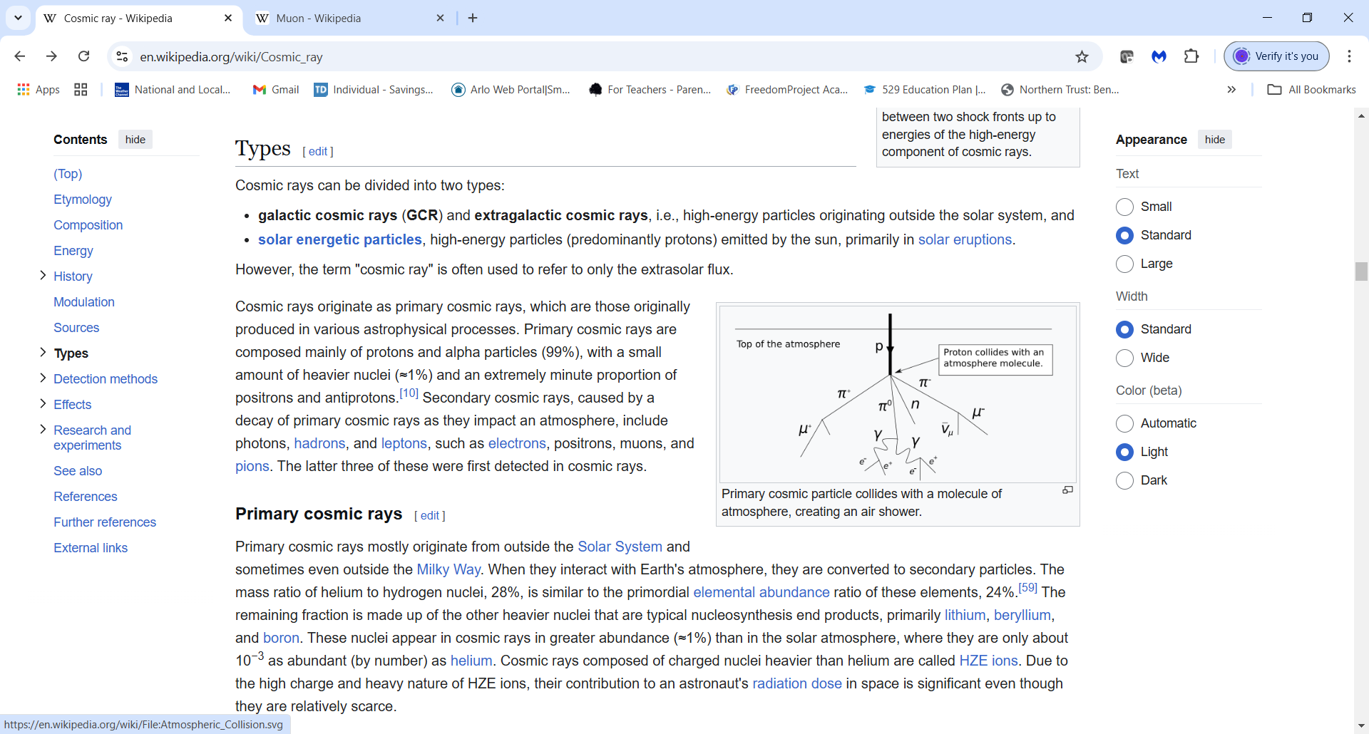
Cosmic Particle Shower
ν_{μ}
μ⁻ muon
μ⁺ antimuon
ν_{μ} muon neutrino
muon antineutrino
e⁻ electron
e⁺ positron
7
Notes:
The high-energy particles incident on the atmosphere interact with atoms and molecules in the air and generate a complex set of secondary charged and uncharged
particles, including neutrons and pions, which decay into muons, electrons, and neutrinos.
While charged pions (π⁻ and π⁺) most often decay into muons and muon neutrinos, neutral pions (π⁰) generally decay into two photons (gamma-rays). The photons may further undergo internal conversions with each resulting in an electron-positron pair as shown in the graphic.

Slide 8
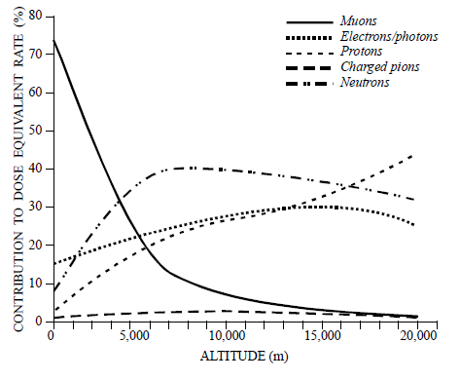
Components of Dose Equivalent Rate from Cosmic Rays in Atmosphere
Ref. UNSCEAR 2000 Report, Sources and Effects of Ionizing Radiation, Annex B, Exposures from Natural Radiation Sources
8
Notes:
This graphic illustrates the contributors to our cosmic radiation exposure, which constitutes less than 10% of our natural background radiation exposure.
Charged-particle radiation is primarily from muons, electrons, and protons. The long mean free path of muons in the atmosphere makes them the dominant component of the charged-particle radiation at ground level, as shown in this graphic.
Muons contribute >70% of cosmic radiation exposure at sea level, electrons/photons about 15%, neutrons <10%, and protons <5%. At the elevation of Denver and Albuquerque, exposure is about 50% from muons, about 20% from neutrons, <20% from electrons/photons, and about 10% from protons.
At aircraft altitudes, neutrons, protons, electrons, and photons are the most significant components of cosmic radiation.
Note that incoming protons initiating the cosmic ray neutron field are strongly affected by the earth’s magnetic field, with the effect that the neutron fluence rate in equatorial regions is less than that in polar regions.

Slide 9
Terrestrial Radiation

Slide 10
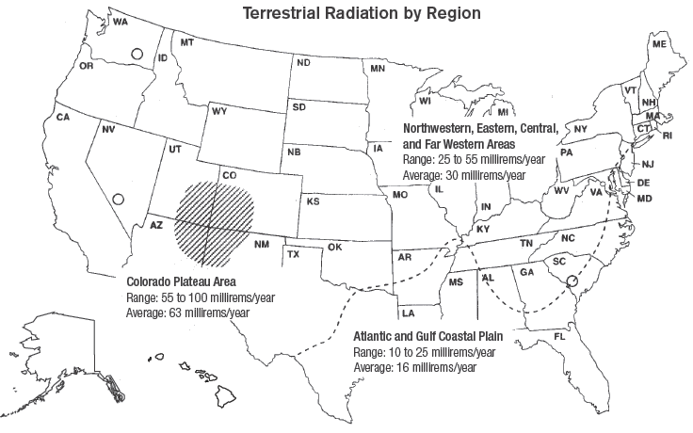
Who is exposed to the most terrestrial radiation?
Terrestrial radiation comes from long-lived radioactive isotopes like potassium, uranium, and thorium (as well as their radioactive decay daughter products), found in most soils.
10
Notes:
The average dose to an individual in the United States from terrestrial radiation sources is about 0.3 millisievert (30 millirem) per year, less than 10% of our natural background radiation exposure.
However, there are some variations over the country, and the average exposure takes the population of regions into account.
On the coastal plains of the Atlantic and Gulf regions, the average annual dose is lower than it is in the western and interior parts of the country.
People living in the Colorado Plateau region receive 4 times as much terrestrial radiation exposure as people living in the Atlantic and Gulf coastal plain.
However, people living in the Colorado Plateau region, with higher background radiation levels, have 15% fewer cancers than the national average.

Slide 11
Terrestrial Sources of Radiation
Isotope | Half-life (years) | Radiation
Ra-226 | 1622 | α, γ
U-238 | 4.5 x 10⁹ | α
Th-232 | 1.4 x 10¹⁰ | α
K-40 | 1.3 x 10⁹ | β, γ
Rb-87 | 4.7 x 10¹⁰ | β
La-138 | 1.1 x 10¹¹ | β, γ
Lu-176 | 2.1 x 10¹⁰ | β, γ
11
Notes:
This table shows some common sources of terrestrial radiation.
These particular isotopes are common sources of terrestrial radiation because they have such long half-lives --- most have been around “forever” (billions of years).
Uranium-238 and thorium-232 have relatively long radioactive decay chains, producing numerous radioisotopes that contribute to the terrestrial radiation dose.
Although radium-226 has a relatively short half-life compared to the others in the table, it is being continually produced from U-238 decay and can be a significant contributor to the terrestrial radiation dose.

Slide 12
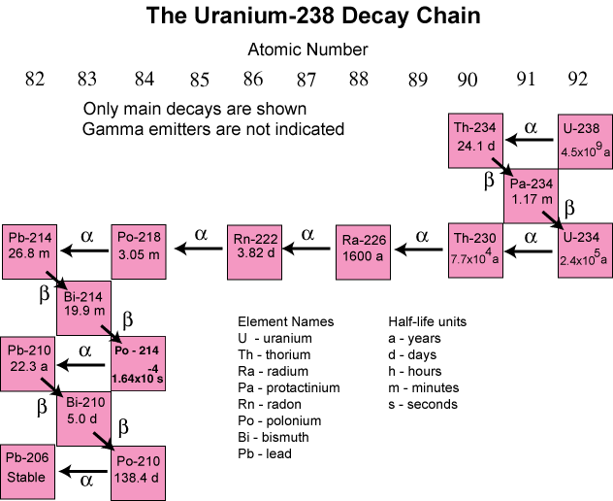
12
Notes:
Natural uranium is abundant in the Earth’s crust and consists of two very long-lived radioactive isotopes – U-235 and U-238.
Both isotopes decay to a stable isotope of lead as shown for U-238 in this graphic.
All the decay chain radioisotopes contribute to natural background radiation.

Slide 13
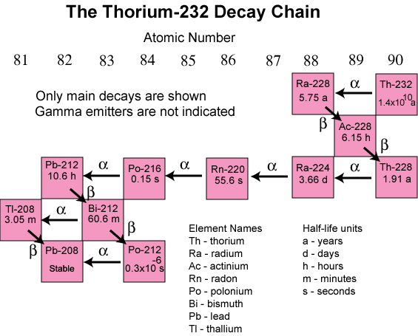
13
Notes:
Thorium-232 is abundant in the Earth’s crust due to its extremely long half-life of 14 billion years.
It decays to a stable isotope of lead as shown in this graphic.
As with the U-238 decay chain, all the Th-232 decay chain radioisotopes contribute to natural background radiation.

Slide 14
Internal Radiation

Slide 15
Natural Radioactivity in the Body
Total Activity of Nuclide
Nuclide in the Body
Uranium 30 pCi (1.1 Bq)
Thorium 3 pCi (0.1 Bq)
Potassium-40 120,000 pCi (4440 Bq)
Radium-226 30 pCi (1.1 Bq)
Carbon-14 100,000 pCi (3700 Bq)
Tritium 600 pCi (22.2 Bq)
Polonium 1,000 pCi (37 Bq)
Estimated concentrations of radionuclides calculated for a 70-kilogram adult based on ICRP 30 data
15
Notes:
We are all radioactive. We survive and thrive with rather remarkable quantities of radioactive materials in our bodies.
Natural radioactive material in our bodies constitutes about 10% of our natural background radiation exposure.
Because we are carbon-based life forms, our bodies contain a lot of carbon-14 atoms. The normal activity of C-14 in the body is between 3,000 and 4,000 Bq.
Our bodies also contain a lot of potassium. Anything containing potassium contains potassium-40. Its half-life is about 1.3 billion years, so it has been around forever.
pCi – pico Curie (10⁻¹² Curie)
Bq – Becquerel (one disintegration per second)
Reference: International Commission on Radiological Protection Publication 30, Limits for Intakes of Radionuclides by Workers, 1979

Slide 16
Radioactive Elements in Human Body
Radioactive Isotope | Half Life (years) | Isotope Mass in the Body (grams) | Element Mass in the Body (grams) | Activity within the Body (Disintegrations/sec)
Potassium-40 | 1.26 x 10⁹ | 0.0165 | 140 | 4,340
Carbon-14 | 5,730 | 1.6 x 10⁻⁸ | 16,000 | 3,080
Rubidium-87 | 4.9 x 10¹⁰ | 0.19 | 0.7 | 600
Lead-210 | 22.3 | 5.4 x 10⁻¹⁰ | 0.12 | 15
Tritium (H-3) | 12.43 | 2 x 10⁻¹⁴ | 7,000 | 7
Uranium-238 | 4.46 x 10⁹ | 1 x 10⁻⁴ | 1 x 10⁻⁴ | 3 - 5
Radium-228 | 5.76 | 4.6 x 10⁻¹⁴ | 3.6 x 10⁻¹¹ | 5
Radium-226 | 1,620 | 3.6 x 10⁻¹¹ | 3.6 x 10⁻¹¹ | 3
Source: http://www.rerowland.com/BodyActivity.htm
16
Notes:
This table, based on calculations by R.E. Rowland, shows the radioisotopes that produce most of the radioactive decays that take place within the adult body.
While there are many other radioisotopes in the body in addition to those listed, most contribute very few decays per second, and are thus trivial in comparison.
One disintegration per second is a Becquerel.
Note: Some of the disintegrations per second (Becquerels) in this table differ from the previous slide, especially for C-14. Data in the previous slide is from ICRP 30 (1979), whereas data in this slide is from NCRP Report No. 94 (1987).
Additional reference: NCRP Report No. 94, Exposure of the Population in the United States and Canada from Natural Background Radiation, 1987

Slide 17
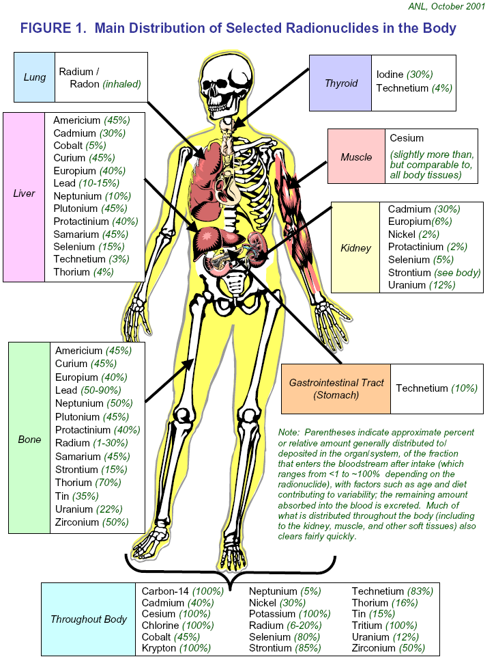
Distribution of Selected Radionuclides in Body
17
Notes:
This graphic illustrates how chemical elements, both stable and radioactive isotopes, are distributed in different parts of the body.
Soluble chemical elements enter the bloodstream via absorption through the GI tract (with differing absorption percentages), and are distributed throughout the body. The numbers in parentheses in the graphic indicate the approximate percent or relative amount generally distributed to (or deposited in) the subject organ or system, of the fraction that enters the bloodstream after intake (which ranges from <1 to ~100% depending on the chemical element). Factors such as age and diet contribute to the variability of element concentration.
Element amounts that remain in the blood (not deposited in tissues and organs) are excreted. Much of what is distributed throughout the body by the blood (including to the kidney, muscle, and other soft tissues) also clears fairly quickly.

Slide 18
Inhaled Radiation (Radon)

Slide 19
What is Radon?
Radon is radioactive noble gas that enters atmosphere from radioactive decay of radium contained in rocks and soil
Radon-222 (Rn-222), with half-life of 3.8 days, arises from radioactive decay of radium-226
Radon-220 (Rn-220), with half-life of 55.8 seconds, arises from radioactive decay of radium-224
Internal exposure from radon and short-lived solid radioactive isotopes (next slide) remaining in lung tissue from radon radioactive decay constitute largest contributor to U.S. natural background radiation exposure

Slide 20
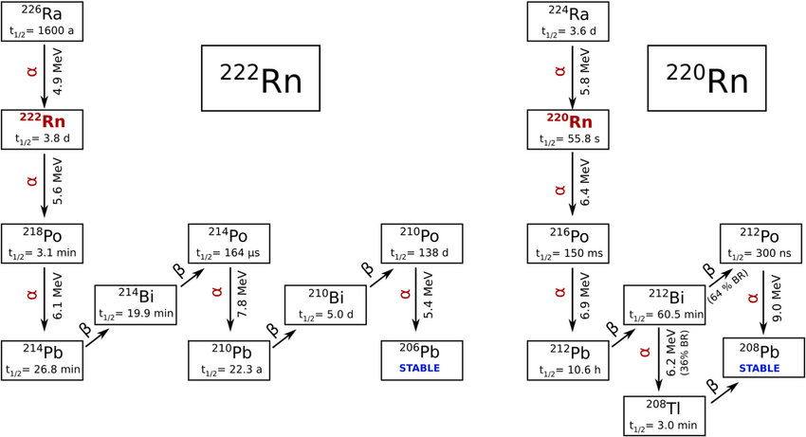
Radon Decay Chains
20
Notes:
Radium-226 is one of the daughter radioisotopes in the uranium-238 decay chain.
Radium-224 is one of the daughter radioisotopes in the thorium-232 decay chain.

Slide 21
What is Radon? (cont.)
Half-lives of Rn-222 and Rn-220 isotopes as well as various decay radioisotopes important for determining relative contributions to bronchial dose
  Timeframe for diffusion of short-lived Rn-220 in soils results in some decay to non-gaseous radioisotopes before reaching soil surface
  Very short half-life of Rn-220 means little travel distance from origination site to immediate environment of human beings before decay to non-gaseous radioisotopes
Half-life differences of radioisotopes from Rn-222 and Rn-220 decay produce very different atmospheric distributions of potentially aerosolized decay products

Slide 22
What is Radon? (cont.)
Exposure mostly from alpha particles emitted by solid radioisotope progeny of radon decay in lungs; some beta particles and gamma-rays also emitted
  General agreement that alpha particles responsible for lung cancer seen in miners
Almost all radon level measurements expressed as concentration of radon in picocuries per liter (pCi/L) of air or in becquerels per cubic meter (Bq/m³) of air

Slide 23
Radon Exposure in a Nutshell
Radon exposure is chronic low-dose ionizing radiation exposure
Chronic low-dose radiation exposures do not inhibit ability of body’s adaptive protection mechanisms to repair radiation-induced cell damage (otherwise, we would not be here)
Exposure to radon (indoor and outdoor) does not result in adverse health effects

Slide 24
Medical Radiation

Slide 25
Medical Radiation Exposure
Medical source most widely varying constituent of natural background ionizing radiation exposure found in literature
  Most common exposure from teeth and broken bone low-dose x-rays
  Nuclear medicine diagnostic imaging procedures result in harmless low-dose exposures
  High-dose exposures from therapeutic radiology procedures (cancer treatment)
  Estimate of ≈50 mrem annual exposure likely average for U.S. population

Slide 26
Consumer Product Radiation

Slide 27




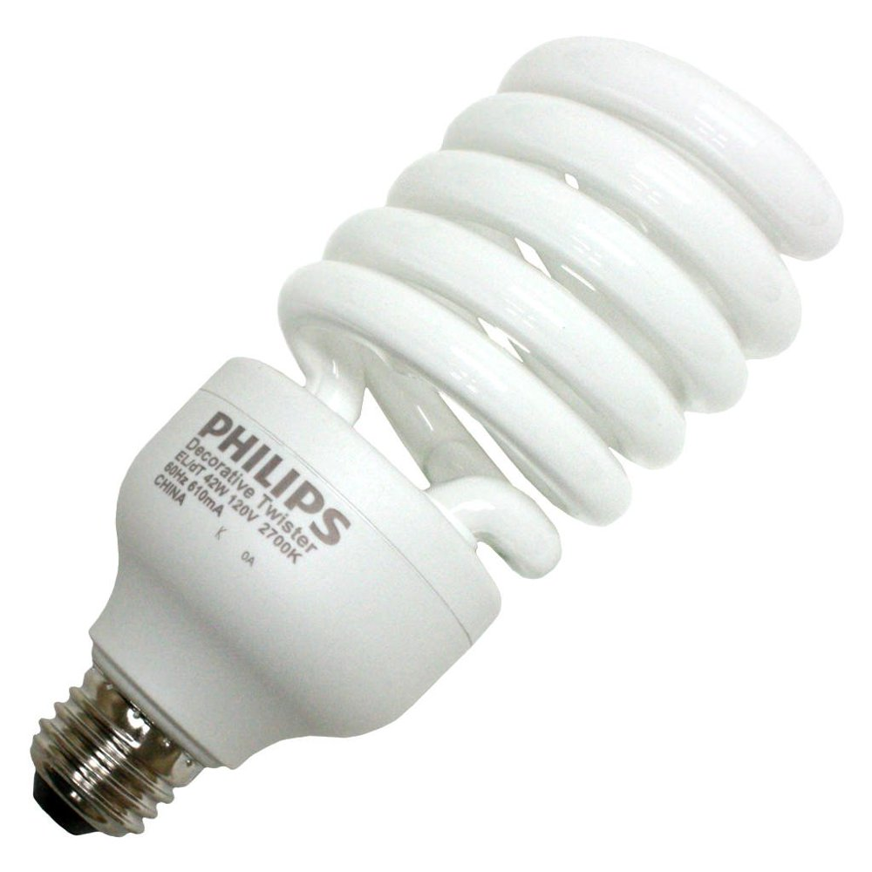
Radiation in the Home
27
Notes:
Radiation from consumer products is one of the smallest contributors to our natural background radiation exposure.
Radioactive consumer products that can be found in American homes include smoke detectors, kitty litter, granite countertops, luminescent clocks, and compact fluorescent light bulbs.
The radioactivity of such consumer products is below regulatory concern and present no health risk to people.

Slide 28
Natural Radioactivity in
Consumer Products
Consumer Product | Natural Radionuclide
Smoke detector | ²⁴¹Am
Watches and clocks | ³H, ¹⁴⁷Pm
Photocopier | ²¹⁰Po
Granite countertop | ²³⁸U, ²³⁴U, ²³²Th, ²³⁰Th, ²²⁶Ra
Compact fluorescent light bulbs | ¹⁴⁷Pm, ⁸⁴Kr, ³H
Ceramic materials (e.g., tiles) | ²³⁸U, ²³⁴U, ²³²Th, ²³⁰Th, ²²⁶Ra, ⁴⁰K
Glassware | ²³²Th, ²²⁸Ra, ⁴⁰K
Water softener salt | ⁴⁰K
28
Notes:
This table shows the natural radionuclides found in some common consumer products.
Potassium-40 is ubiquitous in Earth’s environment and is found in almost every kind of consumer product made from natural Earth materials.

Slide 29

Radioactive Building Materials
Steel
Ceramic
Marble
Drywall
Granite
Plaster/Spackle
Sandstone
Concrete Block
Wood
Brick
Cement
Small amounts of naturally radioactive elements like uranium, thorium, and their radioactive decay products are found in common building materials.
29
Notes:
This slide illustrates the kinds of radioactive construction materials used in commercial and residential buildings.

Slide 30
Typical Radioactivity in
Common Building Materials
U-238 Th-232 K-40
Material (pCi/g) (pCi/g) (pCi/g)
Granite 1.7 0.22 32
Sandstone 0.2 0.19 11
Cement 1.2 0.57 6.4
Limestone concrete 0.8 0.23 2.4
Sandstone concrete 0.3 0.23 10
Dry wallboard 0.4 0.32 2.4
By-product gypsum 5.0 1.8 0.2
Natural gypsum 0.4 0.2 4
Wood -- -- 90
Clay Brick 3 1.2 18
Estimates of concentrations of uranium, thorium and potassium in
building materials (NCRP 94, 1987)
30
Notes:
Building materials such as granite, cement, concrete, and gypsum contain measurable amounts of radioactive uranium, thorium, and potassium.
Note that our homes, office buildings, and other structures we inhabit emit radiation from the materials used in their construction.
Note also that Grand Central Station could not be licensed as a nuclear power plant because its granite structure emits too much radiation.
pCi/g – picoCuries per gram
Reference NCRP 94: National Council on Radiation Protection and Measurements Report No. 94

Slide 31
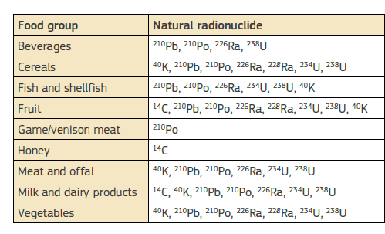
Natural Radioactivity in Food
31
Notes:
Much of what we eat is radioactive.
This table shows the radionuclides found in various food groups.

Slide 32
Natural Radioactivity in Food (cont.)
Food | ⁴⁰K (βγ) pCi/kg | ²²⁶Ra (α) pCi/kg
Brazil Nuts | 5600 | 1000-7000
Lima Bean | 4640 | 2-5
Banana | 3520 | 1
White Potato | 3400 | 1-2.5
Carrot | 3400 | 0.6-2
Red Meat | 3000 | 0.5
Low-sodium Salt | 3000 | ---
Beer | 390 | ---
Drinking Water | --- | 0-0.17
32
Notes:
As noted previously, potassium-40 is ubiquitous in our environment, which also includes our diet. Radium-226 is also absorbed into food products grown in the soil.
References
Handbook of Radiation Measurement and Protection, Brodsky, A., CRC Press 1978
Environmental Radioactivity from Natural, Industrial and Military Sources,
Eisenbud, M and Gesell T., Academic Press, Inc. 1997

Slide 33
Conclusion
Humans have lived in world of radioactive elements for extremely long time
Fact that humans continue to survive and thrive in low-dose radiation environment is testament to fact that naturally occurring ionizing radiation not health risk
Low-dose radiation from medical procedures not uniquely different from natural background radiation and not harmful to human health

