Slide 1
Radiation Hormesis
Beneficial Effects of Low-Dose Radiation
Jeffrey A. Mahn
Nuclear Engineer (Retired)
Albuquerque, NM USA
jamahn47@gmail.com

Slide 2
What is Hormesis?
Hormesis – a fundamental evolutionary-based biological concept that enhances survival and biological performance across wide range of activities via upregulation of adaptive response mechanisms following exposure to low levels of harmful stressor agents
Calabrese, E.J. and Agathokleous, E., Hormesis: Transforming Disciplines That Rely on the Dose Response, IUBMB Life, June 28, 2021

Slide 3
Adaptive Response Mechanismsª
At least 6 different low-dose and low-dose-rate radiation adaptive response mechanisms account for lower cancer rates and greater longevity in humans
Stimulation of adaptive response mechanisms by low radiation doses repair more than 99.9% of DNA damage
Adaptive response mechanisms include:
enhanced production of antioxidant enzymes⁶
enhanced production of DNA repair enzymes⁵
Notes:
Slide reference:
a. Hugh Henry, Radiation Effects on People – The Revolution in Radiobiology, 2024

Slide 4
Adaptive Response Mechanisms (cont.)
Response mechanisms (cont.):
slowed mitosis (permits DNA repair enzymes to accomplish their function)⁶
induced apoptosis (destroys unrepaired cells)
bystander effects (neighboring undamaged cells trade chemical messengers to enhance apoptosis in cells with unrepaired DNA)
enhanced immune system surveillance and removal of remaining unrepaired cells⁷

Slide 5
Radiation Hormesis
Although large acute doses of ionizing radiation
can induce cancer, small doses reduce total
cancer mortality in both animals and humans^{1,2,3}
Concept of radiation hormesis currently applied
to physiological effects of acute low Linear
Energy Transfer (LET) radiation exposures in
range of 1 to 50 cGy (or 50 rads) of total absorbed dose
Gamma-rays and x-rays constitute low LET
radiation, for which 1 cGy = 1 rad = 1 rem

Slide 6
Radiation-induced Adaptive Protection
Response of body’s adaptive protection systems dependent on dose-rate, as well as total dose
Probability of radiation-induced adaptive
protection measurably outweighs probability
of damage from acute whole-body doses
well below 0.2 Gy of low LET radiation
(next slide graphic)⁴
Notes:
Numerous studies support this dose-response conclusion.

Slide 7
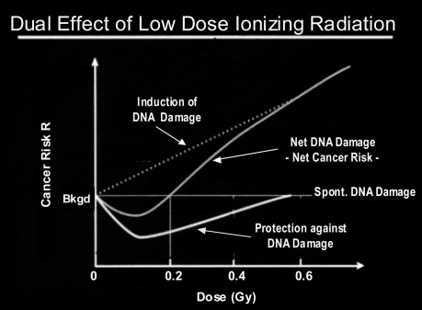
Ref. Evidence for Beneficial Low Level Radiation Effects and Radiation Hormesis, L.E. Feinendegen, MD, The British Journal of Radiology, 78 (2005), pp. 3–7
7
Notes:
This graphic shows that radiation-induced hormesis
is applicable to physiological effects of acute, low-dose radiation in the range of 0.01 to 0.5 Gy of total absorbed dose, and
neutralizes radiation-induced DNA damage for acute doses up to 0.2 Gy.
0.2 Gray (20 rem) is effectively the absorbed dose threshold for radiation-induced adverse health effects.

Slide 8
Radiation Exposure and Cancer Mortality Observations

Slide 9
U.S. Radiation Exposure vs. Cancer Mortality
Next two slides show areas of highest gamma-ray and cosmic-ray radiation exposure in U.S. also areas of lowest cancer mortality

Slide 10
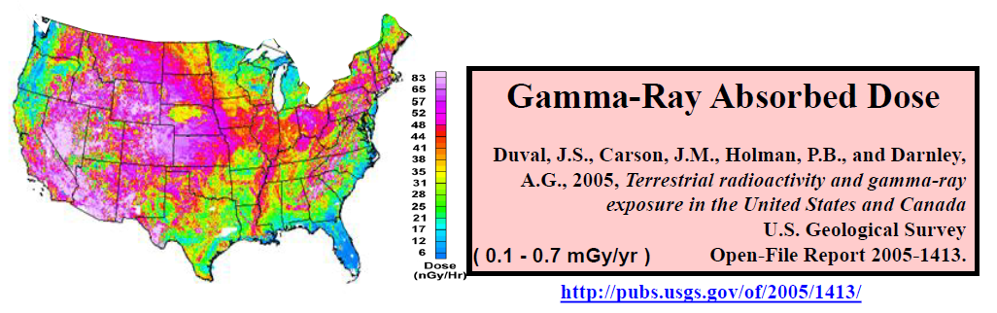
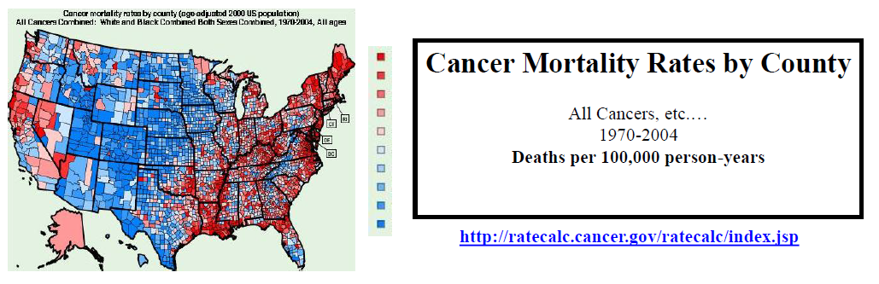
Gamma-Ray Dose vs. Cancer Mortality Rate
(0 – 325 deaths per 100,000 p-y)
10
Notes:
Gamma-Ray Absorbed Dose
Gamma-ray dose rates derived from measurements taken by airborne gamma-ray spectrometry (AGRS)
Grids of 5-20 km flight paths across U.S. and Canada
Elements of most importance: potassium, thorium, and uranium
Highest gamma-ray exposures in Midwest and western U.S.
Cancer Mortality Rates
U.S. average: 207 deaths per 100,000 person-years
Lowest cancer mortality rates in Midwest and western U.S., where terrestrial gamma-ray exposures are highest

Slide 11
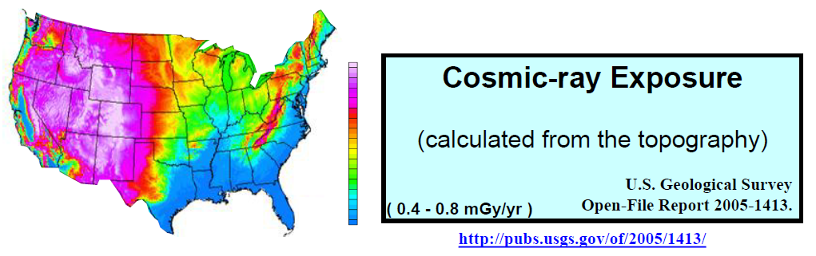
Cosmic-Ray Exposure vs. Cancer Mortality Rate
(0 – 325 deaths per 100,000 p-y)
11
Notes:
Cosmic-Ray Exposure
Cosmic-ray exposure calculated from topography
Elevation data taken from the world database of 1 km digital elevation and were re-gridded using a 2 km grid cell
Equations published by Boltneva, Nazarov, and Fridman (1974)
Highest cosmic-ray exposures in Midwest and western U.S.
Cancer Mortality Rates
U.S. average: 207 deaths per 100,000 person-years
Lowest cancer mortality rates in Midwest and western U.S., where cosmic-ray exposures are highest

Slide 12
Background Radiation Differences on Annual Cancer Mortality
Rates per 100,000 for 46 U.S. States over a 17-Year Period
190
180
LNT prediction
170
160
U.S. average
150
Mortality Rate
140
130
120
110
(270 mrem/y)
100
2.4
2.6
2.8
3.0
3.2
3.4
3.6
Background Dose (mSv/y)
12
Notes:
This graphic shows that for natural background doses below 270 mrem per year, 22 of 38 states had cancer mortality rates below the U.S. average.
States with annual background doses greater than 270 mrem had lower cancer mortality rates than the U.S. average, thus supporting low-dose radiation hormesis.
Cancer mortality predictions based on the linear no-threshold (LNT) dose-response model show the inapplicability of this model to low-dose/dose-rate radiation.

Slide 13
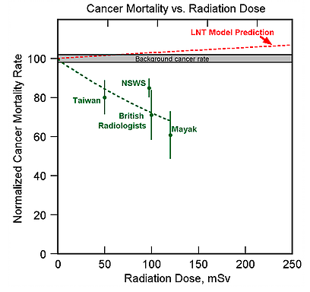
13
Notes:
This graphic also shows the inapplicability of the LNT dose-response model to low- dose/dose-rate radiation.
The LNT model cancer mortality predictions are from the Biological Effects of Ionizing Radiation (BEIR) VII Report (NRC, 2006)
Data points supporting low dose radiation hormesis are for the following radiation exposure studies:
Taiwan – residents of Co-60 contaminated apartments in Taiwan (Hwang, 2006)
NSWS – radiation workers in Nuclear Shipyard Worker Study (Sponsler, 2005)
British Radiologists – British radiologists who entered service during the period 1955-1979 (Berrington, 2001)
Mayak – residents of Russian villages near the Mayak Nuclear Weapons Facility following a radiation release accident in 1957 (Kostyuchenko, 1994)

Slide 14
Idealized Dose Response Curve for Ionizing Radiation
Notes:
Based on the reality of radiation hormesis, we can construct an idealized radiation dose response curve.

Slide 15
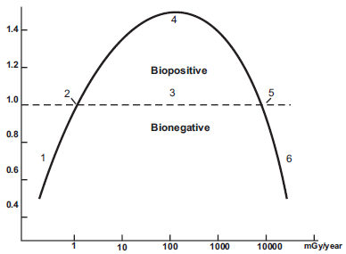
Idealized Dose-Response Curve²⁵ for Chronic Radiation Exposure
Y-axis approximates responses compared with controls (dashed line – about 1 mGy/yr)
X-axis estimates chronic whole-body doses (1 – deficient region, 2 – ambient dose, 3 – hormetic region, 4 – optimum dose, 5 – zero equivalent point, 6 – harmful region)
Relative Health Response
Whole-body Dose (mGy/year)
15
Notes:
This graphic illustrates the idealized dose-response curve for chronic, whole-body radiation exposures.
The beneficial effects of low radiation doses are typically observed soon after initial exposure.
From this graph, the optimum chronic dose-rate for increased health and longevity would be about 100 mGy/yr, and the threshold for increased cancer risk would be about 10,000 mGy/yr.

Slide 16
Idealized Dose-Response Curve (cont.)
Dose not cumulative for chronic low-dose/dose-rate ionizing radiation
Body’s natural defense mechanisms for remediating cell damage not inhibited by low doses of radiation and can repair radiation-induced cell damage in about 24 hours; no long-term accumulation of cell damage
More meaningful rate for communicating chronic ionizing radiation exposure would be milli-gray per hour
Response of body’s natural defense mechanisms to low-dose radiation not acknowledged by agencies that regulate radiation exposures
Agencies essentially deny validity of data exhibiting beneficial biological effect from low-dose/dose-rate ionizing radiation (biopositive region of dose-response curve)

Slide 17
Idealized Dose-Response Curve (cont.)
Radiation-induced hormesis more appropriately associated with hourly dose-rate
Begins to appear at chronic whole-body low dose-rate threshold approximately 0.0001 mGy/hr
Optimum ionizing chronic radiation dose-rate associated with minimal cancer death rate and maximal life span about 0.01 mGy/hr
Increased rates of cancer and congenital defects associated with chronic dose-rates >1 mGy/hr
Notes:
This slide summarizes the important dose rates on the dose-response curve in terms of the more meaningful rate of milli-gray per hour.

Slide 18
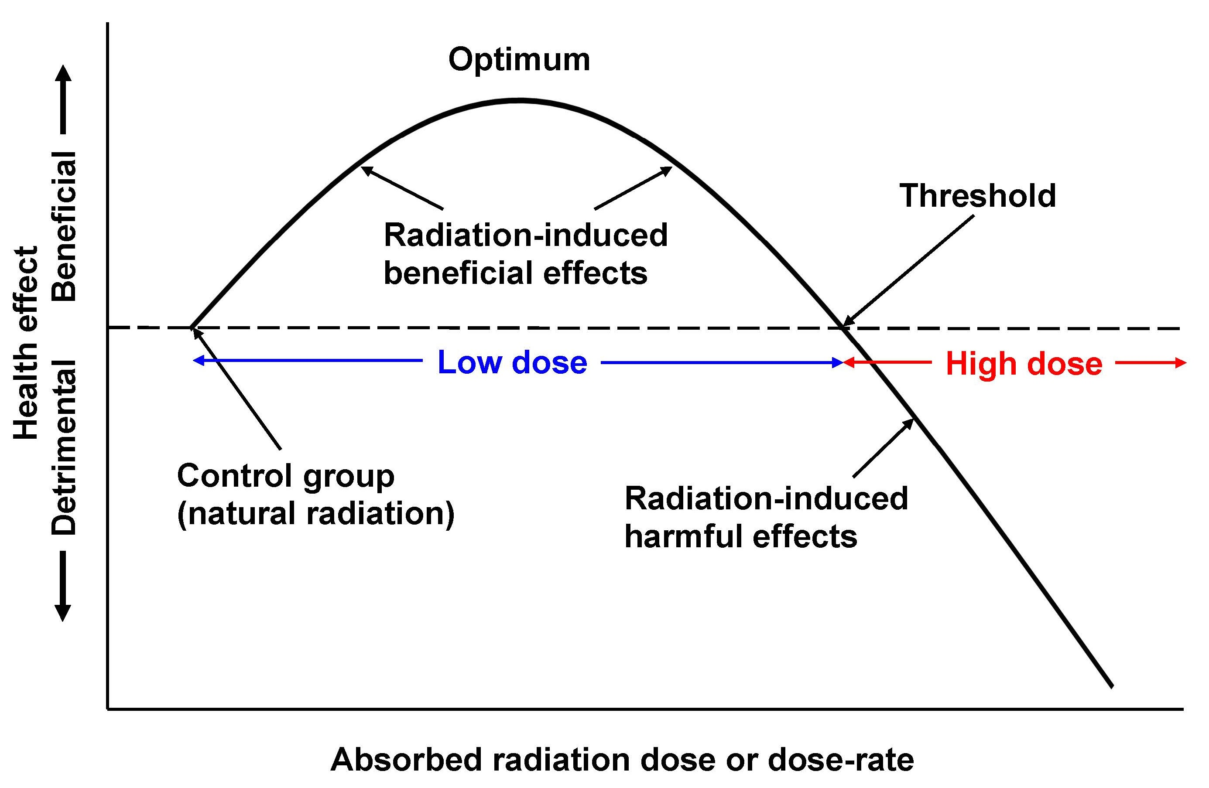
Idealized Dose-Response Curve (cont.)
18
Notes:
This graphic shows another way to look at the idealized dose-response curve for chronic, whole-body radiation exposures, with the ambient dose being natural background radiation. The upper threshold of the low dose region would be the dose above natural background that produces the same health effects that background radiation does. This dose would define the threshold of adverse health effects or the boundary between low dose and high dose regions.
Doses below the threshold dose (the low dose region) would result in more beneficial health effects compared to effects attributable only to natural background, and doses above the threshold dose (the high dose region) would result in detrimental health effects compared to natural background.
Since annual natural background dose around the world varies by as much as a factor of 70 (e.g., Ramsar, Iran vs. areas of U.S.), an upper threshold dose (or dose-rate) would likely be specified relative to the highest background dose. Based on the idealized dose-response curve numbers provided by T.D. Luckey (Ref. 1), the upper threshold dose-rate would be about 1 mGy per hour (about 100 mrem per hour). This is consistent with the threshold dose rate illustrated in the dose-response curve of Slide 15.

Slide 19
NRC Annual Limit for General Public
World-wide Natural Bkgnd. Annual Average
NRC Limit for Pregnant Female Radiation Worker (9 mo.)
NRC Annual Limit for Radiation Worker
Annual Hormetic Optimum
Maximum Annual Natural Bkgnd. in Guarapari, Brazil
Maximum Annual Natural Bkgnd. in Ramsar, Iran
Increased Cancer, Congenital Defect Risk (Annual)
Body’s adaptive protection mechanisms not overwhelmed by chronic low-dose radiation exposures <100 rem per year
19
Notes:
The point of this figure is to understand that chronic radiation exposures of less than 100 rem over a 12-month period (about 8.3 mrem/hr or 0.083 mGy/hr) will not increase the risk of cancer or congenital defects.
In other words, the body’s adaptive protection mechanisms are not overwhelmed by chronic low dose radiation exposures.
The threshold for increased risk of cancer or congenital defects indicated by the bar on the right in this histogram, is consistent with the upper threshold dose rate of the idealized dose-response curve (about 1 mGy/hr).

Slide 20
Most Nuclear Medicine Diagnostics
Maximum for Nuclear Medicine Diagnostics
Maximum for No Excess Cancers or Congenital Defects
Onset of Radiation Sickness; Increased Cancer, Leukemia, Lymphoma, Cataracts, Genetic Def. Risk
LD50/30
Body’s adaptive protection mechanisms not overwhelmed by acute radiation doses <20 rem (0.2 Gy)
20
Notes:
This figure shows that acute radiation doses of less than about 20 rem (0.2 Gy) do not increase the risk of cancer or congenital defects.
Here as well, the body’s adaptive protection mechanisms are not overwhelmed by acute radiation doses of less than 20 rem.
LD_{50/30} is the acute dose that without treatment will be lethal to 50% of those exposed within 30 days.

Slide 21
Reasonable Radiation Thresholds Based on Hormesis Data
Acute whole-body dose threshold for
increased cancer risk approximately 200
mGy (20 rem)⁴
Longevity most important health effect of
chronic exposure to gamma-ray radiation
Reasonable dose-rate threshold for reduced lifespan around 700 mGy/year or about 0.08 mGy/hr (8 mrem/hr)³²
Notes:
For practical purposes, an acute radiation dose less than or equal to 200 mGy should be considered a low dose. For such a dose there is no evidence of any direct or indirect adverse health effects, and in fact, there is evidence that such a dose has beneficial health effects.
An acute dose higher than 200 mGy would then be considered a high dose, with the possibility of adverse health effects.
There is no evidence that a chronic radiation dose less than or equal to 600 mGy per year (≈ 0.07 mGy per hour) has any direct or indirect adverse health effect, and a chronic dose of about 0.07 mGy/hr appears to promote optimal lifespan. (Ref. 32)

Slide 22
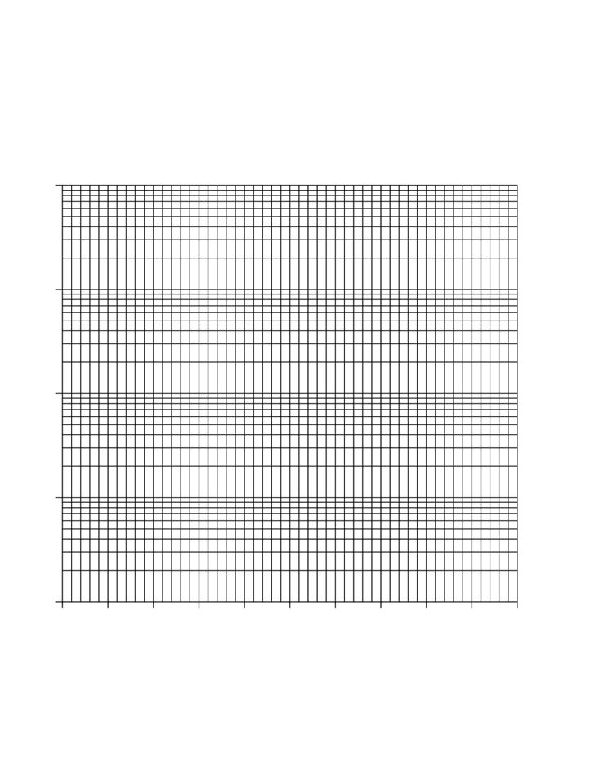
Chronic Exposures in Perspective
100
High Dose-Rate Threshold (80 μGy/hr)
Ramsar, Iran Max. Natural Background (30 μGy/hr)
10
U.S. public chronic exposures to ionizing radiation two orders of magnitude below threshold for lifespan shortening
Dose-rate in Microgray/hour
1
U.S. Average Natural Background (0.4 μGy/hr)
0.1
22
Notes:
Note the logarithmic scale and doses in microgray per hour so that order-of-magnitude differences between normal low-dose-rate exposures and the high-dose-rate threshold are obvious.

Slide 23
Radiation Exposure Studies Supporting Hormesis
Radium Dial Painters
Atomic Bomb Survivors
Nuclear Shipyard Workers
Other Nuclear Workers
Canadian Fluoroscopy Study
Non-Hodgkin’s Lymphoma Trial
Taiwan Apartment Dwellers
Notes:
Let’s look at some radiation exposure studies that support hormesis.

Slide 24
Radiation Hormesis Summary
Concept of radiation hormesis applicable to physiological effects of chronic, low-LET radiation in range of 1 to 50 cGy of total absorbed dose
Probability of radiation-induced adaptive protection measurably outweighs that of damage from acute doses below 0.2 Gy⁴ of low-LET radiation and from chronic dose-rates below 0.08 mGy/hr³²
Notes:
Paracelsus (16th century), the father of toxicology, is credited with the observation that the dose is what makes the poison.
Small amounts of potentially toxic chemicals (e.g., arsenic and mercury) are necessary for life to exist, while amounts above some threshold are toxic.
Ionizing radiation is no different than other potential toxins. Small doses are essential to life, while doses above some threshold increase cancer risk.
Note that the U.S. average dose-rate for (chronic) natural background radiation is around 0.0004 mGy/hr, well within the range of effective adaptive protection.

Slide 25
Radiation Hormesis Summary (cont.)
Evidence of hormesis effect of low-dose radiation from numerous radiation exposure studies
Radiation is poor mutagen and carcinogen
Low-dose responses seem to be protective and high-dose responses damaging, thus body responds differently to high and low doses

Slide 26
References
1. Luckey, T.D., Radiation Hormesis, CRC Press, Boca Raton, 1991
2. Luckey, T.D., “Radiation Hormesis in Cancer Mortality,” Int. J. Occup. Med. Tox., 3:175-191, 1994
3. Luckey, T.D., “Low-Dose Irradiation Reduces Cancer Deaths,” Rad. Protect. Manag., 14:58-64, 1997
4. Evidence for Beneficial Low Level Radiation Effects and Radiation Hormesis,
L.E. Feinendegen, MD, The British Journal of Radiology, 78 (2005), pp. 3–7
5. Ikushima, T., Aritomi, H. and Morisita, J., Radioadaptive Response; Efficient Repair of
Radiation Induced DNA Damage in Adapted Cells, Mutation Research, Vol. 358, pp. 193
198 (1996)
6. Feinendegen, L. E., Muhlensiepen, H., Bond, V. P., Sonhaus, C. A., Intracellular
Stimulation of Biochemical Control Mechanisms, Health Physics, Vol. 52, pp. 663-669,
1987
7. Luckey, T. D., “Physiological Benefits from Low Levels of Ionizing Radiation,” Health
Physics, Vol. 43, pp. 771-789, (1982)
8. Rowland, R.E., Radium in Humans: a Review of US Studies, ANL/ER-3 UC-408,
Argonne National Laboratory, 1994
9. Spiers, F.W., et. al., “Leukemia Incidence in the U.S. Dial Workers,” Health Phys. Soc., 44:1, 1983

Slide 27
References (cont.)
10. Baverstock, K.F. and Papworth, D., “The UK Radium Luminizer Survey,” pp.72-76 in
Taylor, D.M., Mays, C.W., Gerber, G.B. and Thomas, R.G., eds., Risks from Radium and
Thorotrast, British Institute of Radiology, London, 1989
11. R.D. Evans, 1983. “Highlights of the Meeting—Invited Summary,” In Radiobiology
of Radium and the Actinides In Man, Proc. of an Int’l Conf., Health Phys., Vol. 44 (Supp 1),
pp. 571-573
12. R. Thomas, 1994. “The U. S. Radium Luminisers: A Case for a Policy of ‘Below Regulatory Concern,’&” J. Radiol. Prot., Vol. 14, No. 2, pp. 141-153
13. R. Rowland, 1997. “Bone Sarcoma in Humans Induced by Radium: A Threshold Response?”
in Proc. of the 27th Ann. Meeting, European Society for Radiation Biology,
Radioprotection colloquies, Vol. 32CI, pp. 331-338
14. Shimizu, Y., Kato, H., Schull, W.J. and Mabuchi, K., “Dose-Response Analysis Among Atomic
Bomb Survivors Exposed to Low-Dose Irradiation,” pp.71-74 in Sugahara, T., Sagan, L. and
Aoyama, T., eds., Low-Dose Irradiation and Biological Defense Mechanisms, Excerpta
Medica, Amsterdam, 1982
15. Kondo, S., Health Effects of Low-Level Radiation, Kinki University Press, Osaka, 1993
16. UNSCEAR 1994. Annex B: Adaptive Responses to Radiation in Cells and Organisms, in
Sources and Effects of Ionizing Radiation. Report of the United Nations Scientific Committee
on the Effects of Atomic Radiation to the United Nations General Assembly, pp. 185–272.

Slide 28
References (cont.)
17. Zbigniew Jaworowski, Ionizing Radiation and Radioactivity in the 20th Century
18. Schull, W. J., Otakee, M. and Neel, J.V., “Genetic Effects of the Atomic Bomb: Reappraisal,” Science, 213:1220-1227, 1981
19. J.R. Cameron, 1992. “The Good News about Low Level Radiation Exposure: Health
Effects of Low Level Radiation in Shipyard Workers,” Health Phys. Soc. Newsletter, Vol.
20, p. 9
20. T.D. Luckey, 1997, “Ionizing Radiation Decreases Human Cancer Mortality Rates,” in
Low Doses of Ionizing Radiation, Biological Effects and Regulatory Control,
IAEA-TECDOC-976, IAEA-CN-67/64, pp. 227-230
21. Radiation, Science, & Health, 1998. Low-Level Radiation Health Effects: Compiling the
Data, ed., J. Muckerheide (Needham, Mass.: Radiation, Science, and Health)
22. G. Howe, 1995. “Lung Cancer Mortality Between 1950 and 1987 after Exposure to
Fractionated Moderate-Dose-Rate Ionizing Radiation in the Canadian Fluoroscopy Cohort
Study, and a Comparison with Mortality in the Atomic Bomb Survivors Study,” Radiat.
Res., Vol. 142, pp. 295-304
23. Interview with Sadao Hattori, “Using Low-dose Radiation for Cancer Suppression and
Revitalization,” 21st Century Science & Technology, Summer 1997
24. Adapted from Sakamoto et al., 1997, J. Jpn. Soc. Ther. Radiol. Oncol., Vol. 9, pp. 161-175
25. Is Chronic Radiation an Effective Prophylaxis Against Cancer?, Journal of American
Physicians and Surgeons 9, No. 1, Spring 2004, pp 6-10

Slide 29
References (cont.)
26. The White Book of Radiation Contamination in Taiwan, Vol. II; Feb. 8, 1996
27. Taiwan Department of Health. Annual health and vital statistics: 1983-2001
28. Chapter 5, Radiation Hormesis, © M. Ragheb, 5/17/2012, (http://mragheb.com/NPRE%20402%20ME%20405%20Nuclear%20Power%20Engineering/Radiation%20Hormesis.pdf)
29. Evans, R.D., “Radium in Man,” Health Physics, 27:497-510, 1974
30. Luckey, T.D., “Radiation Hormesis Overview,” RSO Magazine, Vol. 8, No. 4, 2003
31. UNSCEAR (1958) Report of the United Nations Scientific Committee on
the Effects of Atomic Radiation; United Nations General Assembly
Official Records; Thirteenth Session, Supplement No. 17 (A/3838).
32. Cuttler, J.M., Feinendegen, L.E., and Socol, Y., Evidence of a Dose-Rate
Threshold for Life Span Reduction of Dogs Exposed Lifelong to γ-
Radiation, Dose-Response, Vol. 16(4), Oct-Dec 2018

