Slide 1
Radioisotope Applications
Jeffrey A. Mahn
Nuclear Engineer (Retired)
Albuquerque, NM USA
jamahn47@gmail.com

Slide 2
What Makes Some Atoms Radioactive?
Two main factors that determine nuclear instability are neutron/proton ratio and total number of nucleons in nucleus
Radioactive decay is process by which unstable atomic nuclei become more stable by emitting energy in the form of particles (α, β) and ionizing electromagnetic waves (γ-rays)
Notes:
Alpha particle and gamma-ray decay are governed by the electromagnetic and strong nuclear forces.
Beta particle decay is governed by the weak nuclear force.

Slide 3
Sources of Radioisotopes
Naturally occurring radionuclide decay chains (e.g., U-238, U-235, Th-232)
Cosmic radiation interactions with Earth’s atmosphere (e.g., C-14, P-32, Cl-36)
Nuclear reactors
Particle accelerators
Nuclear weapon tests

Slide 4
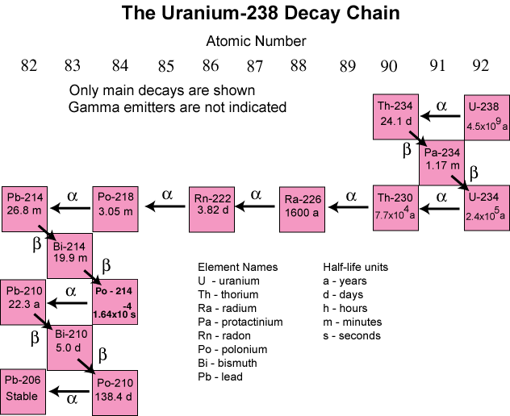
4
Notes:
Natural uranium is abundant in the Earth’s crust and consists of two isotopes –
U-235 and U-238.
Both isotopes decay to a stable isotope of lead as shown for U-238 in this graphic.
In addition to U-235 and U-238, some of the decay chain isotopes are long-lived and contribute to natural background radiation.
Thorium-232 is also abundant in the Earth’s crust and decays to a stable isotope of lead.

Slide 5
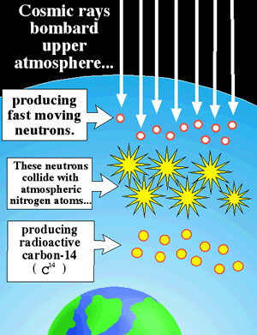
Atmospheric Carbon-14 Production
5
Notes:
Cosmic rays cause elemental transmutation in the atmosphere, in which secondary radiation generated by cosmic rays interacts with atomic nuclei in the atmosphere to generate different nuclides. The production of these nuclides varies slightly with short-term variations in solar cosmic ray flux, but is considered practically constant over long scales of thousands to millions of years.
Many so-called cosmogenic nuclides can be produced, but probably the most notable is carbon-14, which is produced by interactions with nitrogen atoms.
These cosmogenic nuclides eventually reach the Earth's surface and can be incorporated into living organisms.
Carbon-14 has a relatively long half-life and is plentiful in living organisms, but emits only a low energy beta particle, so contributes very little to natural background radiation.

Slide 6
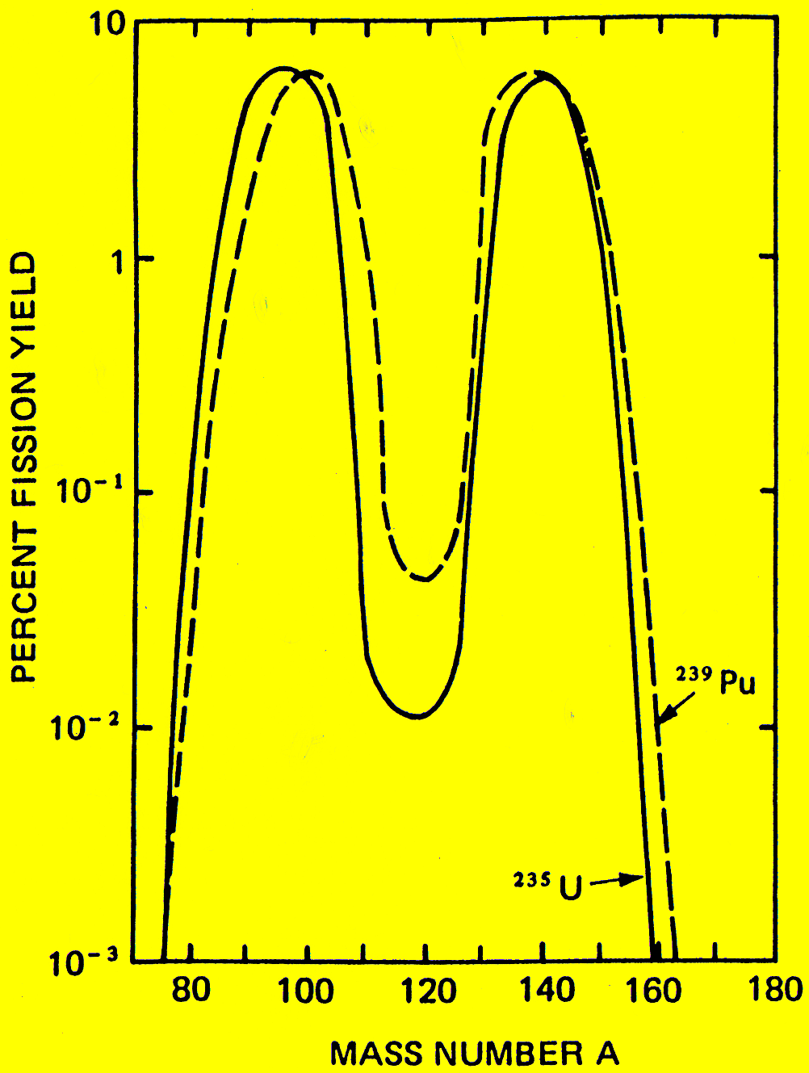
Fission Fragment Mass Distributions for U-235 and Pu-239
6
Notes:
This graphic shows that there is a distribution of radioactive fission fragments created when the uranium-235 or plutonium-239 fuel in a nuclear reactor fissions.
The most probable fission fragments from U-235 fission have mass numbers of 95 and 137, each with less than a 10% yield per fission event.
Fission fragments and their decay products are not released to the environment and therefore are not a component of background radiation.

Slide 7
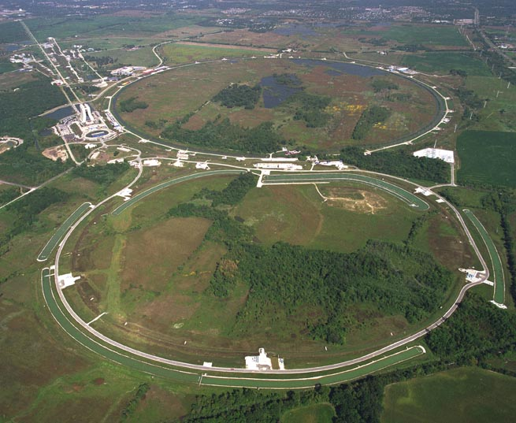
Particle Accelerator
7
Notes:
This is an aerial view of the Fermi accelerator in Batavia, Illinois.
Particle accelerators can be used to create a variety of radioactive isotopes.
Isotopes created in particle accelerators are not released to the environment and therefore do not contribute to background radiation.

Slide 8
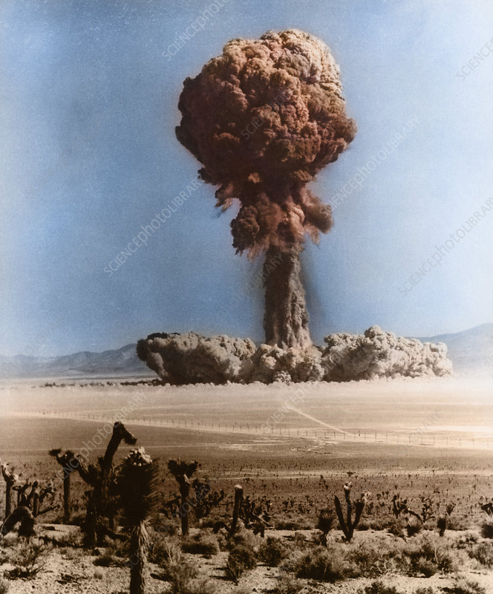
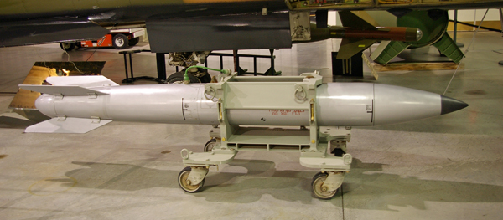
Nuclear Weapon Tests
8
Notes:
Nuclear weapon testing ceased in accordance with the Comprehensive Nuclear-Test-Ban Treaty of 1996.
Some of the long-lived radioactive isotopes from nuclear weapon testing still exist in the environment, but are so dilute as to be of no health consequence.

Slide 9
Radioisotope Applications
Nuclear medicine – diagnostic and therapeutic radiology
Modern industrial processes
radiography (imaging)
gauging applications (e.g., process material flow, density, or
thickness control)
process material fill height detection/control
flow tracing and mixing measurements
sterilization of medical supplies, bulk commodities, and food
products
non-destructive testing/evaluation (NDT/NDE) of materials
(e.g., material analysis, flaw detection in metal cables, metal
castings and welded joints)
Notes:
Nuclear medicine and modern industrial processes make extensive use of radionuclides.

Slide 10
Radioisotope Applications (cont.)
Geologic tools for
radiometric dating of water, soil, rocks, and organic matter
measurement of soil density and water content
measurement of soil erosion rates and deposition
tracking of materials through complex geologic pathways
(e.g., tracking of hazardous material movements in soils)
Humanities – identification of forged treasures, artifacts, or artwork (neutron activation analysis “fingerprinting”)
Notes:
Radionuclides are used as tools for various geological activities.
In neutron activation analysis a neutron source can be used to create radioactive isotopes of chemical elements in materials to identify the chemical composition of the material.

Slide 11
Radioisotope Applications (cont.)
Agricultural uses
research to develop hardier and more disease resistant
crops and livestock
study effectiveness of fertilizers
kill pests and parasites
insect and rodent control
Notes:
Radionuclides are also used as agricultural tools.

Slide 12
Nuclear Medicine Applications
Notes:
Many radioisotopes are used in nuclear medicine for medical diagnostic imaging and for measuring and monitoring various biological processes.

Slide 13
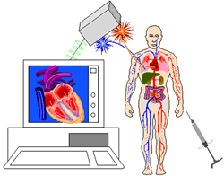
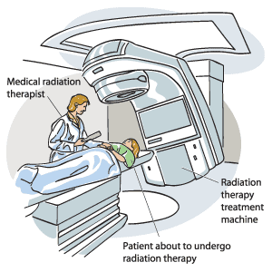
Types of Nuclear Medicine Doses
Diagnostic Radiology (imaging)
Therapeutic Radiology (cancer treatment)
13
Notes:
Ionizing radiation can be used for diagnostic imaging (Diagnostic Radiology) as well as for the treatment of cancer and other diseases (Therapeutic Radiology or Radiation Oncology). The difference is in the dose (next slide).

Slide 14
Note that the worldwide background dose range (provided as a point of reference) represents a chronic dose while the diagnostic imaging and cancer therapy dose ranges are for acute doses.
14
Notes:
This graphic illustrates the difference between a diagnostic imaging radiation dose and a cancer therapy radiation dose.
Note that the lower end of the therapy dose is more than 100 times higher than the upper end of the diagnostic imaging dose.
There is no evidence of adverse health consequences, much less cancer risk, from a diagnostic radiation imaging dose.

Slide 15
Technetium-99m
Most widely used diagnostic radioisotope worldwide
Readily detected gamma-ray
Decays to technetium-99 with 6-hour half-life
Tc-99m totally decayed in less than 3 days
Tc-99 radiological half-life of 213,000 years (low activity)
Emits only beta particles, no gamma-rays
Tc-99 biological half-life of 1 day (expelled from body quickly)
Poses little radiation burden on body

Slide 16
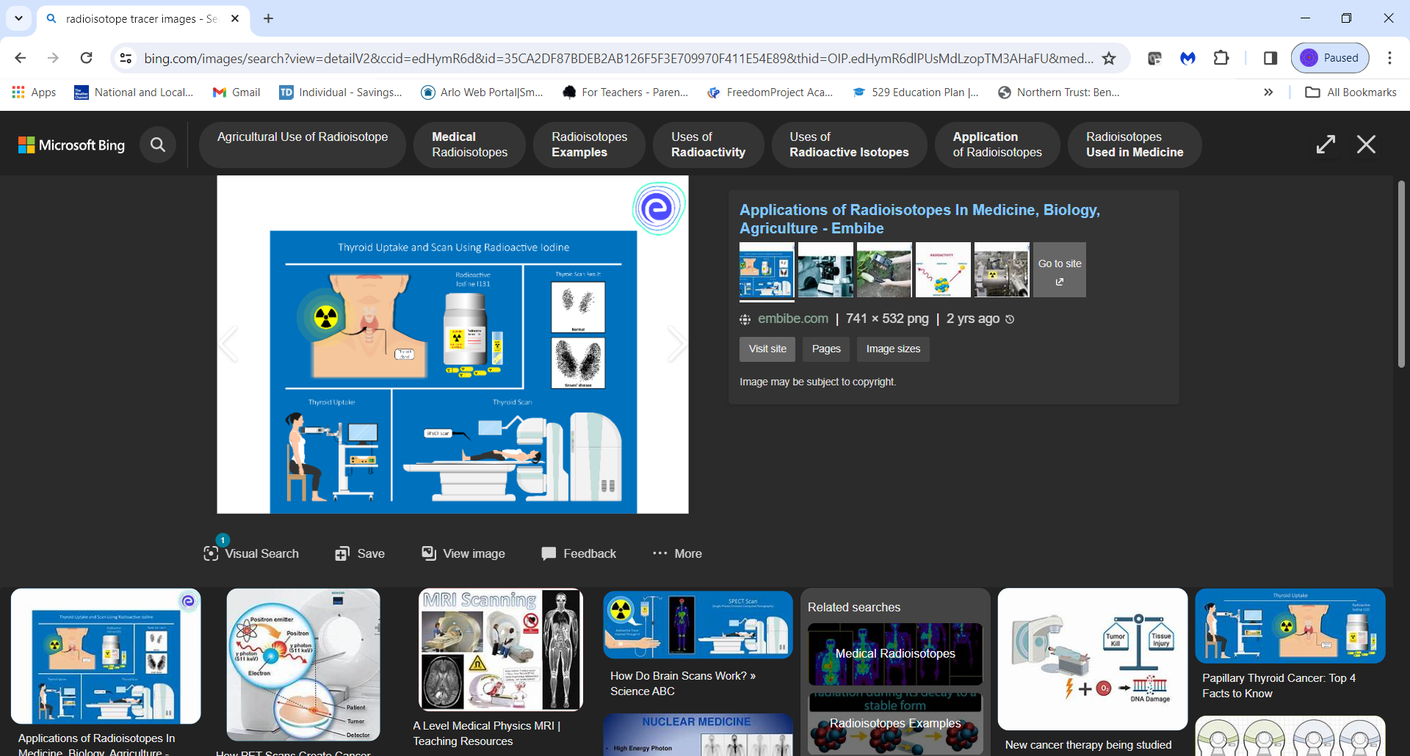
Thyroid Scan Using Radioactive Iodine
16
Notes:
This slide illustrates how radioactive iodine-131 is used to image the thyroid gland.
A radiotracer of iodine-131 is given to the patient orally.
A probe measures the amount of iodine uptake by the thyroid gland.
The scan then checks the distribution of the radioactive tracer in the gland to enable diagnosis of a variety of thyroid gland disorders and diseases.
The scans in the upper right of this graphic show a normal thyroid and a thyroid diagnosed with Graves disease.

Slide 17
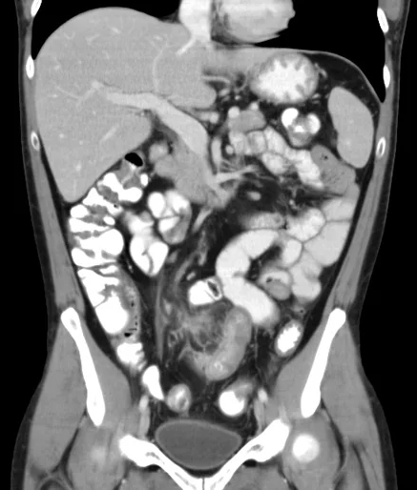
CT* Scan of Abdomen
* Computed
Tomography
(X-rays)
17
Notes:
CT is a medical imaging procedure that uses computer-processed x-rays to produce tomographic images or “slices” of specific areas of the body.

Slide 18
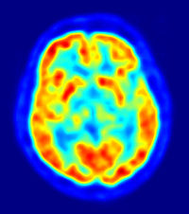
PET* Scan of Human Brain
* Positron
Emission
Tomography
18
Notes:
PET, one of the most sophisticated medical imaging technologies available today, is a type of nuclear medicine procedure that measures the metabolic activity of cells and produces a color-coded image of the body’s function, rather than its structure.
PET scans are used primarily to evaluate people with cancer, brain diseases, and cardiac illnesses.

Slide 19
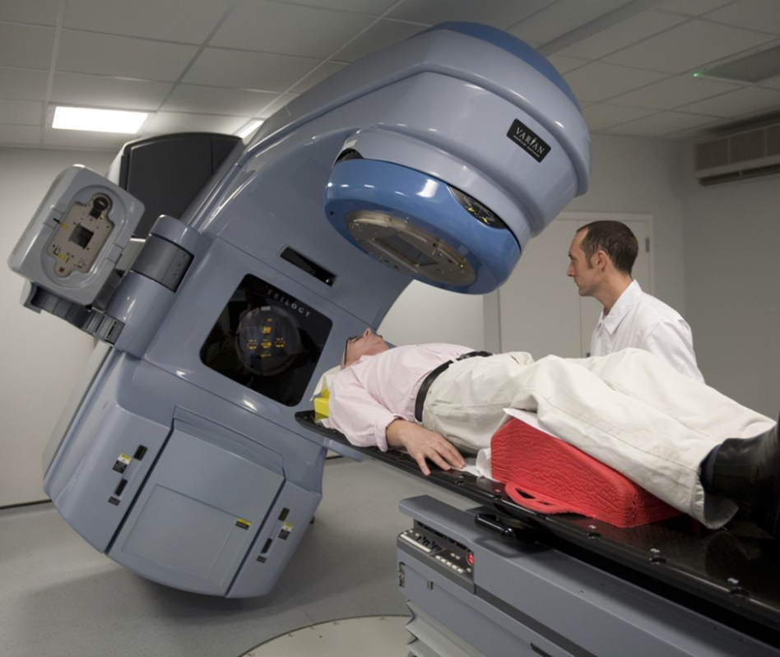
Types of Radiation Therapy
External beam radiotherapy – uses precisely focused external source of radiation to destroy tumors inside the body
19
Notes:
External beam radiotherapy is the most common type of radiation therapy used for cancer treatment.
External beam radiation is given most often as photon (x-ray) beams and less often as particle (proton, neutron) or electron beams.
Radiotherapy machines focus the radiation beam on the exact location in such a way as to maximize the radiation reaching the cancer, while minimizing damage to normal tissue.
Most patients get fractionated therapy treatments over many weeks to permit the recovery of nearby normal tissue via the body’s adaptive repair mechanisms. Lacking normal cell repair mechanisms, tumor cells are destroyed from the cumulative exposures.

Slide 20
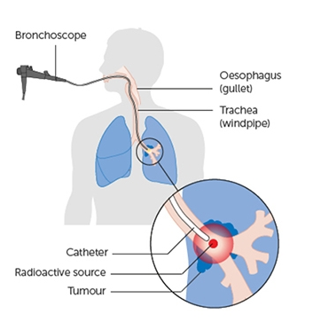
Types of Radiation Therapy (cont.)
Brachytherapy – inserted catheter places radio-isotope directly at site of tumor
20
Notes:
Brachytherapy is a type of internal radiation therapy that places radioactive seeds, ribbons, or capsules in or very near a tumor.
It results in higher doses of radiation being delivered to more-specific areas of the body, compared with external beam radiation therapy.
Brachytherapy is very effective in treating cancer as the radiation is delivered with a high degree of accuracy and has a minimal risk of side effects, due to the targeted and precise nature of delivering the radiotherapy from inside the body.

Slide 21
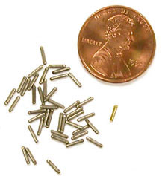
Types of Radiation Therapy (cont.)
Brachytherapy – radioactive seeds implanted at site of tumor
21
Notes:
This slide shows the size of brachytherapy seed implants.

Slide 22
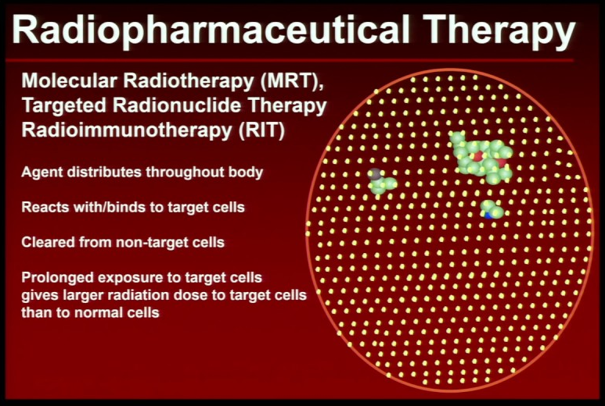
Types of Radiation Therapy (cont.)
Notes:
Radiopharmaceutical therapy targets cancer cells with a radioactive drug.
The radiopharmaceutical is designed to react with or bind to cancer cells, while leaving normal cells unaffected.
FDA clinical trials are evaluating the use of Actinium-225 PSMA radioligand therapy to treat metastatic prostate cancer.

Slide 23
Industrial Applications

Slide 24
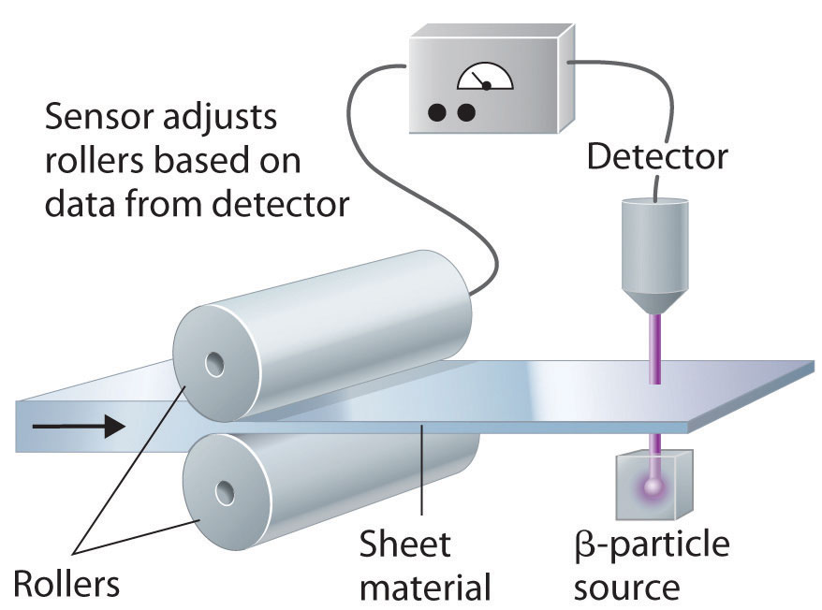
Radioisotope Gauging
Material thickness process control
Notes:
Material thickness process control is one of numerous industrial applications of radioisotopes.

Slide 25
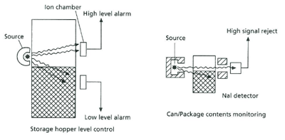
Radioisotope Gauging (cont.)
Material level process control
Package contents monitoring
Notes:
Material level process control and package contents monitoring are two more industrial applications of radioisotopes.

Slide 26
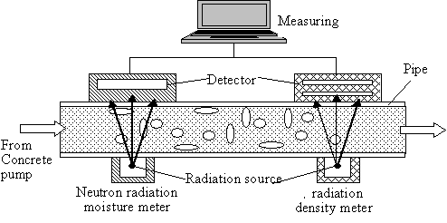
Radioisotope Gauging (cont.)
Process material flow measurement for moisture and void content
Notes:
Process material flow measurement is another industrial application of radioisotopes.

Slide 27
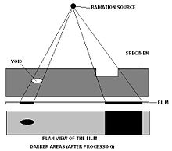
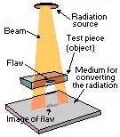
Non-destructive Examination (Radiography)
Material physical characterization
27
Notes:
Non-destructive testing/examination is a very important industrial application of radioisotopes to assure material safety.

Slide 28
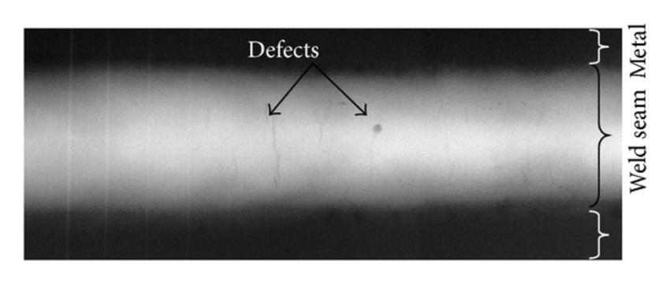
Non-destructive Examination (cont.)
Weld radiographic image
28
Notes:
Weld inspections are an important NDE procedure.

Slide 29
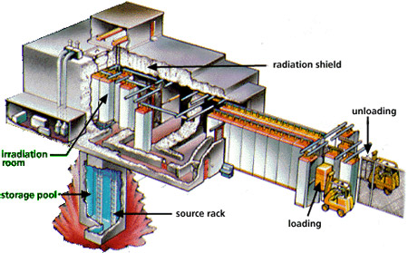
Radiation Sterilization
29
Notes:
Radiation sterilization relies on ionizing radiation, primarily gamma, X-ray or electron radiation, to deactivate microorganisms such as bacteria, fungi, viruses and spores.
Due to numerous advantages over heat or chemical based sterilization techniques, this method is particularly attractive in medicine and healthcare-related fields.

Slide 30
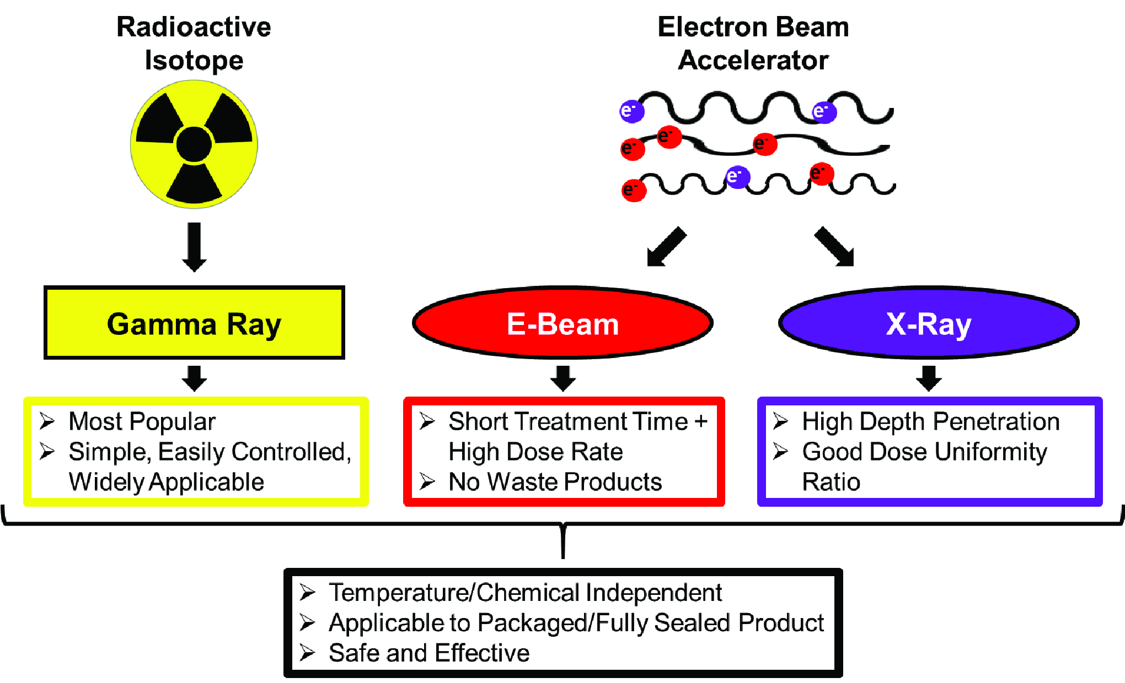
Radiation Sterilization (cont.)
Notes:
This graphic illustrates the current technologies used in ionizing radiation sterilization processes.

Slide 31
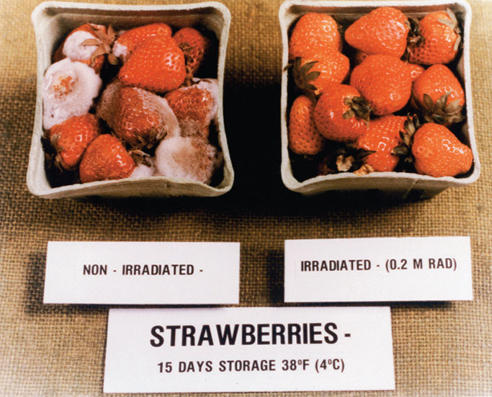
Food Irradiation
By killing microbes and bacteria in food products, irradiation keeps food from spoiling.
31
Notes:
Radiation deposits energy in food products, which is sufficient to kill microbes and bacteria in the food.
Ionizing radiation only interacts with the electrons of atoms. It has no effect on the proton/neutron composition of atomic nuclei, and therefore cannot make food or anything else radioactive.

Slide 32
Environmental Applications
32
Notes:
Radioisotopes are commonly used as tracers in environmental studies.
Radioisotope tracers are chemical compounds in which one or more atoms have been replaced by a radioisotope.
Radiometric dating is a common environmental activity that makes use of radioisotopes contained in matter.

Slide 33
Environmental Applications
Studies of the atmosphere
following atmospheric dispersion, transport, and mixing
processes
identifying sources and sinks of atmospheric gases
measuring deposition of atmospheric constituents on bodies
of land and water
Studies of Earth’s surface waters
measuring replenishment of groundwater resources
monitoring interactions between surface and groundwaters
measuring sedimentation rates in lakes and reservoirs
measuring water aeration
groundwater radiometric dating

Slide 34
Environmental Applications (cont.)
Studies of Earth’s crust and upper mantle
measuring soil erosion
mineral exploration
earthquake monitoring
radiometric dating of rocks and minerals
radiometric dating of lake sediments
Ocean studies
following ocean circulation and mixing processes
measurement of past variations in sea level
measurement of CO₂ exchange with the atmosphere
radiometric dating of ocean sediments

Slide 35
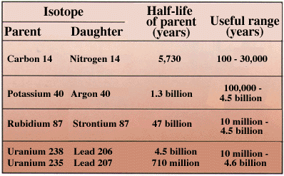
Radiometric Dating
35
Notes:
Radiometric dating is a common activity in the environmental sciences.
Radiocarbon (carbon-14) dating, potassium-argon dating, and uranium-lead dating are among the best known techniques for establishing the geologic age of fossils, archeological materials and rock formations.

Slide 36
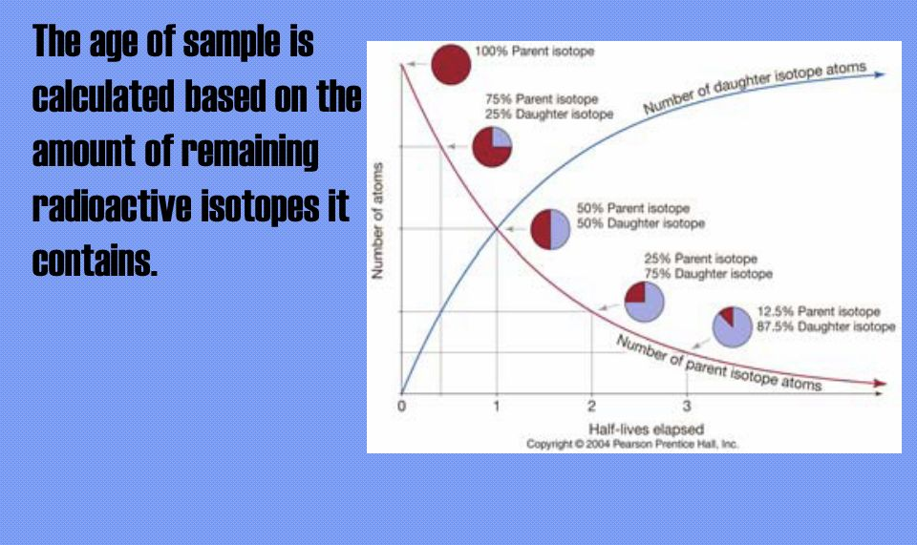
Radiometric Dating (cont.)
36
Notes:
We have seen the radioactive decay curve before. It is the primary tool for determining the age of materials containing radioactive isotopes.

Slide 37
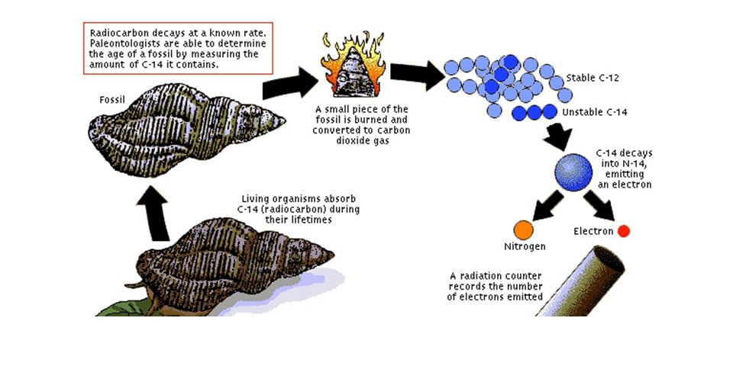
Radiometric Dating (cont.)
37
Notes:
Carbon-14, created in the Earth’s upper atmosphere, eventually reaches the Earth's surface and is incorporated into living organisms. While the production of carbon-14 varies slightly with short-term variations in solar cosmic ray flux, it is considered practically constant over long scales of thousands to millions of years.
When a carbon-based life form dies, the amount of stable carbon-12 remains constant while the radioactive carbon-14 isotope decays with a 5730 year half-life to nitrogen. Therefore, the C-14/C-12 ratio, which changes over time at a known rate, can be used to determine the age of the biological material.

Slide 38
Space Applications

Slide 39
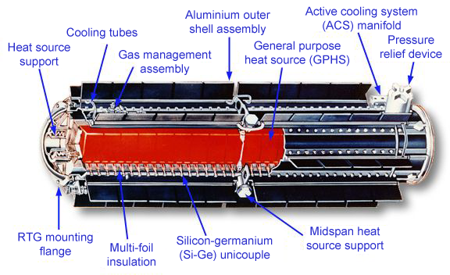
General Purpose Heat Source Radioisotope Thermoelectric Generator (GPHS RTG)
4
39
Notes:
A radioisotope thermoelectric generator (RTG) is a type of nuclear battery that uses an array of thermocouples to convert the heat released by the decay of a suitable radioactive material into electricity.
RTGs powered by plutonium-238, with an 87.7 year half-life, have been used as power sources in satellites and space probes.

Slide 40
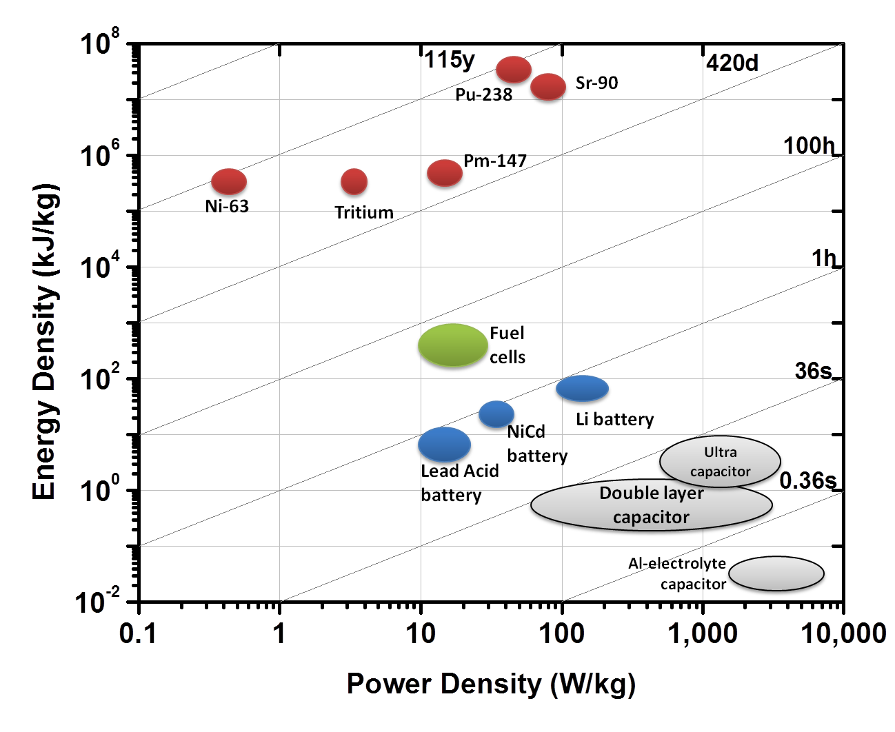
Nuclear Batteries
40
Notes:
This graphic shows that other radioisotopes may also have a potential use in nuclear batteries.
The graphic is a log-log plot showing energy density vs power density for nuclear batteries (red), chemical batteries (blue), fuel cells (green), and supercapacitors (gray). The lines indicate discharge times of the devices.
For the radioisotopes shown in this graphic, plutonium-238 has the most desirable combination of specific activity (radioactivity per unit mass) and specific power (power per unit mass).

