Slide 1
Radon - NOT the Silent Killer the EPA Wants You to Believe
Jeffrey A. Mahn
Nuclear Engineer (Retired)
Albuquerque, NM USA
jamahn47@gmail.com

Slide 2
Radon Most Significant Contributor to Natural Background Radiation Dose
Average natural background radiation dose for Americans from cosmic, terrestrial, radon, and internal sources generally taken to be ≈300 mrem/yearª
Radon contribution is ≈200 mrem/year^{a,b,c} (next slide)
Air we breathe contains radon gas and solid byproducts from radon decay that get attached to aerosol particles
While most radon exhaled when breathing, radioactive decay byproducts remain in lungs to produce lung tissue radiation dose
Notes:
Slide references:
National Council on Radiation Protection and Measurements (NCRP) Report No. 160, Ionizing Radiation Exposure of the Population of the United States, 2009
Assessment of Variations in Radiation Exposure in the United States, United States Environmental Protection Agency, July 15, 2005
NCRP Report No. 93, Ionizing Radiation Exposure of the Population of the United States, 1987

Slide 3
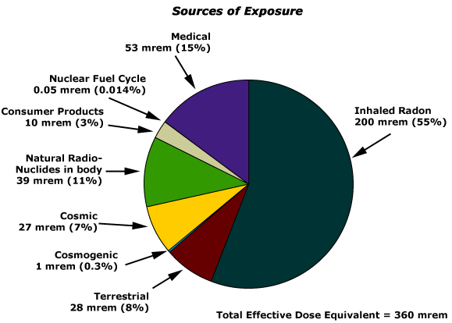
Sources of Natural
Background Radiation
3
Notes:
This graphic shows the various contributors to our annual dose from natural background radiation and their relative contributions.
Actual dose numbers for the individual contributors to our background radiation dose will vary with location.
However, the largest single contributor to our natural background radiation dose is radon.
Source: Lawrence Berkeley National Laboratory, 2011; https://www2.lbl.gov/abc/wallchart/chapters/appendix/appendixd.html

Slide 4
Source of Radon
Radon is radioactive noble gas that enters atmosphere from radioactive decay of uranium-238 and thorium-232 in Earth’s crust
Radon-222 (Rn-222), with half-life of 3.8 days, arises from radioactive decay of U-238
Radon-220 (Rn-220), with half-life of 55.8 seconds, arises from radioactive decay of Th-232
Rn-222 and short-lived radioactive decay products most important contributors to human exposure from natural radiation sources

Slide 5
Source of Radon (cont.)
Due to very short half-life, Rn-220 is lesser contributor to human radon exposure
Timeframe for diffusion of short-lived Rn-220 in soils
results in some decay to non-gaseous radioisotopes
before reaching soil surface
Very short half-life results in little travel distance from
origination site to immediate environment of human
beings before decay to non-gaseous radioisotopes

Slide 6
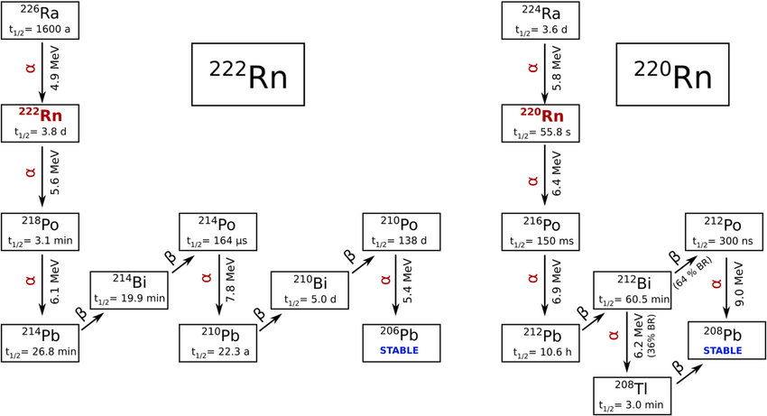
Radon Decay Chains
6
Notes:
Radium-226 is one of the daughter radioisotopes in the uranium-238 decay chain.
Radium-224 is one of the daughter radioisotopes in the thorium-232 decay chain.

Slide 7
Radon Health Concern
Rn-222 itself not huge health concern, since most inhaled radon exhaled before decaying
Inhalation of Rn-222 short-lived progeny (Po-218, Pb-214, Bi-214, and Po-214) attached to aerosol particles are more significant health concern
Most of inhaled aerosolized longer-lived Pb-210 excreted from body before decaying

Slide 8
Radon Health Concern (cont.)
Exposure mostly from alpha particles emitted by solid Rn-222 progeny in lungs; some beta particles and gamma-rays also emitted
General agreement that alpha particles responsible for lung cancer seen in miners
Almost all radon level measurements expressed as concentration of radon in picocuries per liter (pCi/L) of air or in becquerels per cubic meter (Bq/m³) of air
1 pCi/L = 37 Bq/m³

Slide 9
EPA Considers Natural Background Radon Dose Harmless
U.S. EPA assumes annual 200 mrem radon dose corresponds to radon concentration of 1 pCi/L*
EPA indoor radon remediation action level of 4 pCi/L then corresponds to annual radon dose of 800 mrem
* Assessment of Variations in Radiation Exposure in the United States, United States
Environmental Protection Agency, July 15, 2005, page 12
Notes:
We will return to this EPA assumption that a 1 pCi/L radon concentration corresponds to a 200 mrem annual radon dose in later slides.

Slide 10
EPA Assault on Home Radonª
U.S. Environmental Protection Agency declared radon to be “silent killer”
Alleges radon second leading cause of lung cancer
behind smoking
Established action level for remediation of indoor
radon
Claims no known safe level of radon exposure
Estimates 21,000 radon-related lung cancer deaths per
year in U.S., with 2,900 being non-smokers^{b,c}
National Health Advisory on Radon issued January 2005^{d} recommending radon remediation action level of 4 pCi/L
Notes:
Refs.:
Health Risk of Radon, U.S. Environmental Protection Agency, February 27, 2024;
https://www.epa.gov/radon/health-risk-radon
EPA402/K-24/001, Home Buyer’s and Seller’s Guide to Radon, March 2024, U.S. Environmental Protection Agency
What is EPA’s Action Level for Radon and What Does it Mean?, United States Environmental Protection Agency, https://www.epa.gov/radon/what-epas-action-level-radon-and-what-does-it-mean
d. https://www.epa.gov/perspectives/keeping-radon-your-radar#:~:text=In%202005%2C%20the%20U.S.%20Surgeon,reduce%20radon%20in%20their

Slide 11
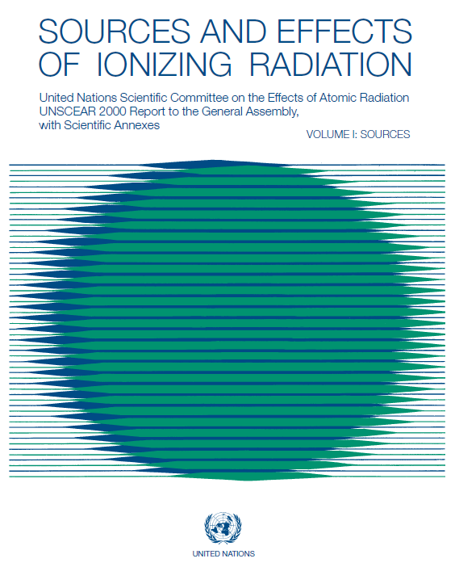
UNSCEAR 2000 Report
One of most comprehensive studies on effects of ionizing radiation – provides detailed assessment of both indoor and outdoor global radon doses

Slide 12
Both Rn-222 and Rn-220 Doses Evaluated in UNSCEAR Report
Half-lives of Rn-222 and Rn-220 isotopes as well as various decay radioisotopes important for determining relative contributions to bronchial dose
Half-life differences of radioisotopes from Rn-222 and Rn-220 decay produce very different atmospheric distributions of potentially aerosolized decay products

Slide 13
UNSCEAR 2000 Report Radon Dose Calculations
Basis for dose calculationsª
Absorbed dose coefficient for basal cells of bronchial epithelium ranges from 5 to 25 nGy(Bq hour m⁻³)⁻¹ [nanoGray per Becquerel hour per cubic meter]; derived from epidemiological studies and physical dosimetry
Central value of absorbed dose coefficient for average indoor conditions estimated to be 9 nGy(Bq hour m⁻³)⁻¹
Applying apportioned tissue weighting factor of 0.08 for bronchial cells and quality factor of 20 for alpha particle radiation produces effective dose coefficient of about 15 nSv(Bq hour m⁻³)⁻¹
Gray – absorption of 1 joule of radiation energy per kilogram of matter
Becquerel – 1 disintegration per second
13
Notes:
Slide reference:
United Nations Scientific Committee on the Effects of Atomic Radiation (UNSCEAR) 2000 Report, Sources and Effects of Ionizing Radiation, page 107

Slide 14
UNSCEAR 2000 Report Radon Dose Calculations (cont.)
Basis for dose calculations (cont.)
Absorbed dose coefficient of 9 nSv (Bq hour m⁻³)⁻¹ used in past UNSCEAR calculations^{b,c} still considered appropriate for average effective dose calculationsª (i.e., used in following dose calculations)
Population-weighted global average Rn-222
concentrationsª of 40 Bq/m³ (1.08 pCi/L) indoors and
10 Bq/m³ (0.27 pCi/L) outdoors
Equilibrium factors of 0.4 for indoor radon^{d} and 0.6 for
outdoor radon^{e} (factors defined to permit radon
exposure estimates in terms of potential alpha particle
energy concentration from measurements of radon gas
concentration)
14
Notes:
Equilibrium factor defined as the ratio of the actual potential alpha particle energy concentration to the concentration that would prevail if all the radon decay products were in equilibrium with the parent radon (i.e., concurrent decay of all daughter radionuclides with parent decay)
Slide references:
United Nations Scientific Committee on the Effects of Atomic Radiation (UNSCEAR) 2000 Report, Sources and Effects of Ionizing Radiation, page 107
Sources and Effects of Ionizing Radiation, United Nations Scientific Committee on the Effects of Atomic Radiation, 1993 Report to the General Assembly
Sources, Effects and Risks of Ionizing Radiation, United Nations Scientific Committee on the Effects of Atomic Radiation, 1988 Report to the General Assembly
United Nations Scientific Committee on the Effects of Atomic Radiation (UNSCEAR) 2000 Report, Sources and Effects of Ionizing Radiation, page 104
Ibid., page 103

Slide 15
UNSCEAR 2000 Report Radon Dose Calculations (cont.)
Basis for dose calculations (cont.)
Occupancy factorsª of 0.8 indoor (7000 hours per year)
and 0.2 outdoor (1760 hours per year)
Despite very short Rn-220 half-life of 55.8 seconds,
UNSCEAR report included Rn-220 global average indoor
and outdoor concentrationsª of 0.3 Bq/m³ and 0.1
Bq/m³, respectively, in dose calculations*
* Rn-220 dose becomes more significant contributor to overall radon dose for areas
of world with thorium-rich monazite sands, where Rn-220 concentrations much
higher
Notes:
An indoor occupancy factor of 0.8 is conservatively high for dose calculations.
Slide references:
United Nations Scientific Committee on the Effects of Atomic Radiation (UNSCEAR) 2000 Report, Sources and Effects of Ionizing Radiation, page 105

Slide 16
UNSCEAR Radon Doses
Indoor and outdoor Rn-222 concentrations result in global average annual effective dosesª of 1.0 mSv (100 mrem) and 0.095 mSv (9.5 mrem), respectively
Rn-220 total annual effective dose^{b} ≈0.09 mSv (9 mrem)
Total global average annual effective dose from both Rn-222 and Rn-220 radioactive decay is then ≈1.2 mSv (120 mrem)
16
Notes:
Note that the UNSCEAR global average annual effective dose is less than the U.S. average annual dose of 200 mrem.
Slide references:
United Nations Scientific Committee on the Effects of Atomic Radiation (UNSCEAR) 2000 Report, Sources and Effects of Ionizing Radiation, page 107
Ibid., page 108

Slide 17
EPA Radon Data
Average U.S. indoor and outdoor radon concentrations are ≈1.3 pCi/L (48 Bq/m³) and ≈0.4 pCi/L (14.8 Bq/m³), respectively, based on EPA 1991 national residential radon survey^{a,b}
Note that EPA indoor and outdoor radon concentrations of 48 Bq/m³ and 14.8 Bq/m³ about 1.2 and 1.5 times higher than UNSCEAR 2000 Report global average indoor and outdoor radon concentrations, respectively
Using UNSCEAR radon annual effective dose calculation, resulting U.S. average indoor and outdoor annual effective doses would be ≈1.2 mSv (120 mrem) and ≈0.14 mSv (14 mrem), respectively
Based on EPA radon data, total U.S. average annual effective radon dose calculated to be ≈134 mrem
17
Notes:
Note that the EPA U.S. indoor average radon concentration (48 Bq/m³) is about 1.2 times higher than the UNSCEAR 2000 Report global average indoor radon concentration and the average outdoor concentration (14.8 Bq/m³) is about 1.5 times higher.
The annual effective dose for the EPA indoor radon concentration of 1.3 pCi/L should be about 120 mrem (100 mrem x 48/40 = 120 mrem).
Similarly, the annual effective dose for the EPA outdoor radon concentration of 0.4 pCi/L should be about 14 mrem (9.5 mrem x 14.8/10 = 14 mrem).
The total annual effective radon dose would then be about 134 mrem, which is less than the 200 mrem annual average for the U.S.
Slide references:
EPA 402-R-92-011, National Residential Radon Survey Summary Report, October 1992 (updated September 2023)
What is EPA’s Action Level for Radon and What Does it Mean?, United States Environmental Protection Agency, https://www.epa.gov/radon/what-epas-action-level-radon-and-what-does-it-mean
https://www.epa.gov/radiation/radionuclide-basics-radon#:~:text=Radon%20is%20in%20the%20atmosphere,(1.3%20pCi%2FL)

Slide 18
EPA Radon Data (cont.)
If indoor radon concentration of 1.3 pCi/L results in calculated dose of 120 mrem, then EPA assumption of 200 mrem dose corresponding to radon concentration of 1 pCi/L cannot be true
Then indoor radon remediation action level of 4 pCi/L corresponds to radon dose of ≈370 mrem, not 800 mrem

Slide 19
Calculating U.S. Average Indoor Radon Concentration
Using UNSCEAR indoor occupancy factor of 0.8,ª U.S. average annual radon dose of 200 mrem results in average indoor annual dose of 160 mrem (1.6 mSv)
UNSCEAR indoor annual effective dose of 1.6 mSv corresponds to indoor radon concentration of 64 Bq m⁻³ (1.7 pCi/L)
U.S. average indoor radon concentration of 1.7 pCi/L matches average residential level shown on next slide from Bernie Cohen indoor radon study
Notes:
Slide reference:
UNSCEAR 2000 Report, Sources and Effects of Ionizing Radiation, page 105

Slide 20
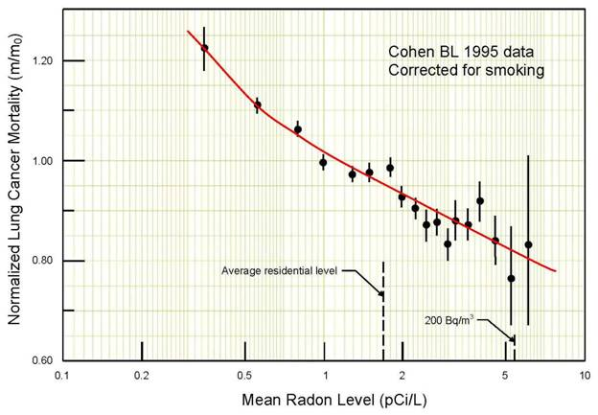
Bernie Cohen Indoor Radon Study
20
Notes:
This slide illustrates the fallacy of the home radon risk narrative.
The graphic shows a normalized lung cancer mortality rate of 1.0 corresponds to a mean radon concentration of about 1 pCi/L and lesser radon concentrations actually result in increased cancer mortality.
Furthermore, the data shows that radon concentrations between 1 pCi/L and about 6 pCi/L actually result in a decreased cancer mortality rate.
A 2021 Polish study confirmed that the relative number of lung cancers decreases with increasing radon concentrations up to 200 Bq/m³ or 5.4 pCi/L (Pylak M, Fornalski KW, Reszczyńska J, Kukulski P, Waligórski MPR, Dobrzyński L, Analysis of Indoor Radon Data Using Bayesian, Random Binning, and Maximum Entropy Methods, Dose Response, May 17, 2021)
Refs.
Cohen BL. Test of the linear-no threshold theory of radiation carcinogenesis for inhaled radon decay products. Health Phys. 1995; 68:157–174
Cohen BL. Lung cancer rate vs. mean radon level in U.S. counties of various characteristics. Health Phys. 1997; 72:114–119

Slide 21
Bernie Cohen Indoor Radon Study (cont.)
Cohen five-year investigation of radon-induced lung cancer in early 1990s
Covered 1,601 counties, comprising ≈90 percent of U.S.
population
Consisted of radon data from EPA and state agencies, and
272,000 measurements by U. of Pittsburgh researchers
Study intended to measure how quickly lung cancer rates increased with higher home radon levels
Found cancer rate decreased significantly with increasing
levels of radon
Numerous scientists tried unsuccessfully to refute
study
Dozens of studies since have confirmed radon’s protective
(hormetic) effect at low exposure levels

Slide 22
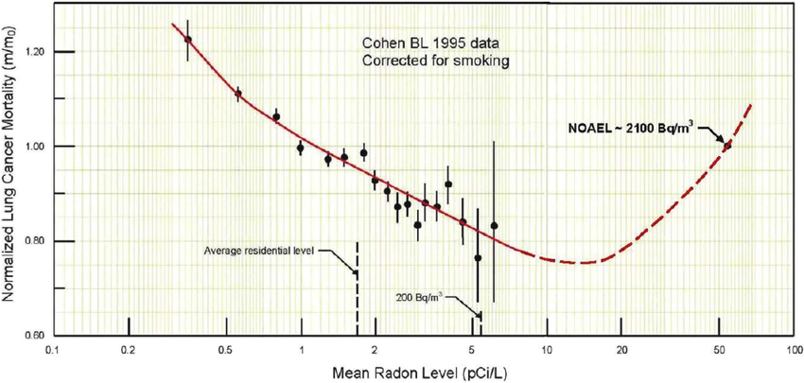
Extrapolation of Indoor Radon Study
NOAEL – no observed adverse effect level
Extrapolation of Cohen study data predicts decreased lung cancer mortality for indoor radon concentrations between 1 pCi/L and ≈56 pCi/L (2100 Bq/m³)ª
22
Notes:
Slide reference:
Cuttler, JM and Sanders, CL, Threshold for Radon-Induced Lung Cancer from Inhaled Plutonium Data, Dose-Response, October-December 2015: 1-4

Slide 23
Radon Dose Calculation Summary
 | UNSCEAR |  | UNSCEAR Calculation Using EPA Data
Effective Dose Coefficient | Indoor Radon Conc. (pCi/L) | Annual Indoor Dose (mrem) | Indoor Radon Conc. (pCi/L) | Annual Indoor Dose (mrem) | Indoor Radon Conc. (pCi/L) | Annual Indoor Dose (mrem)
9 nSv (Bq hour m⁻³)⁻¹ | 1.08 | 100 | 1.3 | 120 | 1.7 | 160
15 nSv (Bq hour m⁻³)⁻¹ | 1.08 | 167 | 1.3 | 200 | 1.7 | 267
23
Notes:
This table compares the indoor radon concentrations and annual indoor doses for the UNSCEAR and U.S. EPA radon data.
The 9 nSv (Bq hour m⁻³)⁻¹ dose coefficient is the established value used in past UNSCEAR calculations of average effective radon doses and is still considered by UNSCEAR to be appropriate for average effective dose calculations. The UNSCEAR indoor radon concentration of 40 Bq/m³ (1.08 pCi/L) corresponds to an annual dose of 100 mrem (1.0 mSv).
The 15 nSv (Bq hour m⁻³)⁻¹ is a more conservative dose coefficient value for calculating effective radon doses to bronchial cells.

Slide 24
Radon Dose Calculation Takeaways
UNSCEAR indoor radon concentration of 1.08 pCi/L is global average from UNSCEAR 2000 Report
EPA indoor radon concentration of 1.3 pCi/L is U.S. average from 1992 National Residential Radon Survey Summary Report (EPA 402-R-92-011)
Indoor radon concentration of 1.7 pCi/L derived from UNSCEAR annual effective dose calculation for U.S. average indoor annual dose of 160 mrem
Using more conservative effective dose coefficient with indoor radon concentration of 4 pCi/L results in indoor radon dose about 630 mrem, well below 800 mrem associated with EPA indoor radon remediation action level

Slide 25
Faulty EPA Radon Assumption
UNSCEAR calculation for indoor radon concentration of 1 pCi/L (37 Bq/m³) corresponds to annual average effective indoor dose of ≈92.5 mrem (0.925 mSv)
Even using more conservative effective dose coefficient of 15 nSv (Bq hour m⁻³)⁻¹ results in annual average effective indoor dose of only 154 mrem
EPA assumption of 200 mrem annual dose from indoor radon concentration of 1 pCi/L clearly incorrect

Slide 26
EPA Home Radon Remediation Action Level
From earlier slide, EPA home radon remediation action level of 4 pCi/L^{a,b} corresponds to average annual radon dose of ≈370 mrem, not 800 mrem
More conservative effective dose calculation for bronchial cells results in annual indoor radon dose about 630 mrem for indoor radon concentration of 4 pCi/L
4 pCi/L arbitrary remediation level has no basis in observable health effects (Cohen study and next slide), even for higher annual dose of 630 mrem (EPA radon-induced lung cancer mortality predictions based on use of flawed LNT dose-response model)
4 pCi/L radon concentration well within hormetic region; remediation measures actually reduce beneficial effects of home radon (Cohen graphic)
Notes:
From an earlier slide, using a dose coefficient of 9 nSv (Bq hour m⁻³)⁻¹, an indoor radon concentration of 4 pCi/L corresponds to an annual radon dose of 370 mrem (120 mrem/1.3 pCi/L)(4 pCi/L), which is well within the hormetic region of the Cohen radon study.
Using the more conservative effective dose coefficient of 15 nSv (Bq hour m⁻³)⁻¹, the dose for a radon concentration of 4 pCi/L would be 615 mrem [(200 mrem/1.3)(4)], which is still well below the EPA’s current 800 mrem indoor radon remediation action level [(200 mrem)(4)].
Hormesis – a dose-response phenomenon where a low dose of a substance or environmental agent has a beneficial effect, while a high dose is inhibitory or toxic.
Slide references:
What is EPA’s Action Level for Radon and What Does it Mean?, United States Environmental Protection Agency, https://www.epa.gov/radon/what-epas-action-level-radon-and-what-does-it-mean
Assessment of Variations in Radiation Exposure in the United States, US EPA Office of Radiation and Indoor Air, July 15, 2005

Slide 27
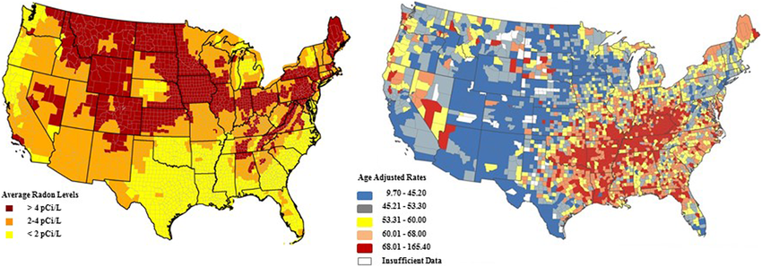
Radon Concentration vs Lung Cancer Mortality Rate
Left: Predicted average indoor radon levels (EPA Map of Radon Zones, provided with permission of EPA Radiation Protection Division).
Right: 2000 to 2009 lung cancer mortality rates per 100,000 by county, corrected for smoking (Static Maps, National Community Mapping Institute).
27
Notes:
This graphic compares predicted radon concentrations in areas of the U.S. with observed lung cancer mortality rates.
After correction for smoking, a significant negative correlation was found between the average residential radon levels and lung cancer mortality rates.
Graphic Source: Vaiserman, A, Koliada, A, Zabuga, O, and Socol, Y, Health Impacts of Low-Dose Ionizing Radiation: Current Scientific Debates and Regulatory Issues, Dose-Response, July-September 2018: 1-27

Slide 28
Data Challenging Legitimacy of EPA Home Radon Remediation Action Level
High background radon radiation areas of world showing no adverse health effects
Kerala, India
Guarapari, Brazil
Ramsar, Iran

Slide 29

High Background Radiation Areas Around the World
Parts of Kerala, India have natural background radiation levels up to 76 mSv/year due to monazite in soil
No significant correlation between cumulative radiation exposure and incidence of cancer or leukemia
No excess birth defects
Notes:
Thorium content in the monazite soil ranges from 8 to 10.5 percent.
76 mSv/year = 7600 mrem/year
Ref. Radiation Research, 1999 and Health Physics Journal, January 2009

Slide 30
High Background Radiation Areas Around the World (cont.)
Tourists and residents cover themselves with thorium-rich beach sand
Notes:
Many tourists and residents of Guarapari actually cover themselves with the thorium-rich beach sand.
175 mSv/year = 17,500 mrem/year

Slide 31
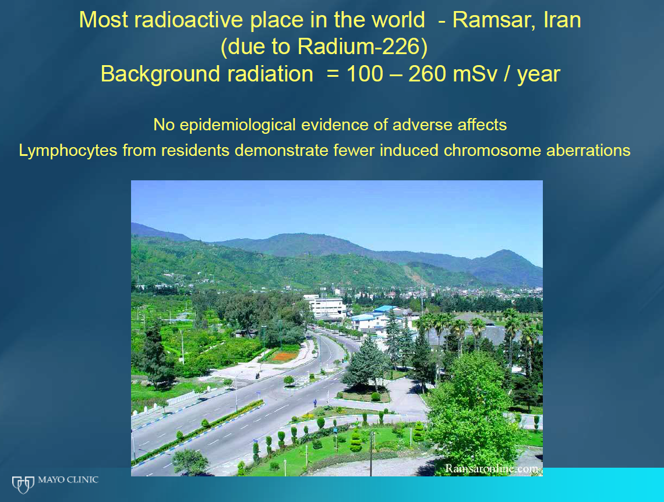
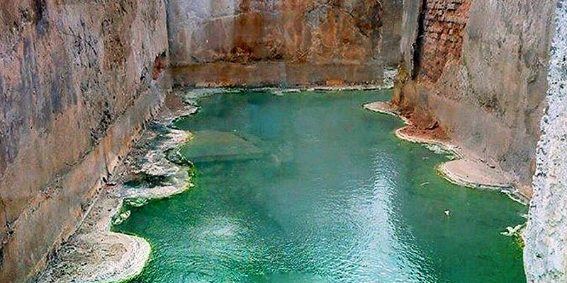
High Background Radiation Areas Around the World (cont.)
City’s 50 sulfurous hot springs contain high levels of radium-226
Notes:
260 mSv/year = 26,000 mrem/year

Slide 32
Further Evidence Challenging EPA Home Radon Remediation Action Level
High background radon radiation data consistent with Feinendegen cancer risk versus dose graphic (next slide) for radon doses up to 20,000 mrem (0.2 Gy); i.e., no observed increase in cancer risk

Slide 33
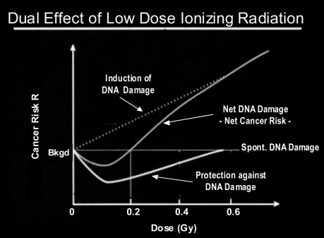
Ref. Evidence for Beneficial Low Level Radiation Effects and Radiation Hormesis, L.E. Feinendegen, MD, The British Journal of Radiology, 78 (2005), pp. 3–7
32
Notes:
This graphic shows that radiation-induced adaptive protection is stimulated by doses up to 0.5 Gy.
0.1 Gray (10 rem) is the optimum dose for stimulating adaptive protection mechanisms.
0.2 Gray (20 rem) is effectively the threshold absorbed dose for observable radiation-induced adverse health effects.
From Feinendegen article:
Adaptive protection causes DNA damage prevention and repair and immune stimulation. It develops with a delay of hours, may last for days to months, decreases steadily at doses above about 100 mGy to 200 mGy and is not observed any more after acute exposures of more than about 500 mGy. Radiation-induced apoptosis and terminal cell differentiation also occur at higher doses and add to protection by reducing genomic instability and the number of mutated cells in tissues.

Slide 34
Revisiting EPA Radon Assault
Assertion of radon being second leading cause of lung cancer
Unsupportable supposition lacking identifiable marker to distinguish alleged radon-induced lung cancer from other potential environmental causes
Don’t know what causes each case of lung cancer (American Cancer Society)

Slide 35
Revisiting EPA Radon Assault (cont.)
Claim of no known “safe level” of radon exposure
Premise of no safe level of radiation based on flawed
Linear No-Threshold dose-response model
Refuted by Cohen indoor radon study and lack of
increased lung cancer mortality in worldwide high
background radon radiation areas
Observed lower lung cancer risk in high background
radiation areas^{a,b,c}
Notes:
We live in a radioactive world.
We are not all incurring lung cancer.
There have been no observable adverse health effects in populations living in high natural radon radiation areas of the world.
Slide References:
Lance, S., Ramsar and Radioactivity, March 22, 2018, http://large.stanford.edu/courses/2018/ph241/lance2/
The Naturally Occurring High Radiation Levels of Ramsar, Iran; Dr. Zoomie, October 25, 2023, https://www.ntanet.net/the-naturally-occurring-high-radiation-levels-of-ramsar-iran/
Mortazavi, SMJ, Cancer Risk Due to Exposure to High Levels of Natural Radon in the Inhabitants of Ramsar, Iran, 2005

Slide 36
Revisiting EPA Radon Assault (cont.)
Established action level for indoor radon remediation –
No scientific basis for such action; counterproductive and harmful based on Cohen indoor radon study
Claim of 21,000 U.S. radon-related lung cancers per year
Flawed LNT dose-response model used for predicting lung
cancer morbidity/mortality; actual lung cancer deaths
don’t correlate with increased indoor radon
concentrations
Hormetic relative risk model (Cohen indoor radon study)
shows decreasing lung cancer incidence for indoor radon
concentrations above EPA remediation action level;
consistent with actual lung cancer data*
* Scott, BR., Residential Radon Appears to Prevent Lung Cancer, Dose Response 2011; 9(4): 444-464
Notes:
Once again, the flawed Linear No Threshold (LNT) dose-response model is used to predict cancer deaths from exposure to low-dose radon radiation even though there are no actual deaths that can be verifiably linked to radon exposure.
Radon is just another convenient boogeyman to frighten the unknowing public by those with an antinuclear agenda.

Slide 37
Radon Exposure in a Nutshell
Radon exposure is chronic ionizing radiation exposure
Chronic low-dose radiation exposures do not inhibit ability of body’s adaptive protection mechanisms to repair radiation-induced cell damage (otherwise, we would not be here)
Exposure to radon (indoor and outdoor) does not result in adverse health effects

