Slide 1
The Tritium Tempest in a Teapot
Jeffrey A. Mahn
Nuclear Engineer (Retired)
Albuquerque, NM USA
jamahn47@gmail.com

Slide 2
Problem Summary
The trouble with tritium is there is no trouble with tritium.
James Conca
2
Notes:
This was the title of an article by James Conca that was published by the American Nuclear Society in October 2022.
The purpose of Conca’s article was to counter the public scaremongering initiated by the plan to dispose of tritiated water from the Fukushima nuclear power plant accident by discharging it to the Pacific Ocean.
Ostensibly, the health concern with tritium is from internal radiation exposure.
The following slides will show why the tritiated water disposal issue gets much more attention than it deserves.

Slide 3
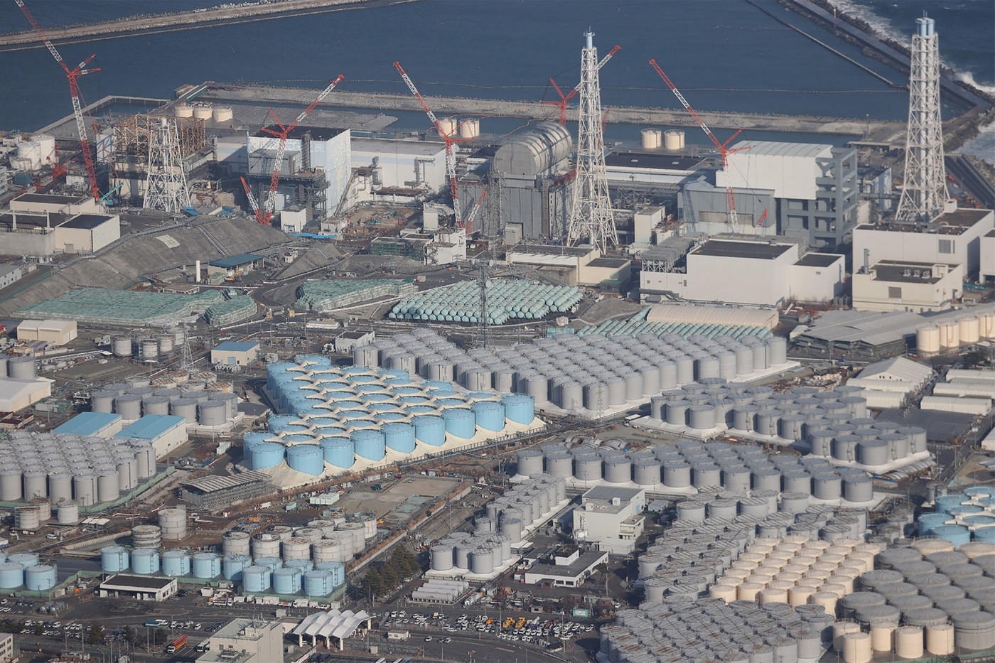
Fukushima Tritiated Water Tanks
3
Notes:
This is the tritium tempest in a teapot – the decision to discharge tritiated water from the Fukushima nuclear power plant to the Pacific Ocean.
As of 2016, there are about 760 terabecquerels (760 x 10¹² Becquerels) of tritium contained in the 860,000 m³ (860 million liters) of water stored in the tanks. This amounts to approximately 2.1 grams of tritium or 14 mL of tritiated water (HTO).
One Becquerel is equal to one disintegration per second; that is, one tritium atom radioactive decay per second.

Slide 4
Fukushima Tritiated Water Controversy
The Real Problem: There are many people who are very angry with the decision to dump tritiated water from the Fukushima accident into the Pacific Ocean.
There are those who know it’s not a genuine health concern, but spread false information to advance an anti-nuclear agenda.
There are many more who uncritically repeat the disinformation.
There are the masses who become frightened because they willingly believe what they are told.
4
Notes:
The contaminated water from the Fukushima nuclear power plant accident has been treated to reduce all radioactive substances to below regulatory discharge limits except for tritium.
Tritium cannot be economically removed from the water because it is chemically indistinguishable from normal hydrogen (protium).

Slide 5
Isotopes of Hydrogen
5
Notes:
What is tritium? As this graphic shows, tritium is an isotope of hydrogen.
The natural abundance in hydrogen of the protium isotope is 99.985%.
The nucleus of a protium atom is a single proton.
“Normal” water, consisting of protium and oxygen, is written as H₂O
The natural abundance in hydrogen of the deuterium isotope is 0.015%.
Deuterium is sometimes called heavy hydrogen because its nucleus contains a proton and a neutron – two subatomic particles of approximately the same mass.
The nucleus of a deuterium atom is called a deuteron
“Heavy” water, consisting of deuterium and oxygen, is written as D₂O
Tritium is a radioactive isotope of hydrogen with a relatively short half-life (12.3 years).

Slide 6
Tritium Production
Levels of tritium generated in normal industrial processes are harmless
More tritium created continuously in Earth’s upper atmosphere from neutron activation of nitrogen (N-14 + neutron → C-12 + H-3) than produced by nuclear reactors
Reactor-generated tritium reacts with oxygen in reactor cooling water to produce HTO (tritiated water)
Notes:
Source: The Trouble with Tritium, by James Conca, October 31, 2022
Oxygen in reactor cooling water, from radiolytic decomposition of the water, reacts with tritium just as it does with normal hydrogen (protium).
Tritium production from any source is not a significant environmental concern.

Slide 7
Natural Tritium in Environment
Natural tritium (H-3) in waters of the Earth present at concentrations that range from 0.185 to 0.925 Becquerel per liter (Bq/L) of water.¹
Tritium so harmless that maximum regulatory limits in drinking water range from low of 100 Bq/L (European Union) to high of 76,000 Bq/L (Australia)² – orders of magnitude higher than naturally occurring levels
Notes:
Sources:
Tritiated Water from Fukushima to be Discharged into Pacific, American Council on Science and Health, April 23, 2021
The Trouble with Tritium, by James Conca, October 31, 2022
Let’s look at some facts regarding tritium.
Becquerel is a unit of radioactivity defined as the disintegration of one atom per second.
Note that the regulatory limits for tritium in drinking water are orders of magnitude higher than for naturally occurring tritium found in water.

Slide 8
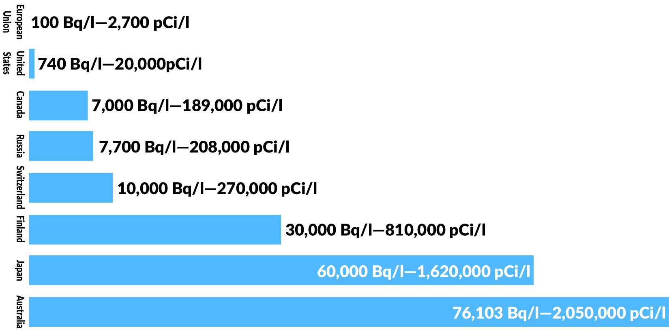
Tritium in Drinking Water Regulatory Limits
8
Notes:
Source: The Trouble with Tritium, by James Conca, October 31, 2022
This slide shows selected regulatory limits for tritium in drinking water.
Note that the Japanese regulatory limit is quite high at 60,000 Bq/L.

Slide 9
Tritium Biological Facts
Tritium has weakest radioactivity of any radionuclide, with beta particle energy of 18.6 keV
Low-energy beta particle has extremely limited range in biological material (< 10 μm), depositing energy primarily through inelastic collisions with atomic electrons of cellular matter¹
9
Notes:
Source:
Health effects triggered by tritium: how do we get public understanding based on scientifically supported evidence? Journal of Radiation Research, Vol. 62, No. 4, 2021, pp. 557-563
The 18.6 keV of energy is actually distributed between the beta particle and the associated anti-neutrino, with the beta energy being only 5.7 keV.
Not only does the tritium beta particle have little energy to deposit in biological matter, but it does so in a very short distance from its origin – less than the diameter of a human cell.
In other words, it has a very small probability of causing any real damage in biological matter.

Slide 10

Tritium Biological Facts (cont.)
While tritium radiological half-life is 12.3 years, biological half-life only about 10 days
Thermodynamically prefers to exist as water (HTO)¹
No observed tritium concentration in biological material
Roughly 60% of body weight is water; 5 tritium atoms per 10¹⁸
hydrogen atoms² → ≈ 1.7 x 10⁻¹⁴ gram tritium in human body
Tritium radioactivity in human body about 59 Becquerels per
liter,² well below EU regulatory limit for drinking water
55% excreted in urine, 29% through skin, 12% in exhaled air
Excess tritium ingestion remediation plan – drink lots of beer
Notes:
Sources:
The Trouble with Tritium, by James Conca, October 31, 2022
Tritium in Groundwater at Commercial Nuclear Power Plants, U.S. NRC, August 19, 2009
An NRC document titled Tritium in Groundwater at Commercial Nuclear Power Plants indicates that U.S. surface waters contain 1 to 5 tritium atoms for every 10¹⁸ atoms of hydrogen. Therefore, the calculated tritium mass in the human body is conservatively high.
The NRC document also indicates that the radioactivity of water containing 5 tritium atoms per 10¹⁸ atoms of hydrogen is 16 pCi/L (59 Bq/L).
Tritium ingestion remediation plan – drink lots of beer

Slide 11
Biological Tritium in Perspective
To put tritium “concern” in proper perspective, consider two radionuclides that present internal radiation exposures that aren’t health concerns – carbon-14 (C-14) and potassium-40 (K-40)
Like tritium, C-14 and K-40 radioactively decay by beta particle emission (K-40 also emits gamma-ray)
C-14 plentiful in human body because we are carbon-based life forms
K-40 found everywhere in human environment

Slide 12
Biological Tritium in Perspective (cont.)
Carbon-14 emits beta particle with energy of 157 keV (greater than 8 times energy of tritium beta)
Carbon ≈ 23% of body weight; one carbon-14 atom for every trillion carbon atoms¹ → ≈ 1.6 x 10⁻⁸ gram carbon-14 in human body (one million times mass of tritium)
Beta particle range in biological material about 300 μm⁽²⁾ (greater than 30 times range of tritium beta)
Biological half-life is 40 days, with primary excretion pathways being feces and exhalation
Carbon-14 presents no biological hazard to humans
Notes:
Source:
Wikipedia
Carbon-14 Radiological Safety Guidance, University of Michigan Environment, Health & Safety, September 27, 2018
The purpose of this slide is to show that the radiological body burden for carbon-14 is significantly greater than for tritium, yet presents no biological radiation hazard.

Slide 13
Biological Tritium in Perspective (cont.)
Potassium-40 emits beta particle with energy of 1330 keV (greater than 70 times energy of tritium beta) as well as 1461 keV gamma-ray
Potassium-40 most common radioisotope in human body
Potassium ≈ 0.18% of body weight;¹ potassium-40 ≈ 0.0117% of potassium² → ≈ 0.015 gram potassium-40 in human body (one trillion times mass of tritium)
Average biological half-life is ≈ 16 days,³ excreted from human body primarily through urine
Potassium-40 contained in food we eat and presents no biological hazard to humans
Notes:
Sources:
https://www.nuclear-power.com/nuclear-engineering/radiation-protection/sources-of-radiation/internal-source-of-radiation/potassium-40-radiation-dose/
Chart of the Nuclides, 15th Edition, 1996, General Electric Co. and KAPL, Inc.
Rahola, T and M Suomela, On Biological Half-life of Potassium in Man, Ann. Clin. Res., 1975 Apr; 7(2):62-5
The purpose of this slide is to show that the radiological body burden for potassium-40 is significantly greater than for tritium, yet presents no biological radiation hazard.
Potassium-40 is the most radioactive of the normal body radioisotopes, and enters the body via the food we eat (next slide).

Slide 14
Natural Radioactivity in Food
Food | ⁴⁰K (β,γ) pCi/kg | ²²⁶Ra (α) pCi/kg
Brazil Nuts | 5600 | 1000-7000
Lima Bean | 4640 | 2-5
Banana | 3520 | 1
White Potato | 3400 | 1-2.5
Carrot | 3400 | 0.6-2
Red Meat | 3000 | 0.5
Low-sodium Salt | 3000 | ---
Beer | 390 | ---
Drinking Water | --- | 0-0.17
14
Notes:
References
Handbook of Radiation Measurement and Protection, Brodsky, A., CRC Press 1978
Environmental Radioactivity from Natural, Industrial and Military Sources,
Eisenbud, M and Gesell T., Academic Press, Inc. 1997
This slide shows the potassium-40 activity of selected food items.
Activity is given in pico-Curies per kilogram, where 1 pCi = 0.037 Bq.

Slide 15
GI Absorption of Radionuclides
Isotope | Radiation | Half-life | GI Absorption
Hydrogen-3 (Tritium) | β | 12.3 years | 100%*
Carbon-14 | β | 5730 years | > 90%¹
Potassium-40 | β,γ | 1.26x10⁹ years | 90%²
Strontium-89 | β | 50.5 days | 30%
Strontium-90/Yttrium-90 | β | 28.8 years | 30%
Iodine-131 | β,γ | 8 days | 100%
Cesium-137 | β,γ | 30 years | 100%
* Tritiated water can also be absorbed through the skin
15
Notes:
Sources:
Carbon-14 Radiological Safety Guidance, University of Michigan Environment, Health & Safety, September 27, 2018
Potassium Fact Sheet for Health Professionals, National Institutes of Health Office of Dietary Supplements, June 2, 2022
This slide shows the absorption of selected radionuclides in the gastrointestinal tract. In particular, human intake of carbon-14 and potassium-40 is primarily through the GI tract, which allows these radionuclides to be distributed throughout the body.

Slide 16
Biological Radionuclide Excretion Pathways
Soluble
Insoluble
Stomach
Stomach
Small Intestine
Blood
Small intestine
Large Intestine
Kidney
Large Intestine
Feces
Sweat +
Exhalation
Urine
Feces
16
Notes:
This slide shows the body’s normal pathways for excretion of radionuclides.
Normal metabolism processes result in carbon-14, and potassium-40 entering the body’s blood stream, where they are ultimately removed from the blood via the lungs and kidneys, respectively.
As already indicated, the primary removal pathways for these radionuclides are
Tritium – urine, sweat, and exhalation
Carbon-14 – feces and exhalation
Potassium-40 – urine

Slide 17
Radioactive Elements in Human Body
Radioactive Isotope | Half Life (years) | Isotope Mass in the Body (grams) | Element Mass in the Body (grams) | Activity within the Body (Disintegrations/sec)
Potassium-40 | 1.26 x 10⁹ | 0.0165 | 140 | 4,340
Carbon-14 | 5,730 | 1.6 x 10⁻⁸ | 16,000 | 3,080
Rubidium-87 | 4.9 x 10¹⁰ | 0.19 | 0.7 | 600
Lead-210 | 22.3 | 5.4 x 10⁻¹⁰ | 0.12 | 15
Tritium (H-3) | 12.43 | 2 x 10⁻¹⁴ | 7,000 | 7
Uranium-238 | 4.46 x 10⁹ | 1 x 10⁻⁴ | 1 x 10⁻⁴ | 3 - 5
Radium-228 | 5.76 | 4.6 x 10⁻¹⁴ | 3.6 x 10⁻¹¹ | 5
Radium-226 | 1,620 | 3.6 x 10⁻¹¹ | 3.6 x 10⁻¹¹ | 3
Source: http://www.rerowland.com/BodyActivity.htm
17
Notes:
This table, based on calculations by R.E. Rowland, shows that both carbon-14 and potassium-40 activities within the human body are much greater than tritium activity.
One disintegration per second is the same as one Becquerel.
Note that radium-226, with a biological half-life of about 45 years, emits an alpha particle (4784 keV) and a gamma-ray (186 keV), has a similar activity in the body to tritium, but is also not considered a health hazard. (Internal alpha radiation is potentially more damaging than internal beta radiation.)
If carbon-14, potassium-40, and radium-226 are not considered health hazards, then tritium is not a health hazard.
Additional reference: NCRP Report No. 94, Exposure of the Population in the United States and Canada from Natural Background Radiation

Slide 18
Tritium Releases to Environment
Routine authorized releases of tritiated water from U.S. nuclear power plants closely monitored by nuclear utilities and reported to Nuclear Regulatory Commission (release information available on NRC website)
Abnormal releases from nuclear power plants always evaluated by NRC
Offsite releases never found to be high enough to
adversely affect public health and safety
Notes:
Source: Backgrounder on Tritium, Radiation Protection Limits, and Drinking Water Standards, U.S. NRC, https://www.nrc.gov/reading-rm/doc-collections/fact-sheets/tritium-radiation-fs.html

Slide 19
Tritium Releases to Environment (cont.)
Millions of gallons of slightly tritiated water released to oceans, large lakes, and large rivers from world’s nuclear power plants every year
Has been occurring for decades in accordance with
globally accepted nuclear safety standards
No observed adverse effects on environment or
humans
Notes:
Source: The Trouble with Tritium, by James Conca, October 31, 2022
Tritiated water releases from nuclear power plants have never posed a health concern to the general public or had adverse environmental effects.

Slide 20
Annual Discharge of Tritium from Nuclear Facilities
Location | Nuclear Facility | Closest waters | Liquid (TBq) | Steam (TBq) | Total (TBq) | Total (mg) | Year
United Kingdom | Heysham nuclear power station B | Irish Sea | 396 | 2.1 | 398 | 1,115 | 2019
United Kingdom | Sellafield reprocessing facility | Irish Sea | 423 | 56 | 479 | 1,342 | 2019
Romania | Cernavodă Nuclear Power Plant Unit 1 | Black Sea | 140 | 152 | 292 | 872 | 2018
France | La Hague reprocessing plant | English Channel | 11,400 | 60 | 11,460 | 32,100 | 2018
South Korea | Wolseong Nuclear Power Plant and others | Sea of Japan | 211 | 154 | 365 | 1,022 | 2020
Taiwan | Maanshan Nuclear Power Plant | Luzon Strait | 35 | 9.4 | 44 | 123 | 2015
China | Fuqing Nuclear Power Plant | Taiwan Strait | 52 | 0.8 | 52 | 146 | 2020
China | Sanmen Nuclear Power Station | East China Sea | 20 | 0.4 | 20 | 56 | 2020
Canada | Bruce Nuclear Generating Station A, B | Great Lakes | 756 | 994 | 1,750 | 4,901 | 2018
Canada | Darlington Nuclear Generating Station | Great Lakes | 220 | 210 | 430 | 1,204 | 2018
Canada | Pickering Nuclear Generating Station Units 1-4 | Great Lakes | 140 | 300 | 440 | 1,232 | 2015
United States | Diablo Canyon Power Plant Units 1,2 | Pacific Ocean | 82 | 2.7 | 84 | 235 | 2019
20
Notes:
Source: Wikipedia
This slide shows the annual tritium discharges to bodies of water from nuclear facilities around the world.
Note that the 760 TBq of tritium at Fukushima is much smaller than the very large annual tritium activity release from the La Hague reprocessing plant in France (11,400 TBq) and about the same as the annual activity release from the Bruce Nuclear Generating Station in Canada (756 TBq).
Neither of these tritium releases produce any public outrage.
TBq (terabecquerel) is 10¹² Bq
Given the specific activity of tritium at 9,650 curies per gram (357 TBq/g), one TBq is equivalent to roughly 2.8 milligrams of tritium.

Slide 21
Tritium Releases to Environment (cont.)
Fukushima Tritiated Water Task Force 2016 Report identified 760 TBq of tritium (≈ 2.1 grams or 14 mL of HTO) contained in 860,000 m³ of onsite stored water
Tritiated water to be diluted with seawater to 1500 Bq/L before ocean discharge via 1 km long undersea tunnel^{1,2}
One-fortieth concentration allowed by Japanese drinking water
safety standards
One-seventh WHO guideline for drinking water
Final tritium concentration about 2.3 x 10⁻⁶ Bq/L following 10-year discharge to North Pacific Ocean³ – absolutely no health concern to aquatic life or humans
Notes:
Source:
Undersea Tunnel to Discharge Fukushima Daiichi Water, World Nuclear News, August 26, 2021
TEPCO to Build Undersea Tunnel to Release Fukushima Water Offshore, Energy Central News, August 24, 2021
Tritiated Water From Fukushima To Be Discharged Into Pacific, American Council on Science and Health, April 23, 2021
Returning to the Fukushima tritiated water controversy, this slide addresses the specifics of the plan to discharge the tritiated water to the Pacific Ocean.
Prior to discharge to the ocean, the concentration of tritium will be reduced to much less than the Japanese regulatory limit for drinking water, and the discharge will take place via a 1 km long undersea tunnel over ten years.
Therefore, the discharge plan will not pose any hazard to the environment, aquatic life, or humans.

Slide 22
The Burning Question
Whereas both carbon-14 and potassium-40 body burdens are much greater than the tritium body burden,
Whereas both carbon-14 and potassium-40 emit higher energy beta particles than tritium (potassium-40 also emits high energy gamma-ray),
Whereas we don’t worry about radiological health effects from carbon-14 or potassium-40,
Why does anyone get all bent out of shape over discharging tritium below drinking water standards to the ocean?
Notes:
So, here we are, wondering now what all the fuss is about.
If we could drink it, why can’t we discharge it to the ocean?

Slide 23
The Sad Answer
As with other nuclear issues, tritium is a political problem, not a real problem.

