Slide 1
Understanding Ionizing Radiation
Jeffrey A. Mahn
Nuclear Engineer (Retired)
Albuquerque, NM USA
jamahn47@gmail.com

Slide 2

This is the reason why nuclear science education is so important.
It’s the antidote for radiophobia – and the nemesis of those who want us to remain fearful of all things nuclear.

Slide 3
Ionizing & Non-Ionizing Radiation
Ionizing Radiation: Energy transmitted as particles or electromagnetic waves and having sufficient energy to dislodge orbital electrons in atoms, thereby producing ions.
Examples: alpha, beta, gamma-ray, and x-ray
Non-Ionizing Radiation: Electromagnetic waves that do not have sufficient energy to dislodge orbital electrons in atoms; can produce a heating effect in body tissue.
Examples: visible light, infrared, microwaves,
radio waves, and radar
3
Notes:
All of our electrical devices (e.g., TVs, microwave ovens, lights, cell phones, electrical transformers, high voltage transmission lines, etc.) emit only non-ionizing radiation.
Despite some claims, there is no evidence that exposure to non-ionizing radiation sources causes cancer.

Slide 4
Types of Ionizing Radiation
Alpha Particle – α
Helium nucleus (2 protons & 2 neutrons)
Beta Particle – β
Energetic electron emitted from atomic nucleus when a neutron converts to a proton and an electron
Gamma Ray – γ
High energy electromagnetic wave emitted when nucleus of atom transitions from higher to lower energy state
4
Notes:
While alpha and beta radiation are particles, gamma-rays are pure energy and are part of the electromagnetic spectrum (next slide).

Slide 5
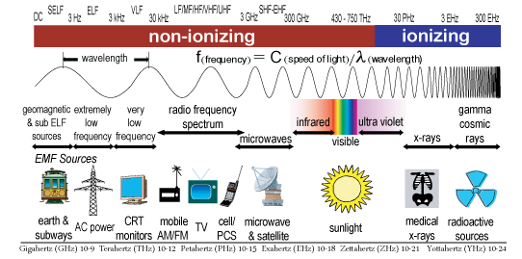
Electromagnetic Spectrum
5
Notes:
This slide shows the electromagnetic spectrum.
At the low energy end of the spectrum are long wavelength, low frequency waves such as radio waves.
At the high energy end of the spectrum are short wavelength, high frequency waves such as x-rays and gamma-rays.
The non-ionizing portion of the spectrum extends from the low energy end of the spectrum to the low energy end of the ultraviolet region, and includes the visible frequencies as well as the frequencies of all electrical and electronic devices.
The ionizing portion of the spectrum begins in the high energy end of the ultraviolet region and extends to cosmic rays.

Slide 6
Gamma-ray Radiation
Gamma-ray radiation oftentimes accompanies alpha and beta radioactive decay processes in atoms
Has no effect on number of protons or neutrons in daughter nucleus produced from particle decay
Gamma-ray emission changes energy state of daughter nucleus from higher to lower energy or to ground energy state
6

Slide 7
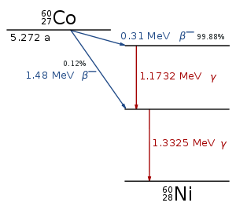
Example Gamma-ray Emission Following Radioactive Decay
7
Notes:
This graphic illustrates the two beta particle decay modes for cobalt-60.
Both decay modes produce nickel-60 with its nucleus in an elevated energy state.
To get to the ground energy state, the nickel-60 nucleus emits one or two gamma-rays.

Slide 8
Quantifying Radioactivity
Source strength of radioactive material, or decay rate, is λN, where
λ is decay constant for particular radioisotope (usually
expressed as disintegrations per second)
N is number of atoms present in radioactive material
Quantity λN known as activity of radioisotope
Activity expressed in units of Becquerel (Bq) or Curie (Ci)
1 Bq = 1 atomic disintegration per second (dis/sec), 1 Ci =
3.7x10¹⁰ dis/sec
8
Notes:
Radioisotope – short for radioactive isotope
Decay constant – probability per unit time that a decay will occur
Disintegrations per second is the same as radioactive decays per second.
Since the number of atoms of a particular radioisotope decreases with time, as atoms decay, the activity of a radioisotope decreases with time.

Slide 9
Quantifying Radioactivity (cont.)
Decay constant of radioactive isotope can be calculated from its half-life (λ = 0.693/t_{1/2})
Radioisotope half-life is experimentally observed quantity
The smaller the half-life, the larger the decay constant
Radioisotope activity (i.e., decay rate) directly
proportional to decay constant (e.g., large λ → large
activity)
Radioisotope activity can be converted to dose rate for calculating radiation exposure
Notes:
Given the same number of atoms (N), radioactive isotopes with short half-lives (or large decay constants) have a higher activity than isotopes with long half-lives (or small decay constants) because more short-lived atoms undergo radioactive decay than long-lived atoms in a given amount of time.
The higher the activity of a radioactive material, the higher the dose-rate.
In a given amount of time, a higher activity source of radioactivity will result in a higher dose than a lower activity source.

Slide 10
Natural Radiation Exposures
Radioactive content of Earth’s crust responsible for
about 65% of natural radiation exposure (mostly
from radon)
Areas in the world where natural background radiation much higher than in U.S. (350 mrem/yr average)
average annual dose in Araxa, Brazil is 2,500 mrem
annual dose in State of Kerala, India as high as 3,500 mrem
annual dose in Guarapari, Brazil as high as 17,500 mrem
annual dose in Ramsar, Iran as high as 26,000 mrem
10
Notes:
Despite claims made by various organizations, radon is not the leading cause of lung cancer in non-smokers.
From Cancer risk due to exposure to high levels of natural radon in the inhabitants of Ramsar, Iran, International Congress Series, Vol. 1276, February 2005, pp. 436-437:
Inhabitants of Ramsar, a city in northern Iran, are exposed to levels of natural radiation 55–200 times higher than the average global dose-rate. To assess the association between the radon concentration and frequency of lung cancer, lung cancer patients in eight districts of Ramsar with different levels of radon were studied over 2 years. It was concluded that the lung cancer rate may show a negative correlation with natural radon concentration.
In other words, exposure to higher natural radon levels may actually reduce the risk of cancer.

Slide 11
How much is a millirem (mrem)?
Assume annual radiation exposure for typical American is 360 mrem
Average dose from watching color TV is 2 mrem each year
Granite from Grand Central Station exposes employees to 120 mrem of radiation each year
People in Denver receive 50 mrem more each year than those in LA because of altitude
Nuclear industry contributes less than 1 mrem/year to an individual’s background radiation
Millirem is small unit of measure

Slide 12
Interaction With Matter
-------------------------------------------------- Relative Relative Radiation Range LET* -------------------------------------------------- Alpha 1 10,000 Beta 100 100 Gamma 10,000 1 --------------------------------------------------
* Linear Energy Transfer – energy deposition per unit of
distance traveled
12
Notes:
When people talk about low Linear Energy Transfer (LET) radiation they are referring to beta and gamma radiation.
Because they lose only small amounts of energy in each collision, the range of beta particles and gamma-rays in matter is relatively large by the time all of their energy has been lost in collisions.
Alpha radiation, on the other hand, loses a lot of its energy in each collision and therefore has a relatively short range in matter (about 2 inches in air).
With respect to alpha particle emitters as external radiation sources, alpha particles have insufficient range to result in whole-body exposures (i.e. produce an external whole-body radiation dose).
Therefore, only beta particle and gamma-ray emitters produce external whole-body radiation doses.
This will become evident in the Geiger counter activity.

Slide 13
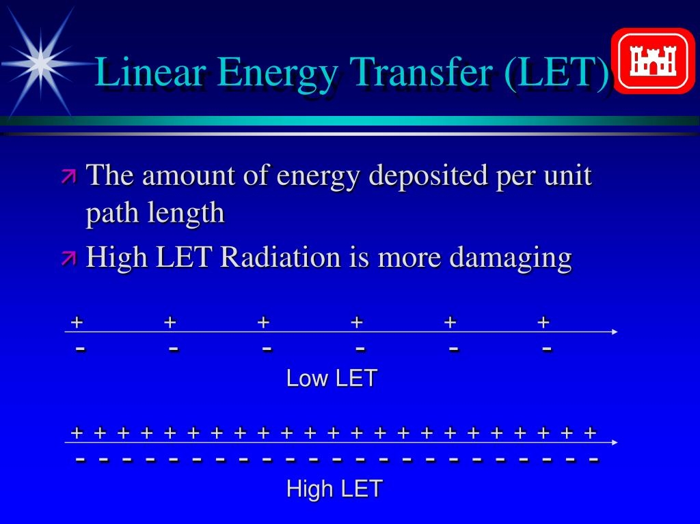
13
Notes:
This graphic illustrates how high LET radiation produces more ionizations (i.e., deposits more energy) than low LET radiation over the same path length.

Slide 14
What Does This Mean?
Radiation | Range in Air
Alpha (4-5 MeV)ª | 1-2 inches
Beta – 0.1 MeV 1.0 MeV^{b} 3.0 MeV | 4 inches 12 feet 43 feet
Notes:
a. Alpha energy associated with Uranium, Thorium, and Plutonium
decay
b. Average maximum energy of beta particles from fission products
is about 1.2 MeV
14
Notes:
Alpha particles, having a high LET, have a very limited range in air, while the range of beta particles in air is dependent on the particular beta particle’s energy.
MeV – million electron volts; 1 MeV = 1.6 x 10⁻¹³ joule

Slide 15
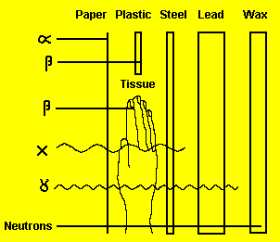
Penetrating Properties of Ionizing Radiation
15
Notes:
This graphic illustrates the relative penetrating power of alpha, beta, x-ray, and gamma-ray radiation.
Alpha particles can be blocked by a sheet of paper.
Most beta particles can be blocked by a sheet of plastic, a thin sheet of any metal, or the dead layer of human skin.
X-rays and gamma-rays can penetrate the human body, but can be blocked by large thicknesses of very dense metals such as lead.

Slide 16
Focus of Radiation Concerns Based on Penetrating Power
Internal radiation hazards
result from inhalation or ingestion of alpha and beta sources
concern about skin and clothing contamination with alpha and beta sources is proximity to pathways for inhalation and ingestion
External radiation hazards – gamma-rays and x-rays
16
Notes:
Sources of alpha and beta particle radiation are not external radiation hazards because these particles cannot penetrate the dead layer of human skin.
In addition, alpha particles have an extremely short range in air.
Gamma-rays and x-rays are potential external health hazards. The actual hazard depends on the source strength. For example, the museum gamma-ray sources are not a health hazard because they contain so little cobalt-60.

Slide 17
Absorbed Dose
Radiation Absorbed Dose (rad)
Energy deposition per unit mass of material
Originally defined as 100 ergs of energy
absorbed by one gram of matter
International Standard – Gray [Gy]
1 Gy = 100 rad = 1 Joule/kilogram
17
Notes:
Historically, radiation exposure for x-ray and gamma-ray radiation was measured in a unit called the roentgen (R), which was defined in terms of the energy deposited in one gram of air.
However, the roentgen was not found to be useful for comparing the effects of x-ray and gamma-ray radiation on other materials.
The radiation absorbed dose (rad) applies to all radiations and materials, and is generally used to measure radiation energy deposited in biological systems.
Since about 1980, the accepted standard used for absorbed dose is the Gray.

Slide 18
Radiation Effects
Depend on absorbed dose and LET
Effect on biological systems quantified using upper limit of radiation’s relative biological effectiveness, called quality factor (QF)
Radiation Quality Factor
X-rays 1
Gamma radiation 1
Beta particles 1
Alpha particles 20
18
Notes:
The effects of radiation on biological systems depend on both the absorbed dose and the radiation LET.
In the past, biological effects of radiation have been quantified by using a quality factor for the particular radiation.
A quality factor of 1 was chosen for low LET radiation and a factor of 20 was chosen for alpha particle radiation to characterize the difference in adverse biological effects from absorbed radiation doses.
More recently, the use of quality factors has come under some criticism for not accurately characterizing actual biological effects.
Tissue weighting factors have been proposed as being more appropriate to use for calculating dose than quality factors so that dose is then dependent on the specific biological tissue receiving the exposure (some tissues are more susceptible to radiation damage than others).

Slide 19
Equivalent Dose
Absorbed dose to individual organs or tissue adjusted to account for biological effectiveness of radiation type
Historical/conventional unit
Dose (rem) = QF x Dose (rad)
Provides common reference and allows for additive doses for different radiation type exposures
Represents POTENTIAL for biological effects
19
Notes:
The dose in rem (roentgen equivalent man) was then derived by multiplying the radiation absorbed dose by the QF for the radiation type.
For low LET radiation the rem is then equivalent to the rad, so 1 Gy is equivalent to 100 rem.
For alpha radiation (with a QF of 20), 1 Gy is equivalent to 2000 rem.
Note that effective dose is a whole-body dose, calculated as the addition of equivalent doses to all organs, each adjusted to account for the sensitivity of the organ to radiation type.

Slide 20
Equivalent Dose (cont.)
International (SI) unit – Sievert [Sv]
Dose (Sv) = QF x Dose (Gy)
For low LET radiation, 1 Sv = 1 Gy
Notes:
The dose in rem (roentgen equivalent man) was then derived by multiplying the radiation absorbed dose by the QF for the radiation type.
For low LET radiation the rem is then equivalent to the rad, so 1 Gy is equivalent to 100 rem.
For alpha radiation (with a QF of 20), 1 Gy is equivalent to 2000 rem.

Slide 21
Radiation Terms and Units
 | Traditional | SI*
Activity | Curie (Ci) 3.7x10¹⁰ dis/sec | Becquerel (Bq) 1 dis/sec
Absorbed Dose | Rad 100 ergs/gm | Gray (Gy) 1 joule/kg
Equivalent Dose | Rem | Sievert (Sv)
* Abbreviation for International System of Units
Notes:
A nice summary table of traditional and International Standard units
Rad and Gray are measures of radiation energy absorption in materials.
Rem and Sievert are measures of radiation-induced damage based on the linear, no-threshold dose-response model that denies the existence of biological repair or removal mechanisms for cell damage.

Slide 22
Dose Types
Acute Dose
Dose delivered over a short period of time (e.g., chest x-ray)
Chronic Dose
Dose delivered over an extended period of time (e.g., natural background radiation)
Dose Rate Effect
Large acute dose generally more damaging than chronic dose of same magnitude because cell damage may overwhelm body’s natural repair mechanisms

Slide 23
Effectiveness of dose is dependent on dose-rate
Dose-rate
Dose
1 bottle of Aspirin
or
250 rem of
Radiation
Dose-Rate
Over 50 seconds
Or over 50 years
Over 50 seconds
Or over 50 years
Death
Minimal health risk
Death
Minimal health risk
Notes:
This slide nicely illustrates the effect of dose rate.

Slide 24
Dose Reduction and Control
Basic principles
Restrict proximity TIME
Dose = Dose Rate x Time
Increase DISTANCE from the source
Point source: “1-over-R-squared” reduction
Use SHIELDING material
Notes:
The Radiation Protection Principles are time, distance, and shielding.
Minimize radiation exposure time.
Maximize the distance from the radiation source.
Use appropriate shielding material (i.e., high density material) to decrease the radiation intensity.

Slide 25
Correcting a Radiation Exposure Misconception
Exposure to ionizing radiation does not
make humans, animals, or food
radioactive
Only way to make an atom radioactive
is to change ratio of neutrons to
protons in atomic nucleus
Ionizing radiation only interacts with
atomic electrons and has no effect
on number of neutrons and protons in
atomic nucleus
25
Notes:
Radioactive decay changes the atomic nucleus.
The emitted radiation merely deposits energy in matter; it does not affect the number of protons or neutrons in interactions with atomic nuclei.
Exposure to any kind of ionizing radiation cannot make anything radioactive, period.

Slide 26
Ionizing Radiation Summary
Types of ionizing radiation – alpha, beta,
gamma-ray, x-ray
Radiation health concerns based on
penetrating power
External hazard – gamma-ray and x-ray
Internal hazard – alpha and beta

Slide 27
Ionizing Radiation Summary (cont.)
Dose factors – biological effect of acute
exposure more serious than chronic
exposure of same magnitude
Radiation protection principles
Time – minimize exposure time
Distance – maximize distance from source
Shielding – insert appropriate shielding material between people and source

